Slide 1
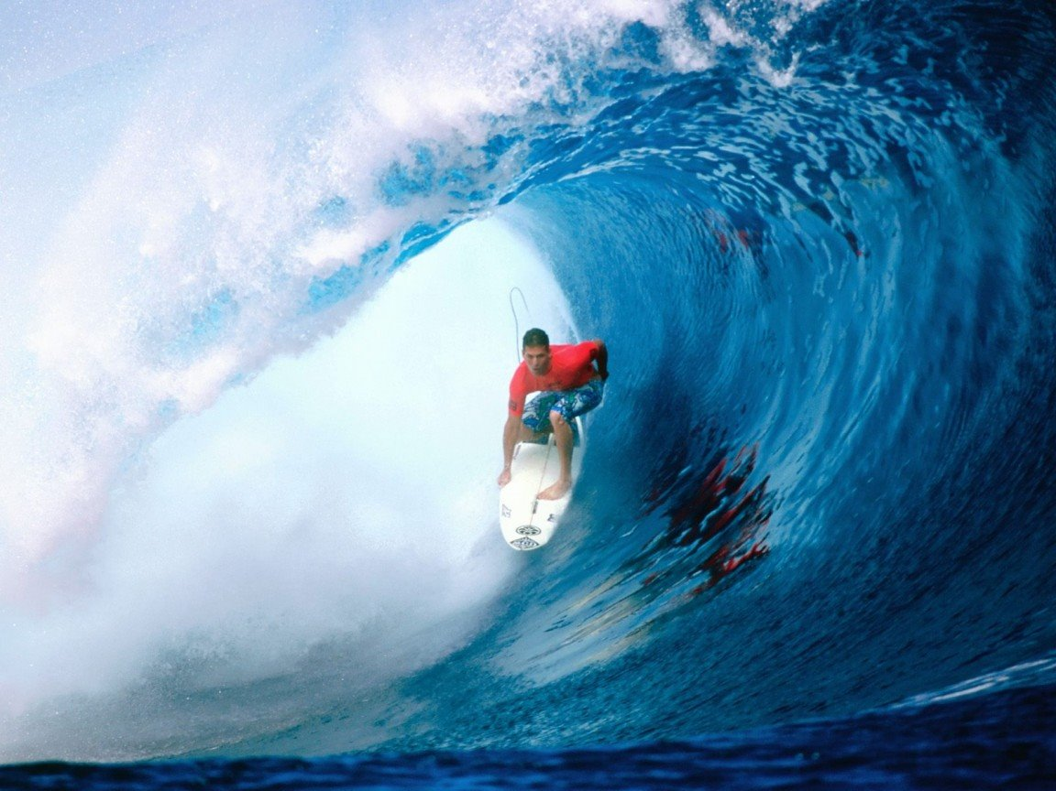
Chapter 25a
Understanding Waves

Slide 2
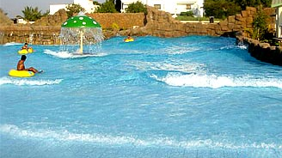
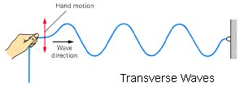

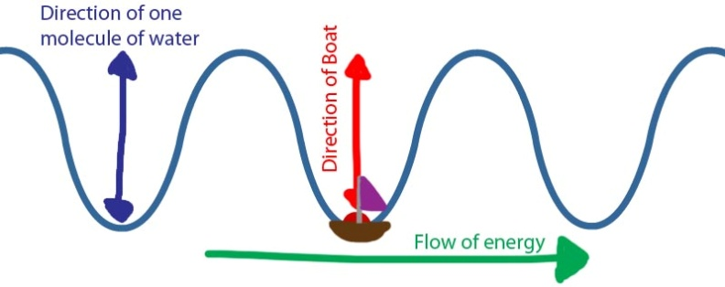
Types of Waves
Wave – A disturbance carrying energy in matter or space
Transverse Waves – Motion of the wave is vertical while energy is horizontal;
ex: Wave Pool
Notice how waves transfer only energy, not the matter.

Slide 3
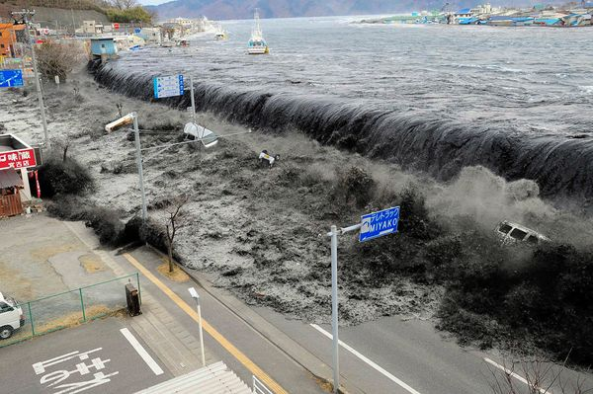

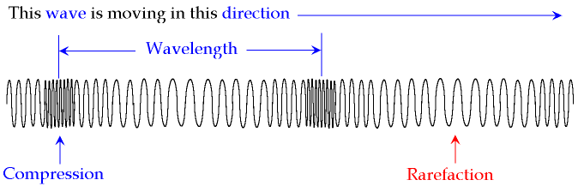

Types of Waves
Longitudinal Waves – The wave’s motion is in the same direction as the energy;
ex: Tsunami waves
The matter and energy move in the same direction but
the matter only vibrates – the energy transfers

Slide 4
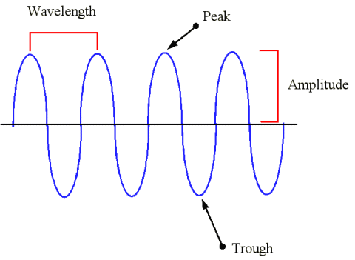
Properties of Waves
Crest – The highest point Trough – The lowest point
Wavelength (λ) – The distance between two similar points on a wave (crest to crest); measured in meters
Amplitude – The height of a
wave from its point of rest
The speed of a wave can
be measured by…
Frequency (f) – The number
of waves per second; Hz
Period (T) = How long it takes
for one wave or cycle; s
Wavelength
Crest
Amplitude
Rest
Trough

Slide 5
Measuring Waves
Velocity = wavelength (frequency) Velocity = wavelength period
In a wave pool, a series of waves are separated by a distance of 10 meters and each wave travels at 2 m/s.
What is the frequency 2 m/s = 10m f f = 0.2 Hz
of the waves?
How many waves are 0.2 waves per second
produced per second?
How long will it take 2 m/s = 10m T = 5 sec
to create one wave? T
You guys are awesome!

Slide 6
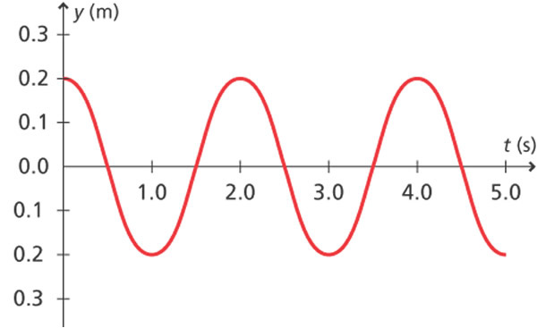
Wave Characteristics
Identify the following values for the wave shown below
with a wavelength of 5 meters:
Amplitude: 0.2 m
Period: 2 seconds
Frequency: 0.5 Hz
Velocity: ?
Which equation
should we use?
v = λ f v = λ We could use either one!
T
velocity = 5 m (0.5 Hz) velocity = 2.5 m/s

Slide 7
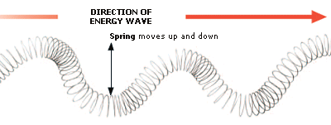
Try On Your Own
A slinky is shook up and down to create a transverse wave which sends waves out with a velocity of 0.4 m/s.
If the slinky produces a wave every 0.5 seconds,
what is the wavelength for the waves of the slinky?
Which equation
should we use?
v = λ f v = λ
T
0.4 m/s = λ (0.5 s) λ = 0.2 m

Slide 8
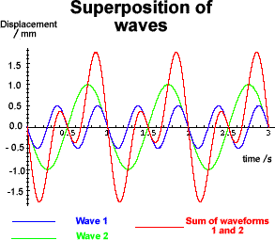
Chapter 25b
Wave Behavior

Slide 9
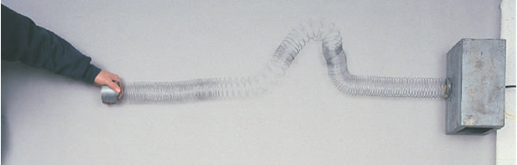
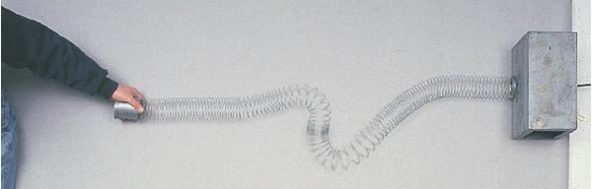
Wave Behavior
What happens when a wave strikes a boundary?
Incident Wave – The wave that strikes a boundary
Reflected Wave – The wave returning from a boundary
Describe the amplitude of a reflected wave.

Slide 10

Wave Behavior
What happens when waves are combined?
Superposition – When waves combine to make a new wave
Destructive Interference – Results when waves with equal but opposite amplitude combine; amplitude decreases
Constructive Interference – When wave displacements are in the same direction; amplitude increases

Slide 11
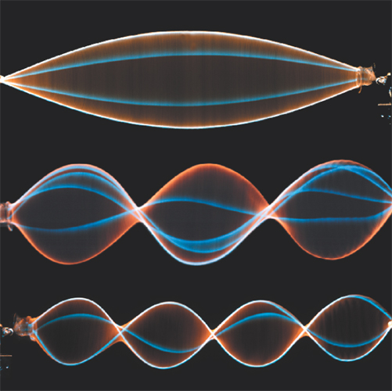
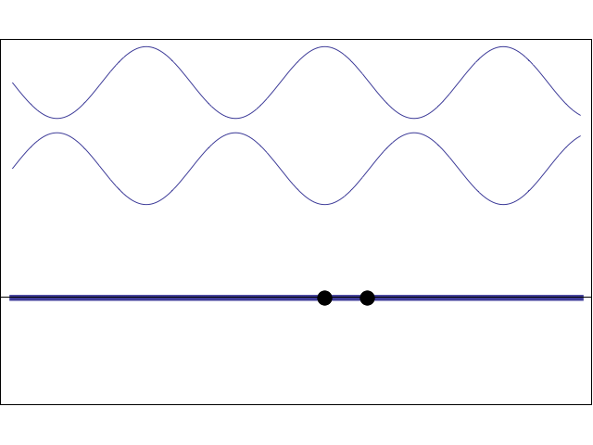
Wave Behavior
How are waves like this created?
Standing Waves – When two
opposing waves create a wave
which appears to be stationary
At which point(s) do you see
destructive interference?
Node – A point in the medium
which doesn’t move
At which point(s) do you see
constructive interference?
Antinode – The point which has
the largest displacement
How many nodes and antinodes are in the last wave?

Slide 12
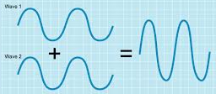
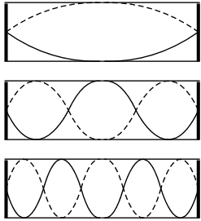
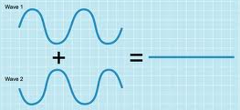
Try On Your Own
How would the amplitude
change for these waves
if they were combined?
How would the amplitude
change for these waves
if they were combined?
Which one is an example of constructive interference?
Which of these waves has four nodes?
Which has five antinodes?

Slide 13
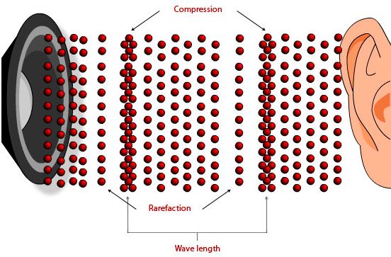
Chapter 25c
Sound Waves

Slide 14
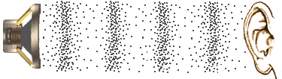
Understanding Sound
What is a sound wave?
Sound – Longitudinal waves transmitted through matter
Sound waves are vibrations in the air.
Notice the particles do not move very far.
The speed of sound in…
Air ~ 340 m/s Water ~ 1,500 m/s Wood ~ 4,000 m/s
The closer the atoms within a substance
the better the sound can travel.

Slide 15
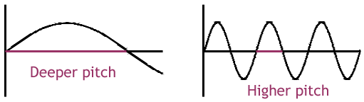
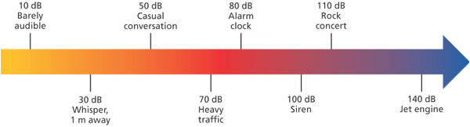
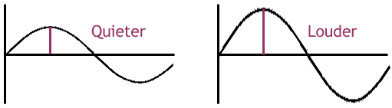
Characteristics of Sound Waves
Sound wave can be described in terms of…
Pitch – Measures the frequency of a sound wave
Which of these waves
has a higher pitch?
Another variable is…
Loudness – Measures the amplitude (energy) of a sound wave
Which of these waves
is the loudest?
At what decibel can
sound waves harm the human ear?

Slide 16
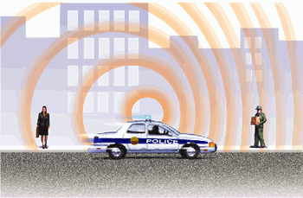
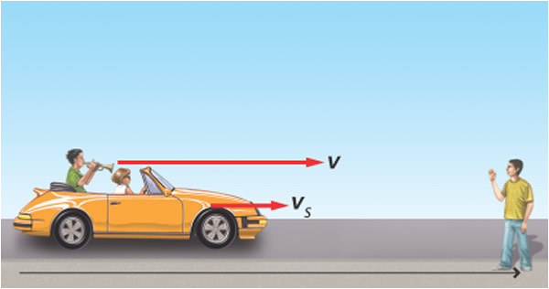
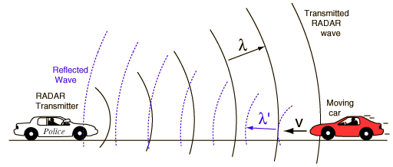
Sounds on the Move
Ever notice how a siren screams as it’s approaching
but then quickly drops as soon as it passes?
Doppler Effect – A change in
pitch due to the compression
of a moving sound wave
The velocity of the sound
increases creating a shorter
wavelength and higher frequency.
This effect is used by bats, radar detectors, and
astronomers to tell the speed and direction of movement.

Slide 17
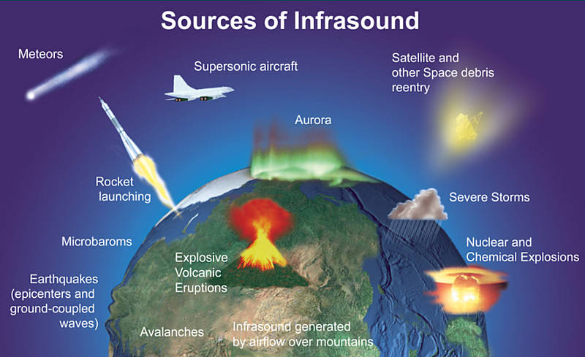

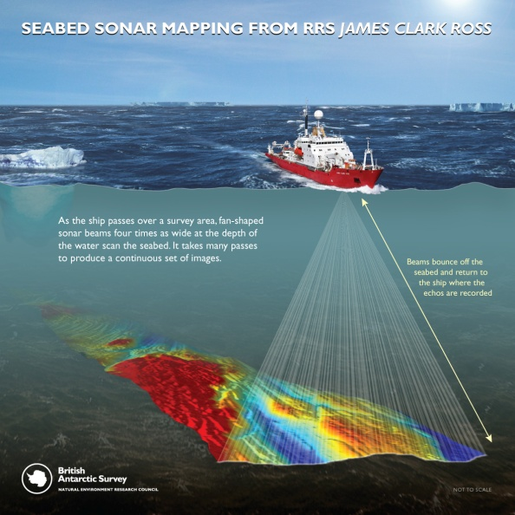
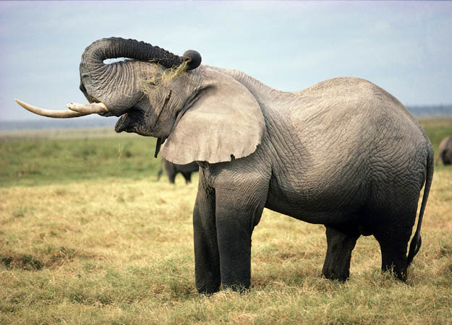
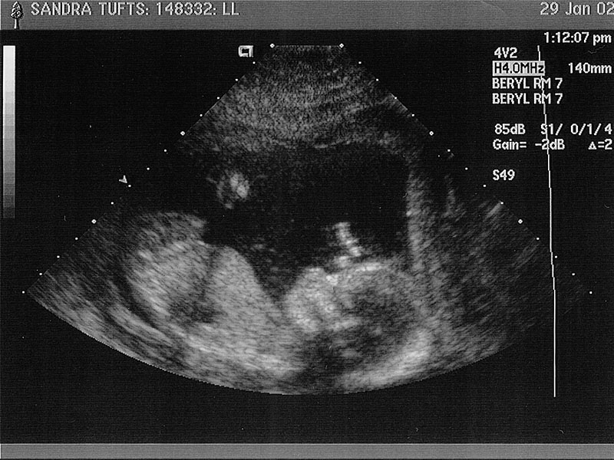
Sound Beyond Limits
Our range of human hearing is from 20 to 20,000 hertz.
Ultrasound – Sound waves above 20,000 Hz
These waves can be used
for a variety of purposes
including imaging and sonar.
Infrasound – Sound waves below 20 Hz
These waves are often caused by natural causes.
Some people exposed to infrasound have complained about a sense of unease, discomfort, and supernatural forces.

Slide 18
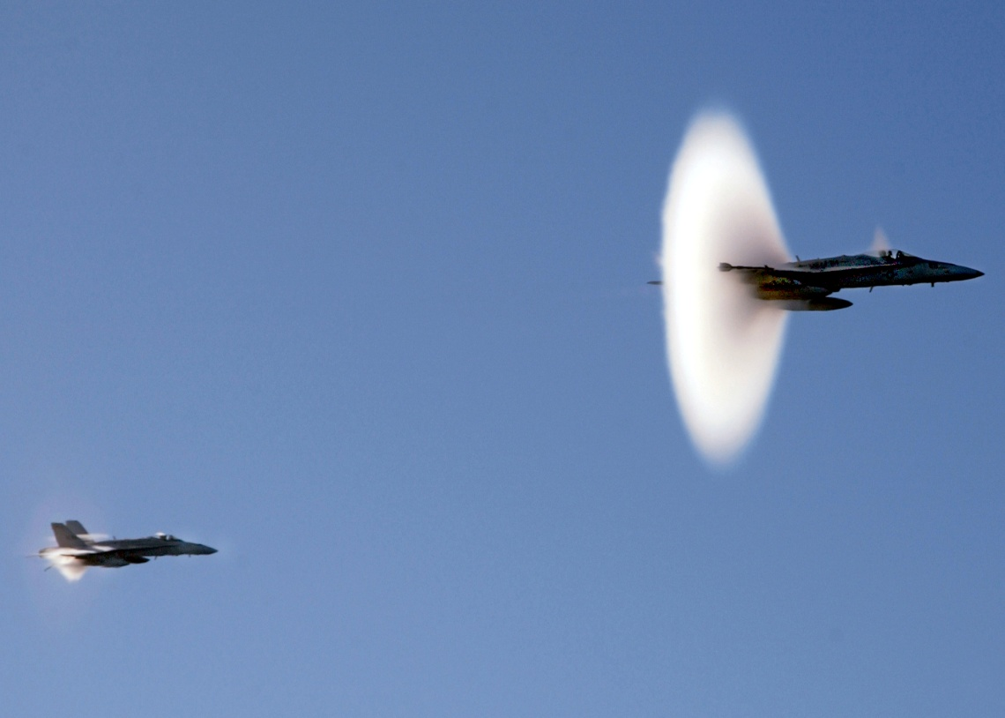

Faster than Sound
Can anything travel faster than the speed of sound?
Supersonic – Travel that exceeds the speed of sound
Mach 1 is ~340 m/s or
~ 750 miles per hour
This creates a
sonic boom
explosion of air!
The whip is the first
man-made device that
can break the sound barrier.

