Slide 1
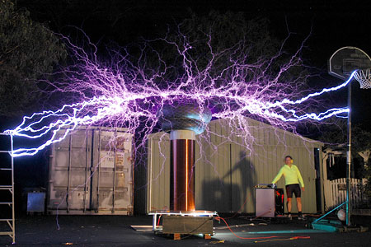
Chapter 32-33a
Static Electricity

Slide 2
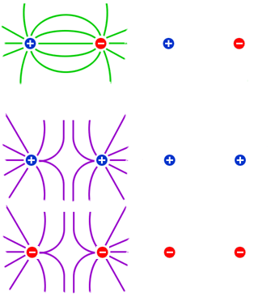
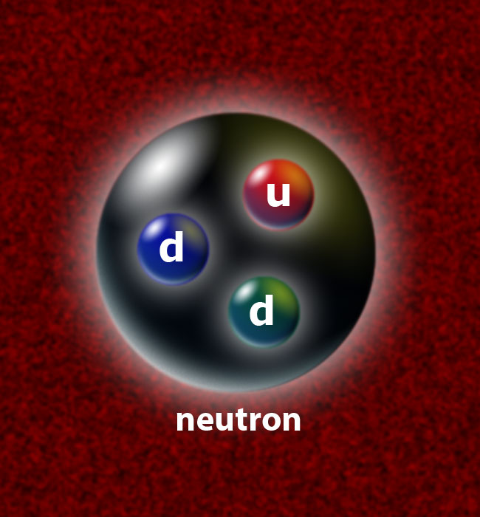
Behavior of Charged Particles
Charged particles are either positively or negatively charged and we know that if two charges are brought close to each other…
Opposites Attract
and
Like Charges Repel
Within the atom
there are…
Protons – Positively charged
particles which identify an element
Electrons – Negatively charged Which subatomic
particles which cause bonding particle is missing?

Slide 3
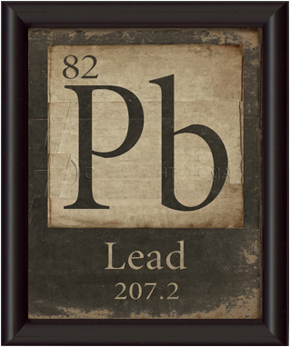
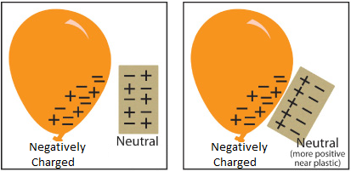

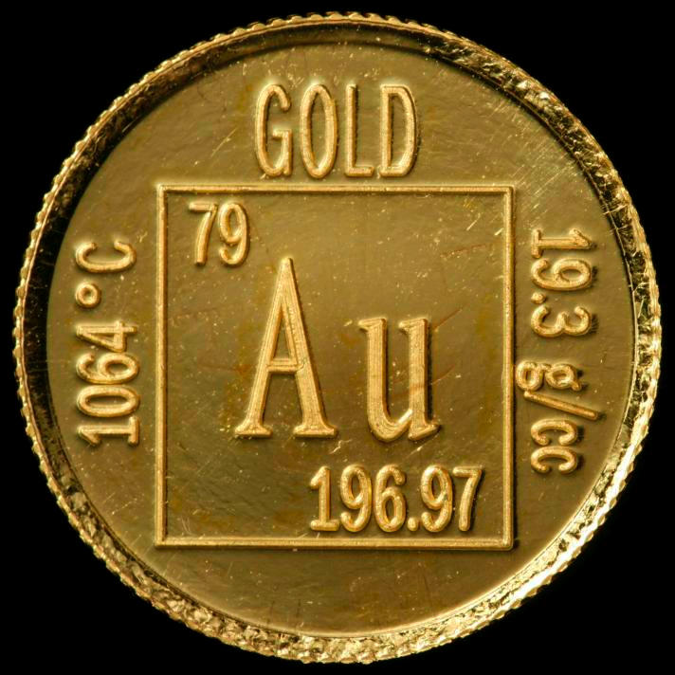
Charging Objects
Have you ever collected a static charge of electricity?
Static Electricity – The build up of electrons within or upon an object
Which objects are
charged in this image?
The balloons are
charged but the
woman is not!
Charged Objects – Have excess or shortage of electrons
How does an object become positively charged?
You can’t easily change the number of protons!

Slide 4

What is Electricity?
Electricity is the flow of electrons.
Some materials block the flow of electricity,
while others allow electricity to flow easily.
Insulators – Prevent electron flow
Ex: wood, rubber, glass, pure water
Conductors – Allow electron flow
Ex: metal, graphite, earth, salt water
Which are the conductors & insulators in a light bulb?
The filament and screw cap are conductors.
The glass housing is an insulator.

Slide 5
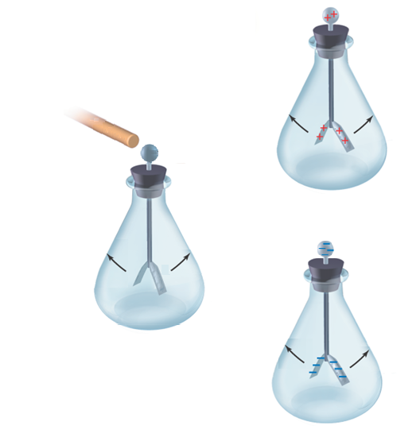
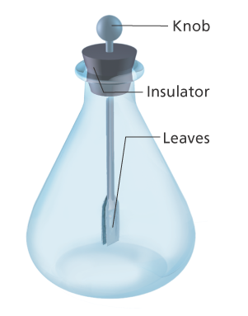
Detecting Charged Particles
Electroscope – Device used to detect charged items
When the leaves are uncharged
they lay flat but…
When a charged object is
introduced, the leaves repel.
This is because
opposite charges attract
and like charges repel.
The only question is… are the
leaves both positive or negative?
With an electroscope it is difficult to tell!

Slide 6
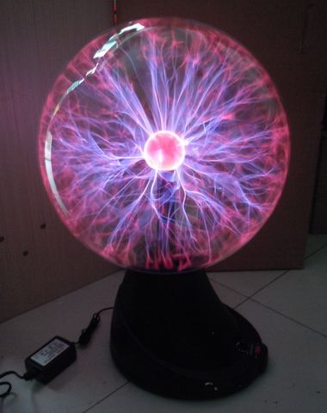
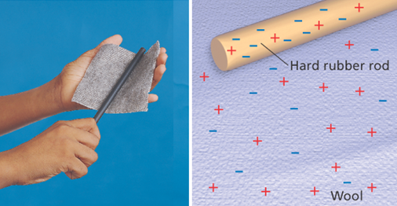
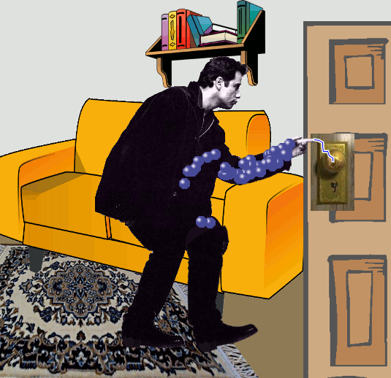
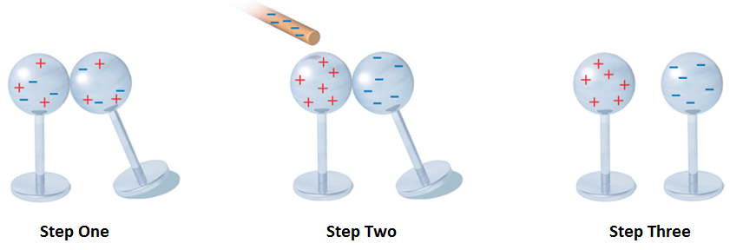
Types of Charging
The transfer of electrons is accomplished by the
Three Methods of Charging:
Friction – Rubbing two objects
together; wool and rubber
Which object is giving electrons?
Which is collecting the electrons?
Conduction – Charging by direct
contact between two objects
Induction – Charging an object
without direct contact
Can you describe each step in charging these globes?

Slide 7
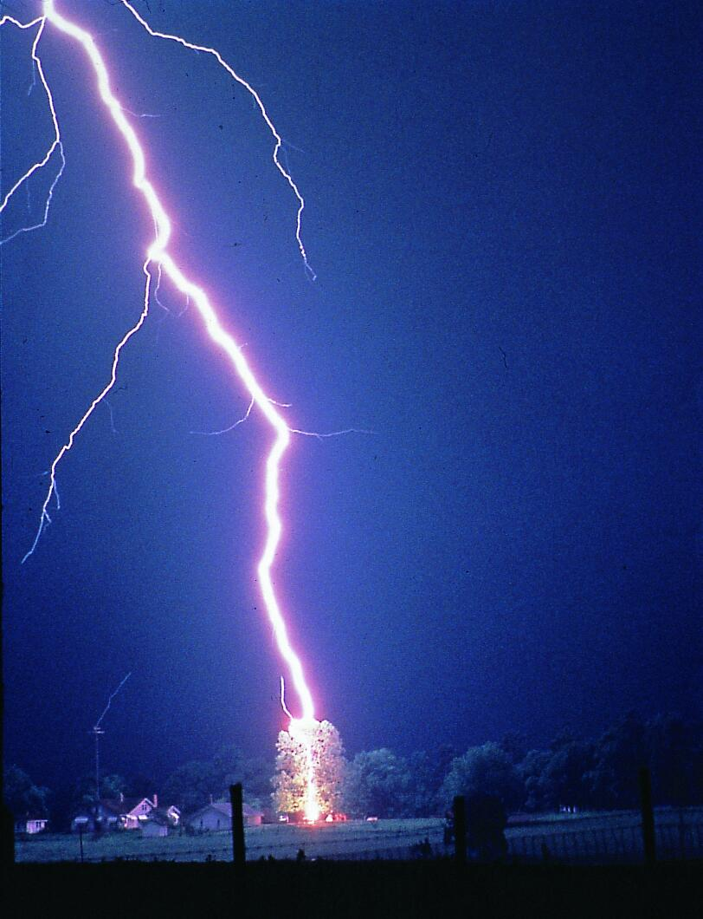
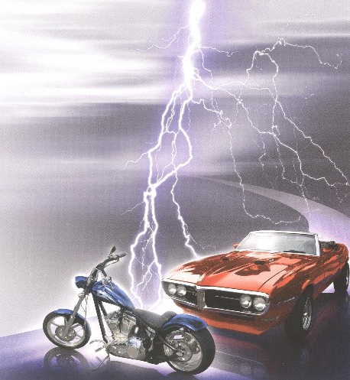

Lightning Crashes
A lightning bolt provides a great example of charging!
First, rain drops pass through the
clouds charging them by… Friction.
When the charge is great enough,
a bolt of lightning jumps to a
conductor such as a tree.
This tree is charged by… Induction.
Lastly, the charge is grounded as
it travels through the tree and
down into the earth.
The earth is charged by… Conduction.
Why do houses need lightning rods but cars do not?

Slide 8
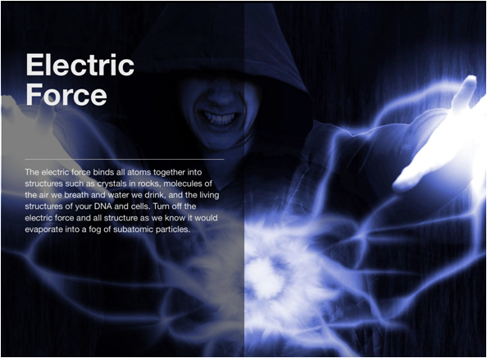
Chapter 32-33b
Electric Fields & Forces

Slide 9
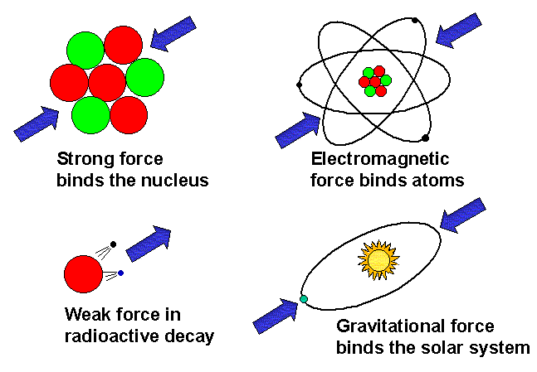
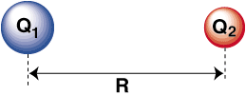

Understanding Electric Forces
There are four different types of forces -
Strong force, Weak force, Gravitational Force and…
Electric Force – The attractive
or repulsive force between two
charged particles (in Newtons)
What is a major difference
between gravitational and
electric forces?
Which two variables influence
the strength of the force is between charged particles?
The strength of the charges (q measured in Coulombs)
and the distance between them (d measured in meters)
affects the electric force.

Slide 10
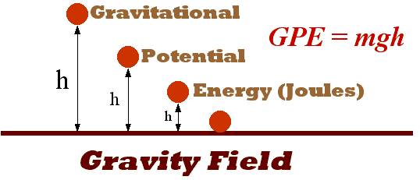
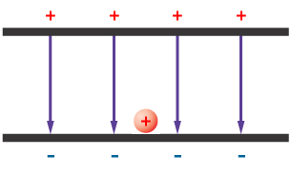
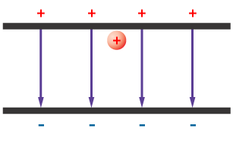
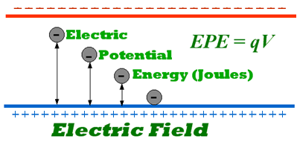
Measuring Electric Forces
What gives an object more
gravitational potential energy?
In which direction does the
object want to move?
What gives a particle more
electric potential energy?
In which direction does the
particle want to move?
Which of these charged particles has the most energy?
Why do these charged particles have
the same amount of force acting upon them?

Slide 11
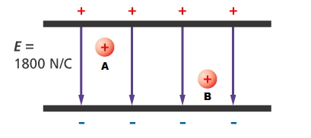
Within an Electric Field
Electric Field (E) – A region between two charged plates in which the sum of attractive
and repulsive forces is equal
Which of these particles
has a greater repulsion force?
Particle A – A little attractive & a large repulsive force
Particle B – A large attractive & a little repulsive force
What’s the strength of this electric field if both charged particles (0.00008 C) experience a total force of 0.144 N?
E = F E = 0.144 N E = 1,800 N/C
q 0.00008 C

Slide 12
Forces, Work & Energy
Voltage = Electric potential difference
V = E d (distance)
What is the voltage of 0.00002 C
charge that is raised 0.0042 m in
an electric field of 1430 N/C?
V = 1430 N/C (0.0042 m) Voltage = 6 V
So how much work can it accomplish when it moves down?
V = W 6 V = ___W___ W = 0.00012 J
q 0.00002 C
How much energy does it need to raise it back up again?
0.00012 J because work is equal to the change in energy!

Slide 13
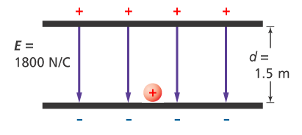
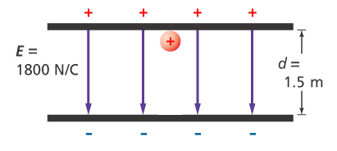
Try On Your Own
What is the voltage for a
test charge of 0.000052 C
if the electric field is
1,800 N/C and the distance
it will travel is 1.5 meters?
V = E d V = 1,800 N/C (1.5m) V = 2,700 Volts
How much work must be done to raise this test charge 1.5 meters above the negatively charged plate?
V = W 2,700 V = ____W____ W = 0.14 J
q 0.000052 C

