Slide 1
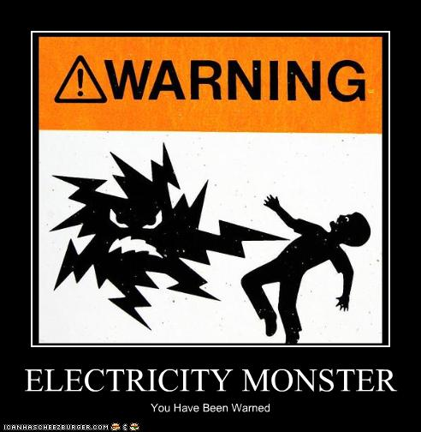
Chapter 34-35a
Current Electricity

Slide 2
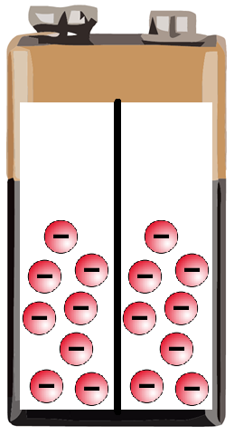
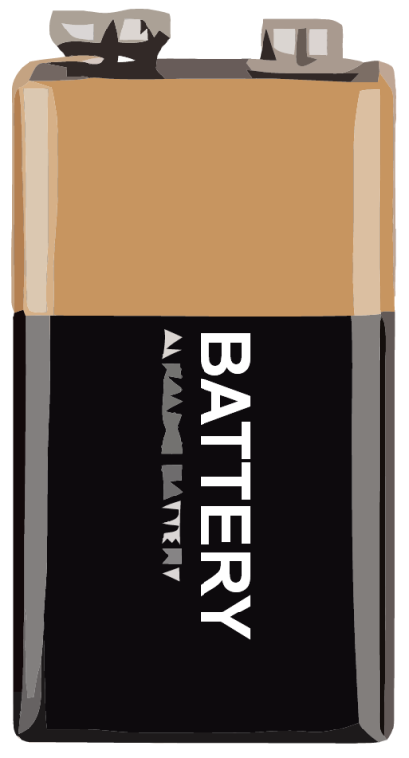
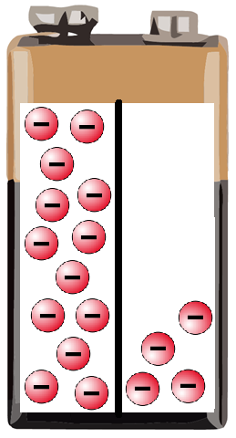


Types of Electricity
Static electricity is… An accumulation of electrons.
Current Electricity – The flow of electrons from a higher potential (concentration) to a lower potential.
From which end does
electricity run in a battery?
It runs from negative to positive.
But how does a battery work?
The difference in electrons offers
the potential to create an electric current.
So when does the battery die?
Batteries die when there isn’t a potential difference.

Slide 3
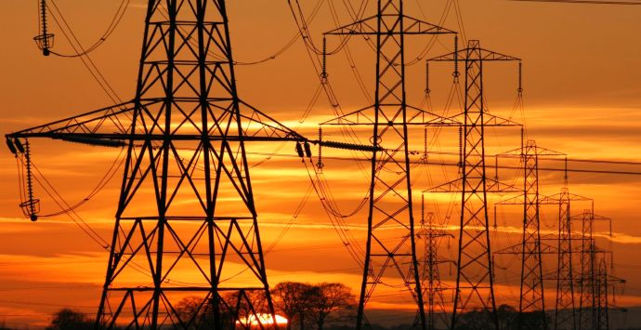
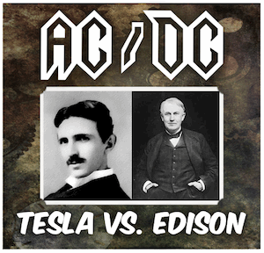
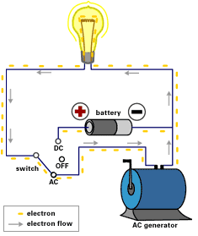

Types of Current
Thomas Edison said the best option for electricity was…
Direct Current (DC) – Electrons flow in one direction;
Batteries use chemicals to create a potential difference
However there was another
scientist who said the best
option for electricity was…
Alternating Current (AC) –
Electrons vibrate back & forth;
Homes in the U.S. use 120 volt AC
Alternating current is more common because it is more powerful and can be transferred over long distances.

Slide 4
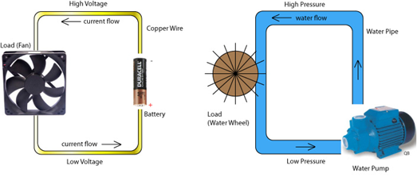
Understanding Electric Current
Scientists often compare the flow
of electrons to the flow of water.
Voltage – The potential difference which pushes electrons
(water pressure)
Current – The amount
of electrons transferred
(amount of water)
Resistance – Converts
electrical energy to
heat, light or motion (work)
There’s a higher resistance when the wire is thinner,
longer, hotter, or just a poor conductor.

Slide 5
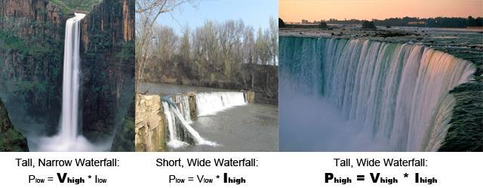
Comparing Electrical Flow
Describe the Voltage, Current, and Power for these
waterfalls using the water-electricity analogy.
High Voltage, High Current, Voltage, Current & Power
Low Current/Power Low Voltage/Power are all High
What could be used to cause resistance in these images?

Slide 6
Calculating Electric Current
Ohm’s Law - Voltage = Current x Resistance
V = I R
(volts) (amperes) (ohms or Ω)
The terminals of a 120 V battery are connected with a copper wire which has a resistance of 3 Ω.
How much electricity flows through the wire?
120 volts = I (3 Ω) I = 40 amps
That’s enough amps to kill a person!
If an electric buzzer was attached to this circuit creating a resistance of 24 Ω, what would be the current?
120 volts = I (24 Ω) I = 5 amps

Slide 7
Electrical Power and Energy
A student leaves his headlights on as he runs into
school late. The lights draw 3 amps from the car’s
12 V battery. How much power is used?
Electrical Power (Watts) = Current x Voltage
P = 3 amps ∙ 12 volts
P = 36 watts
How much energy is used if
he leaves the lights on for 7 hours?
Electrical Energy (Joules) = Power x time (s)
E = 36 watts ∙ 25,200 seconds
E = 907,200 Joules

Slide 8


Try On Your Own
A 1,200 W hair dryer is being used which
draws 10 amps from the wall outlet.
Calculate the resistance of the hair dryer.
V = I R P = I V E = P t
1200 W = 10 amps V
V = 120 volts
120 V = 10 amps R
R = 12 Ω
The 1200 watt hair dryer has a resistance of 12 ohms.

Slide 9
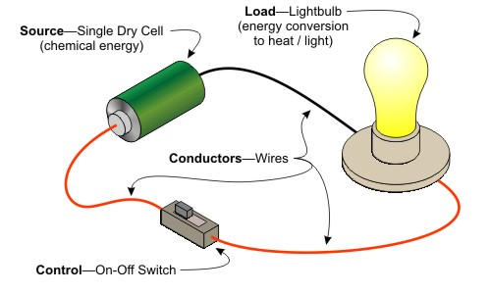
Chapter 34-35b
Simple Circuits

Slide 10
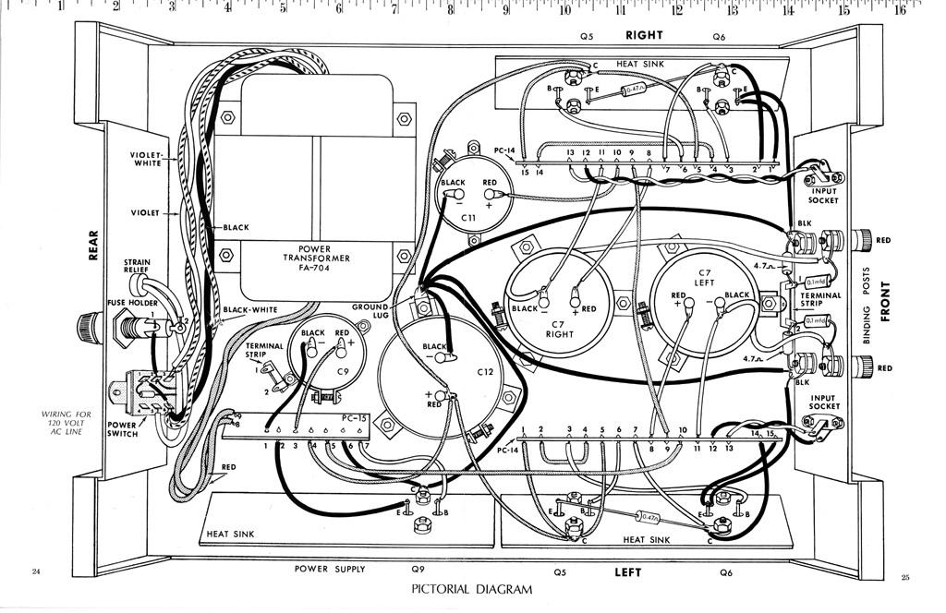
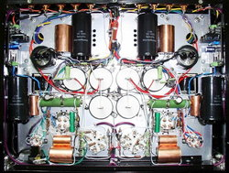
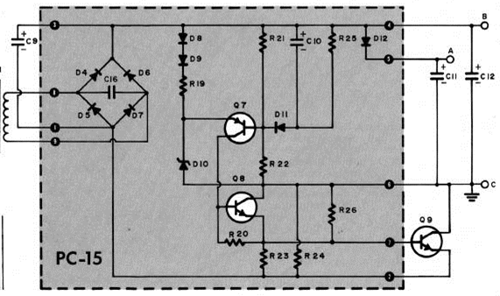
How Electrons Flow
Circuit – A path which electricity can flow along
Schematic – A design for an electrical system
While both terms are used interchangeably,
it is easy to see the value of a schematic.
Which of these is easier to read?

Slide 11
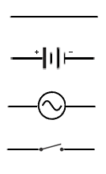
Circuit Symbols
The elements of a circuit are given universal symbols
so they can be understood in any language.
Conductor (wire)
DC Battery
AC Power Source
Switch
(open/broken stops e⁻)

Slide 12
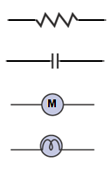
Circuit Symbols
There can be several purposes for creating a circuit.
Resistor
(creates heat)
Capacitor
(stores energy)
Electric Motor
(creates motion)
Light Bulb
(creates light)
Which of these are found in a PS4?

Slide 13
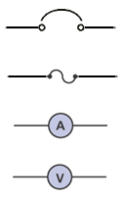
Circuit Symbols
Some devices are there for safety.
Circuit Breaker
(switches off if overheated)
Fuse
(breaks if overheated)
Ammeter
(measures current)
Voltmeter
(measures voltage)
Which is more deadly – high voltage or high current?

Slide 14
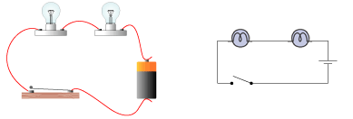
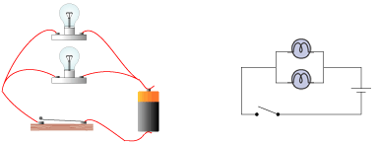
Circuit Design
There are two primary types of circuits…
Series Circuit – Electricity flows in one direction
Lights are dimmer and
if one bulb goes out,
they all go out!
Parallel Circuit – Electricity branches off
Lights are brighter
and one bulb doesn’t
affect the others.
What is the advantage of a series circuit?

Slide 15
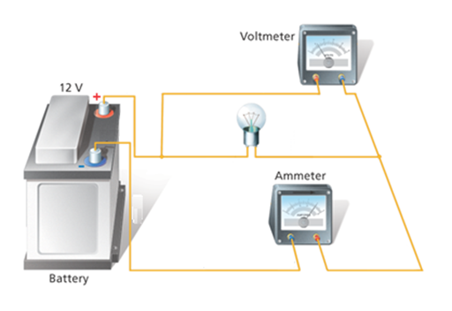
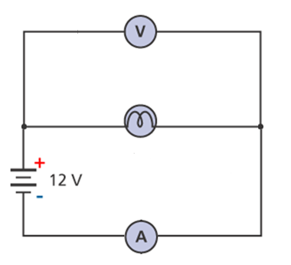
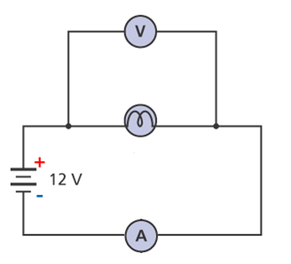
Creating Circuits
How would this image below
be represented in a schematic?
Just like this!
or like this!

Slide 16
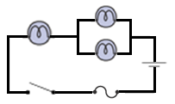
Try On Your Own
Draw a schematic using a battery, a fuse, a switch,
and a single light bulb which is in series with
two other light bulbs that are in parallel.
Which light bulb could burn out
and shut down the entire circuit?
Which light bulb could burn out
without affecting the others?
Is this a schematic most likely
for use in a home or automobile?
Remember that electricity has to have a clear
path from one terminal to the next in order
for the electrons to flow.

Slide 17
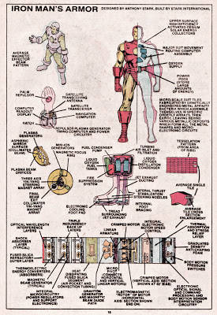
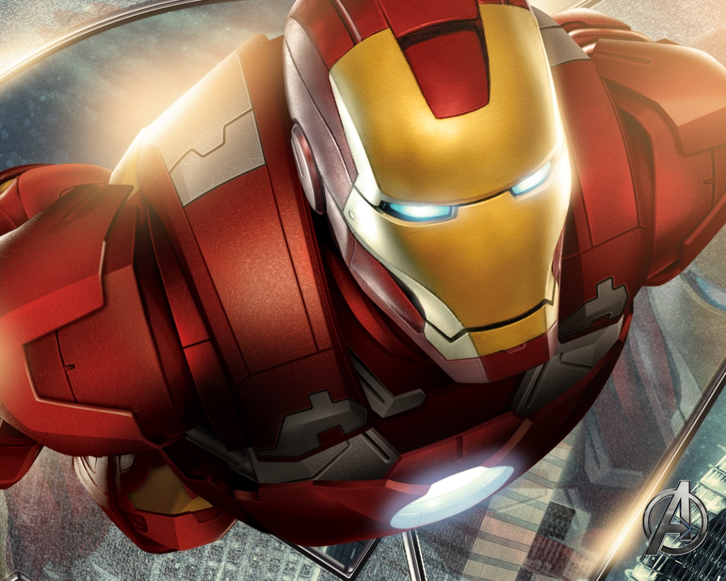
Chapter 34-35c
Calculating Circuits

Slide 18
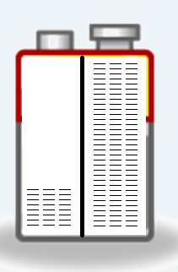
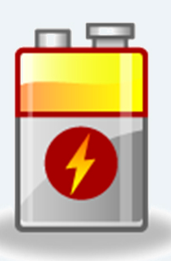
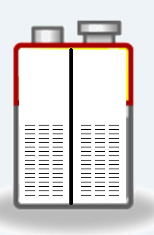
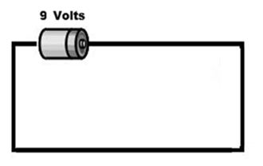
Understanding Electricity
What is potential difference?
Let’s take a look inside a 9V battery.
The negative terminal has a surplus
of electrons which flow to other side.
Until… There isn’t a potential difference
What happens if you just connect a battery’s terminals?
It gets really hot! But why?
Without resistance or a limiting path
the electrons would be pushed very
quickly from one end to the other.
Resistance limits the current as it does work.

Slide 19
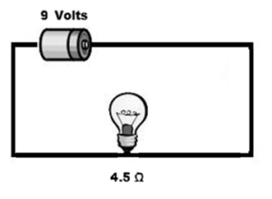
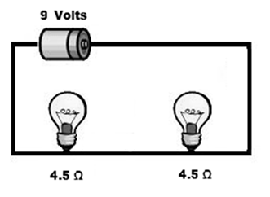
Calculating Circuits
Using Ohm’s Law we can find the voltage,
current and resistance for a simple circuit…
V = I R 9V = I (4.5 Ω)
I = 2 amps
But what if it’s a series circuit?
Equivalent Resistance (series)
R = R₁ + R₂ + R₃…
9V = I (4.5 Ω + 4.5 Ω)
I = 1 amp

Slide 20
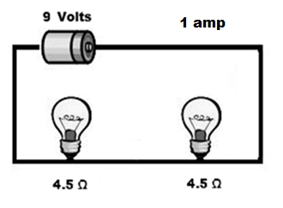
Understanding Resistance
Remember how the lights in a series
circuit are significantly dimmer?
Voltage Drop – The “push” decreases
as it goes through resistors in series
Current and resistance are constant.
What is the voltage drop across
one of these lights?
V = I R V = 1 amp (4.5) Voltage Drop = 4.5 volts
What is the voltage drop across both light bulbs?
It’s 9 V because the total voltage
through the circuit remains constant.

Slide 21
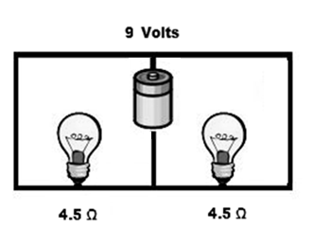
Calculating Circuits
But what if it’s a parallel circuit?
Equivalent Resistance (parallel)
1 = 1 + 1 + 1…
R R₁ R₂ R₃
9 V = I ∙ 1/ _1_ + _1_
4.5 4.5
9 V = I (2.25) I = 4 amps
Remember that the lights in parallel are brighter?
That means that the voltage and resistance are constant but the current splits in a parallel circuit.
What’s the current through one bulb? 2 amps

Slide 22
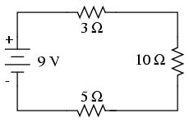
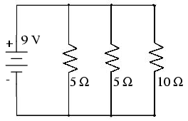
Try On Your Own
How much current is running through this circuit?
V = I R 9V = I (5Ω + 10Ω + 3Ω)
I = 0.5 amps
How much does the voltage drop
over the first two resistors?
V = 0.5 amps (15 Ω) V = 7.5 volts
How much current runs through this circuit?
9 V = I ∙ 1/ _1_ + _1_ + _1_
5 5 10
9 V = I (2 Ω) I = 4.5 amps
Where is the least amount of current?

Slide 23
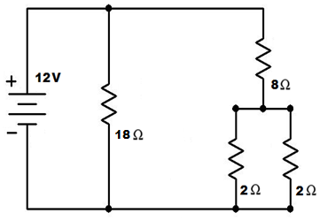
Try On Your Own
How much current is running through this circuit?
R₁ = 18 Ω
R₂ = 1/ 1 + 1 + 8 Ω
2 2
R_{total} = 1/ _1_ + _1_
18 9
12 V = I (6 Ω) I = 2 amps
Where in this circuit is the current the greatest?
Where in this circuit does the voltage drop?

