Slide 1

Chapters 2-3a
Visualizing Motion

Slide 2
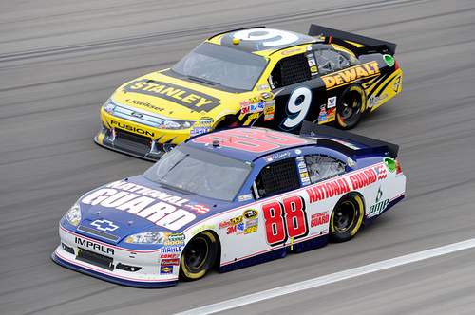
How Do We Measure Motion?
How fast is the #88 car traveling?
185 mi/hr
5 mi/hr
About 1,000 mi/hr
Over 7,000 mi/hr
The correct answer is…
Well, if we measure the
distance the car travels along the track and divide by the time (or just look at the speedometer) we can be sure the speed of the vehicle is 185 mi/hr.
But…

Slide 3
How Do We Measure Motion?
Motion cannot be measured without understanding
Frame of Reference –
A stationary point
from which motion can
be described
The most common
frame of reference
is the Earth.
So compared to the Earth the #88 car travels 185 mi/hr.
But what about compared to the driver of the #9 car?
How about choice b. 5 mi/hr

Slide 4

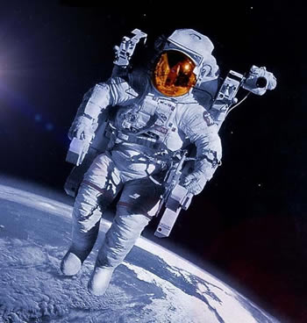
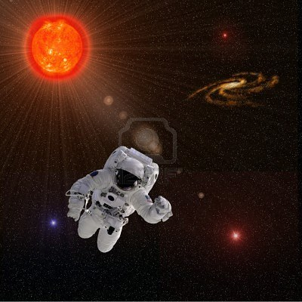
How Do We Measure Motion?
But what about the speed of the #88 car compared to…
A man watching the race
from a stationary point
in orbit around the Earth
The Earth rotates at
about 1,000 mi/hr so
the answer could be c.
And it could also be
d. Over 7,000 mi/hr if
a person was watching the race from… the Sun!
So how fast are you moving right now?
And in which direction?!? (Think about the teacup ride)

Slide 5
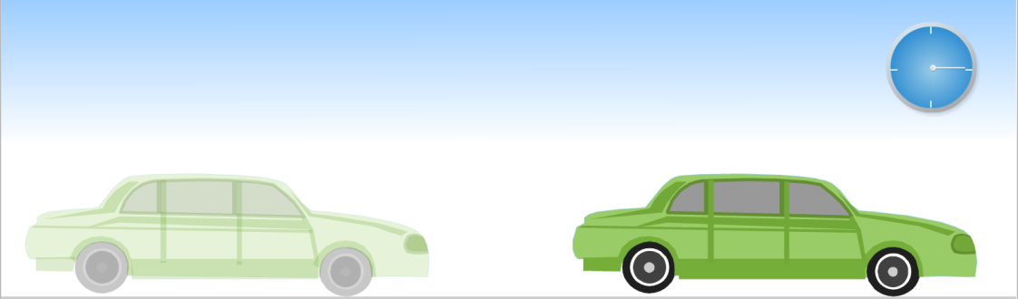
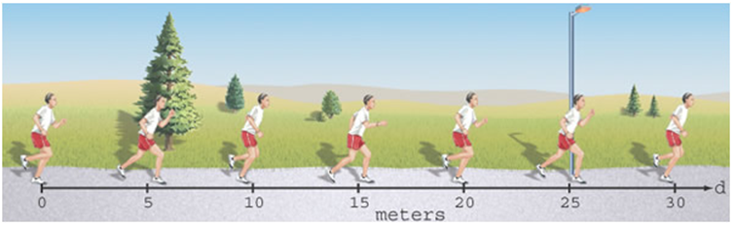
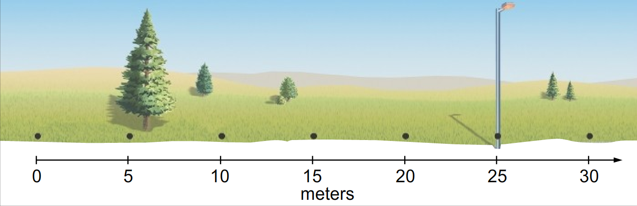
Using a Motion Diagram
Look at the following image and identify two
variables we need to consider when describing motion.
Can this motion diagram
tell us how far the car
traveled in the past
fifteen seconds?
To visualize the motion
of an object, it’s often
better to use a…
Particle model which focuses on one point of the object and uses a dot to represent every second it moved.
How fast was this man running? 5 m/s to the right.

Slide 6
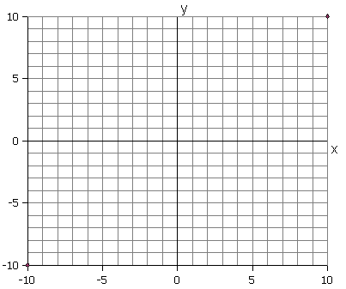
Graphing a Particle Model
The motion of a particle model can be mapped using a…
Coordinate System – Used to measure a vector (magnitude
and direction) from the origin.
In this class, we state that
east, right, north or up are
positive values on the y-axis
& time is on the x-axis.
So what is the change in
position for this object?
+5m
The only problem is… In which direction?
But what about this?
Position (m)
East
Right
North
Up
Time (s)

Slide 7
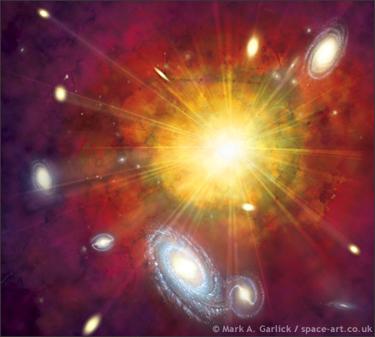
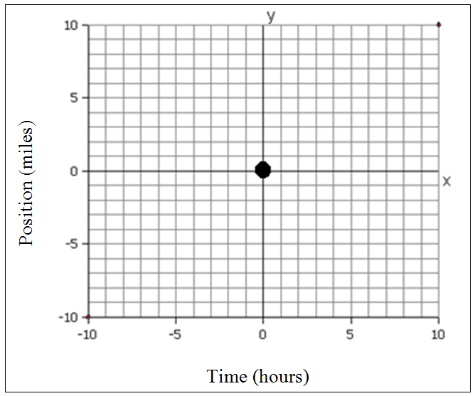
The Position & Time for the Origin
How do we determine the origin?
The origin could be your house at noon.
Your friend is meeting you at your house
at noon. How far away does your
friend live from your house?
How long does it take for your
friend to get to your house?
At what time did you leave?
How far did you walk?
How long did it take?

Slide 8
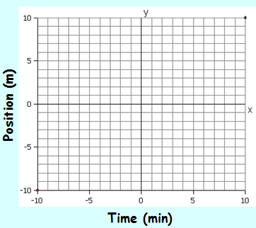
Interpreting Graphs
What is the cat doing in this graph of his actions?
He’s lying in a window sill
He’s running to the right
to get it’s dinner at 6pm
He’s eating a yummy
tuna and chicken dinner
He’s walking back toward
the window sill
What he doing now?
Teleporting
What is he doing now? Traveling back in time

Slide 9
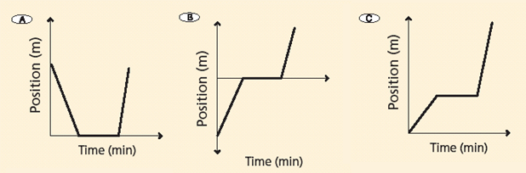
Try On Your Own
Match the descriptions below with the correct graph
A slow person running a relay race
hand off the baton to a faster person. C
An airplane landing & then taking off. A
A race car quickly gets to the track B
and then quickly begins the race.

Slide 10
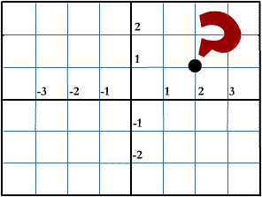
Chapters 2-3b
Graphing Displacement

Slide 11
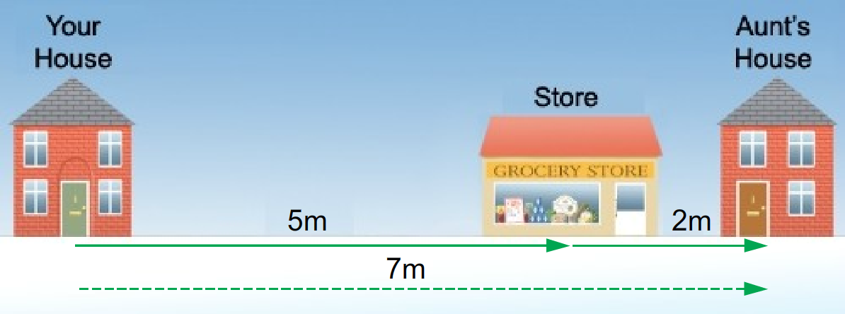
Adding & Subtracting Vectors
Imagine traveling from your house to the store
to pick up some milk for your aunt.
You’ve traveled a distance of 5m.
Then you move
another 2m to
your aunt’s house.
That’s a total
distance of 7m.
In this case you have traveled a distance of 7m
Your displacement, the distance from
your initial and final positions, is also 7m.

Slide 12
Graphing Motion
How could we represent this trip in a graph?
It takes 30s to
get to the store.
Then another 60s
to buy the milk.
Then 10s to
get to your
aunt’s house.
How can we calculate
the average speed Avg Speed = Total Distance
for this trip? Total Time
20
16
12
8
4
Distance (m)
30 60 90 120 150
Time (s)

Slide 13
Adding & Subtracting Vectors
But what if things didn’t work out quite so well?
You travel a distance of 5m to the store
but then realize that you forgot your wallet.
So you go back to
get it and then
return to the store.
Then you move
another 2m to
your aunt’s house.
That’s a total distance of 17m.
But your displacement is still only 7m.

Slide 14
Graphing Motion
How could we represent this trip in a graph?
It takes 30s to
get to the store.
But then you run
back to the house
to get your wallet.
Then back to the
store to buy the milk.
And then go over
to your aunt’s house.
This graph does not illustrate your 7m displacement!
20
16
12
8
4
Distance (m)
30 60 90 120 150
Time (s)

Slide 15
Graphing Displacement
Instead of distance, we should be measuring position!
It takes 30s to
get to the store.
But then you run
back to the house
to get your wallet.
Then back to the
store to buy the milk.
And then go over
to your aunt’s house.
This graph explains the story much better ☺
20
16
12
8
4
Position (m)
Distance (m)
30 60 90 120 150
Time (s)

Slide 16
Try On Your Own
Use Speed = ∆ Distance to calculate each different speed.
∆ Time
12 m = 0.6 m/s
20 s
4 m = 0.1 m/s
40 s
–16 m = -0.4 m/s
40 s
What does the negative sign indicate?
The object changed direction
20
16
12
8
4
B
Position (m)
A
C
20 40 60 80 100
Time (s)

Slide 17
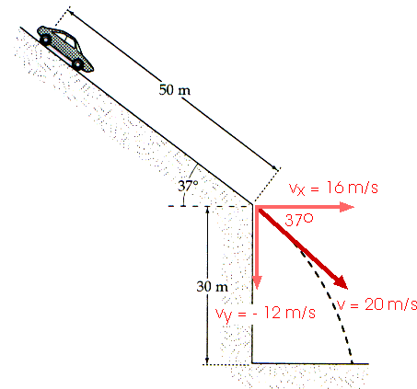
Chapters 2-3c
Understanding Velocity

Slide 18
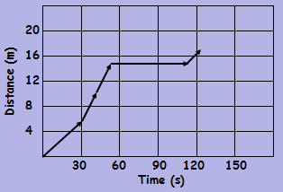
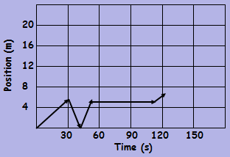
Measuring Velocity
Just as distance couldn’t tell the whole story in a trip to your Aunt’s house, speed also has limitations. So we use…
Velocity – Measures the speed and direction of movement
Which of these takes into account
the direction the person is moving?
Measuring Speed = 17m = 0.14 m/s
125s
Measuring Velocity = 7m = 0.06 m/s
125s

Slide 19
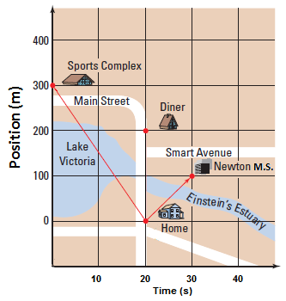
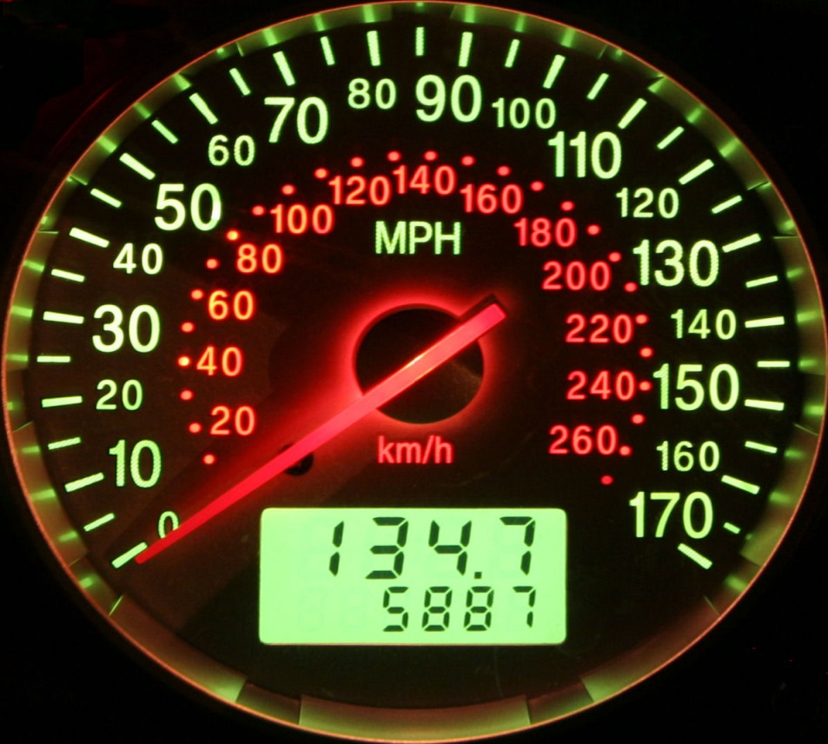
Comparing Graphs
Can we use a position graph to create a velocity graph?
You must understand the difference between
Your Location and Your Speed
Velocity (m/s)
Position (m)
Time (s)
Time (s)
Time (min)

Slide 20
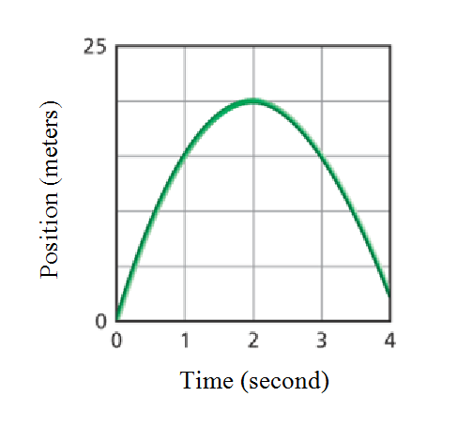
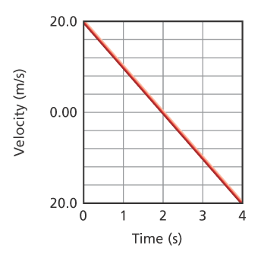
Positive and Negative Values
Which of these choices could this position graph be describing?
a) A car going east makes a U-turn
b) A ball thrown up in the air
c) A boomerang thrown north
All of these could be represented
by this graph!
Which of the choices above could
be described by this velocity graph?
Again, all of these are correct.
The positive velocity (speed) slows
to zero and then increases in the
opposite direction.

Slide 21
Measuring Velocity
To measure average velocity we use the equation…
v = d_{f} – d_{i} Position _{final} – Position _{initial}
∆t change in time
A cyclist travels 500m within a time period of 20s. What’s his average velocity?
v = d_{f} – d_{i} 500m - 0m v = 25 m/s
∆t 20s
Was he moving faster at the start or end of the race?
Instantaneous Velocity – Velocity at a moment in time.
If he was traveling downhill in this problem, would his average velocity be closer to the start, middle, or end?

Slide 22
Try On Your Own
Lets try solving for some of these variables…
A cyclist maintains a constant velocity of 5 m/s during a race. How long will it take him to finish the 250 m race?
v = d_{f} – d_{i} 5 m/s = 250m – 0m ∆t = 50 s
∆t ∆t
Another cyclist gets a 10 meter head start in the race and finishes in 49 seconds. What’s her average velocity?
v = d_{f} – d_{i} v = 250m - 10m v = 4.9 m/s
∆t 49 s
Which cyclist won the race? The woman
Who was going faster? The man

