Slide 1

Chapter 4a
Visualizing
Acceleration

Slide 2
What is Acceleration?
Acceleration – Measures a change in velocity (speed/direction)
A vehicle comes to a stop, slowing from 35 m/s to 0 m/s within 7s as the light turns red. What’s its acceleration?
a = v_{f} – v_{i} = 0m/s – 35m/s a = -5m/s or -5m/s²
Δt 7s s
So what is the object’s velocity after…
30m/s 25m/s 20m/s 15m/s 10m/s 5m/s 0m/s
1s 2s 3s 4s 5s 6s 7s
The light turns green and the car accelerates at 5 m/s² to a velocity of 63 m/s? How long would this take?
a = v_{f} – v_{i} 5m/s² = 63m/s – 0m/s Δt = 12.6s
Δt Δt

Slide 3
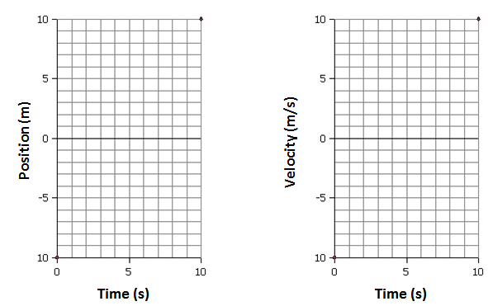
Understanding Velocity Graphs
There are two key examples of
Position-Time & Velocity-Time graphs.
What’s the velocity? What’s the velocity?
What would a position-time and a velocity-time graph
look like for an accelerating object?

Slide 4
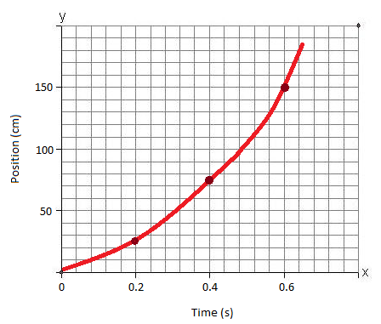
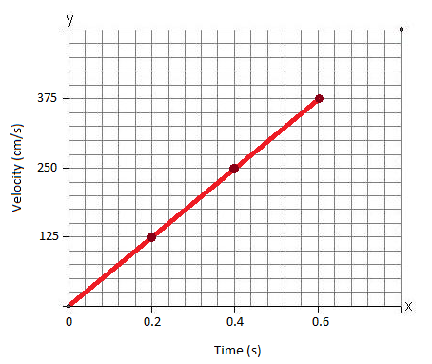
Acceleration on Position Graphs
How fast is the object moving at each interval?
1st Time Period
v = 25-0 cm = 125 cm/s
0.2 s
2nd Time Period
v = 75-25 cm = 250 cm/s
0.2 s
3rd Time Period
v = 150-75 cm = 375 cm/s
0.2 s
This object is moving with a constant… acceleration.
It’s 125 cm/s faster every second – 125 cm/s/s or cm/s²

Slide 5
Using Velocity Graphs
Which cart has the fastest acceleration?
a = v_{f} – v_{i}
Δt
Green
a = 20-0m/s
150s
a = 0.13 m/s²
Black
a = 0-20m/s
120s
a = -0.17 m/s² How about the Red cart’s acceleration?
20
16
12
8
4
Velocity (m/s)
30 60 90 120 150
Time (s)

Slide 6
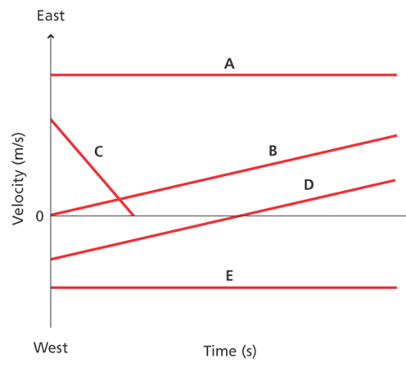
Using Velocity Graphs
We need to understand positive and negative values
for velocity and acceleration. Which shows…
A positive constant velocity?
A is going East
A negative constant velocity?
E is going West
A positive acceleration?
B
A negative acceleration?
C
Slows down, stops and
then changes direction? D

Slide 7
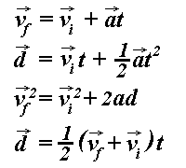
Chapter 4b
Deriving Acceleration

Slide 8
Finding the Average
How do we find the average of two test scores?
Add them up and divide by two!
A rat accelerates from 3 m/s to 5 m/s in 5 seconds? How far did it travel?
Can we use these equations? v = d_{f}-d_{i} or a = v_{f}-v_{i}
t t
At a constant acceleration, we use the average velocity.
To find the average velocity add them and divide by two.
d = (v_{f} + v_{i}) t = (5 m/s + 3 m/s) 5 s
2 2
d = 20 m

Slide 9
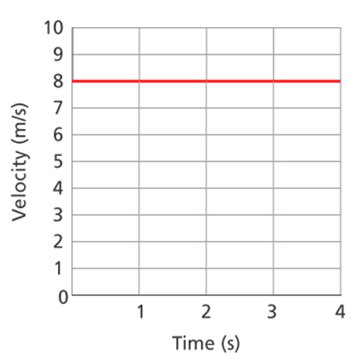
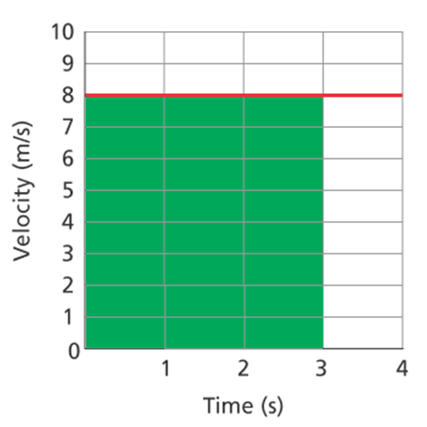
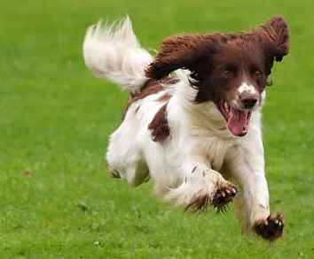
Calculating Displacement
Okay, so how about this…
A dog runs with a velocity
of 8 m/s for 3 seconds.
What is his displacement?
v = d_{f} – d_{i} 8 m/s = _d_
Δt 3s
d = 24 m
Can we solve this
using a graph?
Area = Base x Height
The area under a velocity graph
represents the displacement.

Slide 10
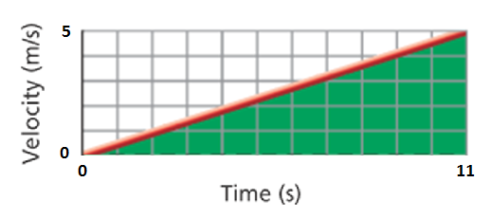
Calculating Displacement
So how can we calculate the displacement for an object that is accelerating?
A dog begins a race
and reaches a velocity
of 5 m/s in 11 s.
How far did she travel?
Which equation will help us measure
the area under this velocity line?
Area = ½ Height x Base
d = ½ (v_{f} + v_{i}) Δt
d = ½ (5 m/s + 0 m/s) 11s d = 27.5 m

Slide 11
Try On Your Own
A go cart accelerates from rest and travels 160 m in 40 seconds. What is the final velocity?
Which equation should we use?
v = d_{f} – d_{i} a = v_{f} – v_{i} d = ½ (v_{f} + v_{i}) t
Δt Δt
d = ½ (v_{f} + v_{i}) Δt 160 m = ½ (v_{f} + 0 m/s) 40 s
160m= 20s v_{f} v_{f} = 8 m/s
What was the go-cart’s acceleration?
a = v_{f} – v_{i} a = (8 m/s - 0 m/s) a = 0.2 m/s²
Δt 40 s

Slide 12

Chapter 4c
Acceleration
Due To Gravity

Slide 13

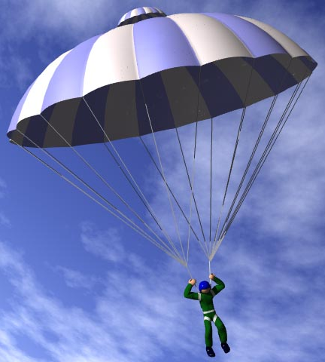
Airborne!
Imagine a man falling out of an airplane…
Without a parachute, will he fall
faster and faster forever?
How could this man increase his air resistance enough to save his life?
Objects in free fall experience an acceleration due to gravity of -9.8 m/s² .
if we ignore air resistance.
Why is the acceleration negative?
How fast will a falling apple be going after 2 sec?

Slide 14
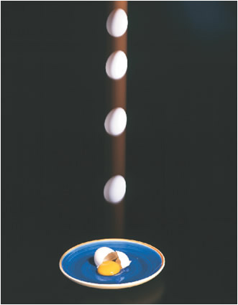
Calculating Acceleration
Is this egg being thrown upward or falling downward?
The acceleration due to gravity
is the same either way… -9.8 m/s²
An egg is thrown upward with an
initial velocity of 4.4 m/s.
How long did it take to reach
its highest point?
a = v_{f} – v_{i} d = ½ (v_{f} + v_{i}) t
Δt
What do we know? v_{i} v_{f} a d
-9.8 m/s = 0 - 4.4 m/s t = 0.45 seconds
Δt

Slide 15
Calculating Acceleration
Let’s try this a different way…
An egg is dropped and falls for
0.45 seconds. How fast was it
going when it hit the ground?
a = v_{f} – v_{i} d = ½ (v_{f} + v_{i}) t
Δt
-9.8 m/s = v_{f} - 0 v = -4.4 m/s
0.45 s
How far did the egg fall?
d = ½ (-4.4 + 0 m/s) 0.45 s
d = -0.99 meters

Slide 16
Try On Your Own
A slingshot launches a pellet straight up with a speed of 6.2 m/s. How long will it take to reach its peak?
v = d_{f} – d_{i} a = v_{f} – v_{i} d = ½ (v_{f} + v_{i}) t a_{g} = -9.8 m/s²
Δt Δt
-9.8 m/s² = 0 - 6.2 m/s t = 0.63 s
Δt
How far upward did it travel?
d = ½ (0 + 6.2 m/s) 0.63 s d = 1.95 m

