Slide 1
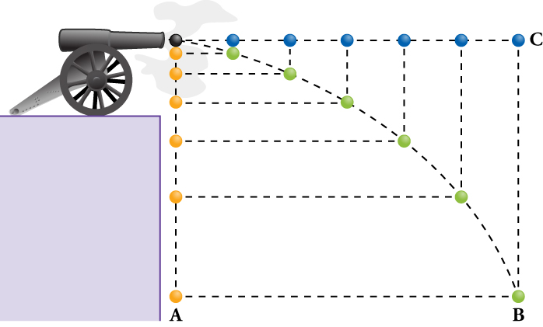
Projectile
Motion

Slide 2
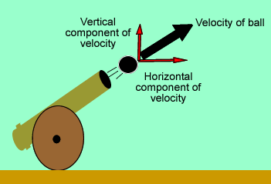
Projectile Motion Concepts
A projectile is any object that moves through the air or space, acted on only by gravity (and air resistance, if any). A cannonball shot from a cannon, a stone thrown into the air, a ball rolling off the edge of a table, a spacecraft circling Earth—all of these are examples of projectiles.
The horizontal (x) and vertical (y) components of motion are independent of each other – meaning that they do not affect each other’s motion.
All objects accelerate towards the Earth, near the surface, at the same rate equal to -9.8 m/s² (acceleration due to gravity).
Gravity ONLY affects the vertical (y) direction.
The horizontal velocity of an object in projectile motion is constant – there in no force in the horizontal direction, so there is no acceleration in the horizontal direction – hence constant velocity.

Slide 3

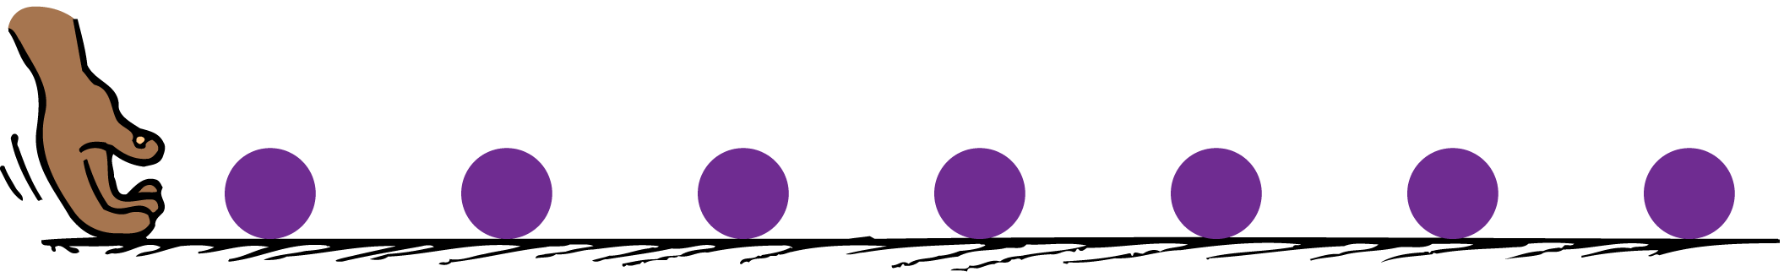
Projectile Motion
Projectile motion can be separated into components.
Roll a ball along a horizontal surface, and its velocity is constant because no component of gravitational force acts horizontally.
Drop it, and it accelerates downward and covers a greater vertical distance each second.

Slide 4
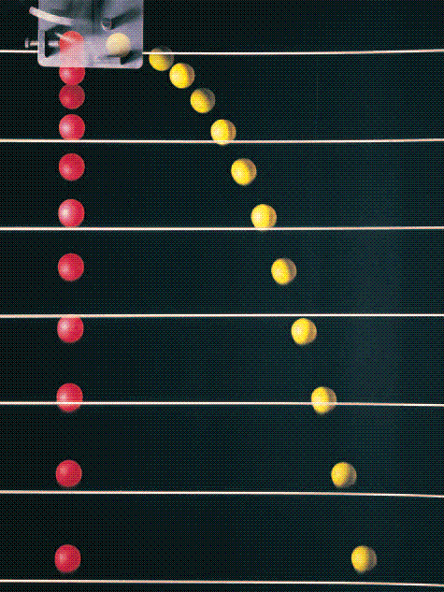
Projectile Motion
There are two important things to notice in the photo of two balls falling simultaneously:
  The ball’s horizontal component of motion remains constant. Gravity acts only downward, so the only acceleration of the ball is downward.
  Both balls fall the same vertical distance in the same time. The vertical distance fallen has nothing to do with the horizontal component of motion.
The ball moves the same horizontal distance in the equal time intervals because no horizontal component of force is acting on it.
The path traced by a projectile accelerating in the vertical direction while moving at constant horizontal velocity is a parabola.
When air resistance is small enough to neglect, the curved paths are parabolic.
A strobe-light photo of two balls released simultaneously–one ball drops freely while the other one is projected horizontally.

Slide 5

The Vertical and Horizontal components are independent of each other.

Slide 6
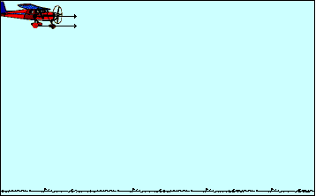
The Horizontal Component of the motion of a projectile has constant velocity

Slide 7
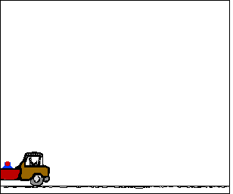
The horizontal velocity is constant because the acceleration in the horizontal direction is zero

Slide 8
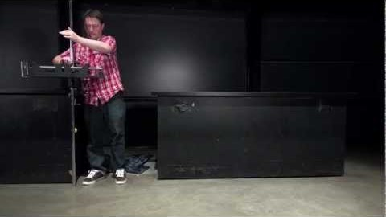
Projectile Motion Video: One object dropped at the same time another object is launched horizontally

Slide 9
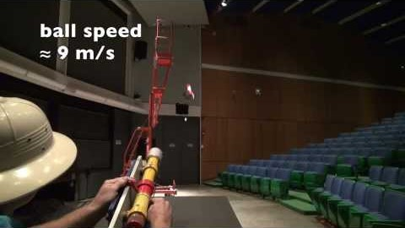
Projectile Motion Video: Horizontal Velocity is constant and does not get affected by gravity

Slide 10
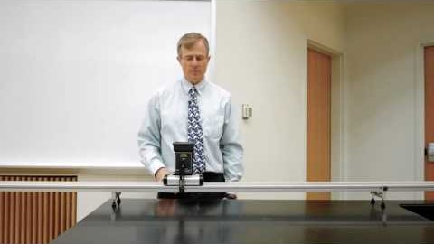
Projectile Motion Video: Gravity only changes the vertical component

