Slide 1
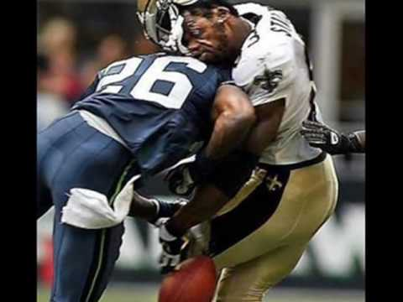
Chapter 8
Momentum & Collisions

Slide 2

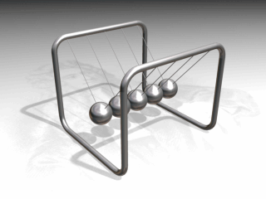
Understanding Momentum
Momentum (ρ) = mass x velocity
A person with a mass of 60 kg
is traveling at 30 m/s on a highway.
Calculate his momentum.
ρ = 60 kg x 30 m/s
The momentum of this person is
1,800 kg▪m/s
The Law of Conservation of Momentum – Within a closed system, total momentum for a collision does not change!
A 0.5 kg metal sphere on a Newton’s cradle hits into the others with a velocity of 1.2 m/s. What will be the initial speed of the sphere on the opposite side? 1.2 m/s

Slide 3
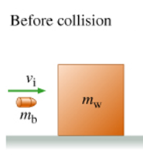
Understanding Momentum
The conservation of momentum in the Newton’s cradle
applies to all objects in collisions.
A bullet with a mass of 0.005 kg
is fired at a 2 kg block of wood.
If the bullets is traveling at
600 m/s just before it hits the
block, what’s its momentum?
Momentum (ρ) = mass x velocity
ρ = 0.005 kg (600 m/s)
ρ = 3 kg▪m/s
What is the momentum of the 2 kg block
before it is hit by the bullet?

Slide 4
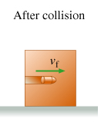
Understanding Conservation
Remember, the total momentum before the collision
is the same as the momentum after the collision.
Initial Momentum of…
0.005 kg Bullet = 3 kg▪m/s
2 kg Block = 0 kg▪m/s
ρ_{i} = 3 kg▪m/s
How fast will the bullet & block travel just after collision?
Momentum (ρ) = mass x velocity ρ_{f} = 3 kg▪m/s
3 kg▪m/s = 2.005 kg (v) v = 1.5 m/s
The speed of the bullet changes from 600 m/s
to 1.5 m/s after it hits the block of wood.

Slide 5
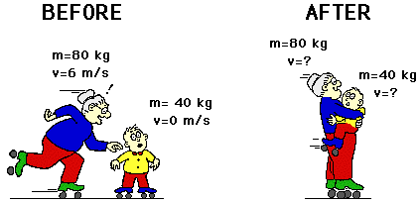
Understanding Collisions
Just like the momentum for the bullet and the block,
the total momentum remains constant for all collisions.
Grandma is traveling at 6 m/s
and scoops up little Howard.
Her mass is 80 kg and his
is 40 kg. What’s their velocity
after she picks him up?
Momentum (ρ) = mass x velocity
ρ_{i} = 80 kg (6 m/s) + 40 kg (0 m/s) = 480 kg▪m/s
ρ_{f} = 480 kg▪m/s 480 kg▪m/s = 120 kg (v)
Final velocity = 4 m/s

Slide 6
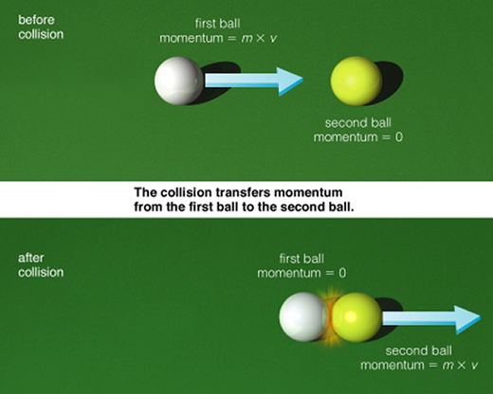
Try On Your Own
A 0.17 kg cue ball is going at 0.2 m/s when it strikes a 0.15 kg yellow ball. If the cue ball comes to a complete stop, what’s the yellow ball’s velocity?
ρ_{i} 0.17 kg (0.2 m/s) + 0 _{(yellow)} = 0.034 kg▪m/s
ρ_{f} 0 _{(cue)} + 0.15 kg (v) = 0.034 kg▪m/s
v = 0.034 kg▪m/s
0.15 kg
v = 0.23 m/s
How does this example
differ from the
grandma & child or
bullet & block examples?

Slide 7
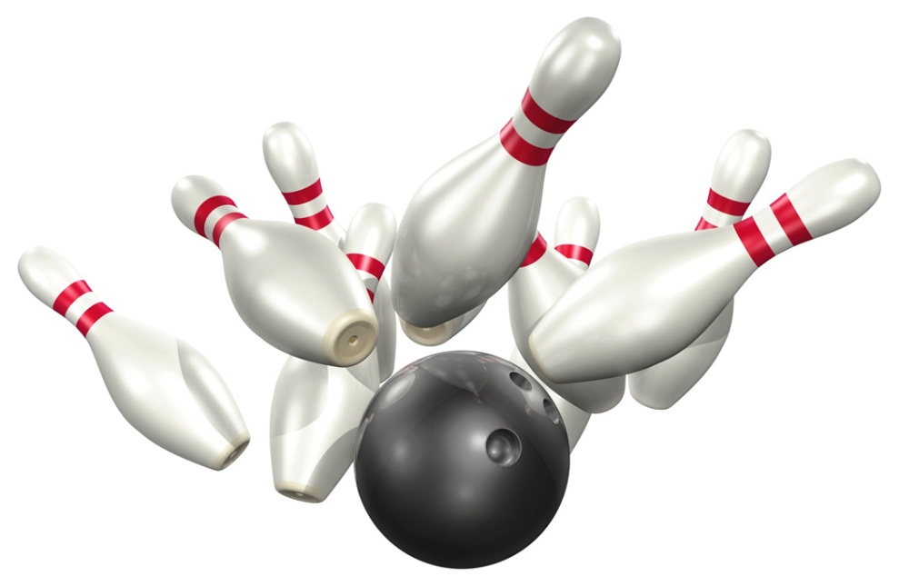
Try On Your Own
A 6 kg bowling ball is rolling
down an alley toward a single
bowling pin. It hits the 1.5 kg
pin with a velocity of 2 m/s.
If the bowling ball continues
into the gutter with a velocity
of 1 m/s, how fast does
the pin move?
ρ_{i} = 6 kg x 2 m/s + 1.5 kg x 0 m/s ρ_{i} = 12 kg▪m/s
12 kg▪m/s = 6 kg x 1 m/s + 1.5 kg x (v)
6 kg▪m/s = 1.5 kg x (v) v = 1.33 m/s
The bowling pin flies away at 1.33 m/s.

Slide 8
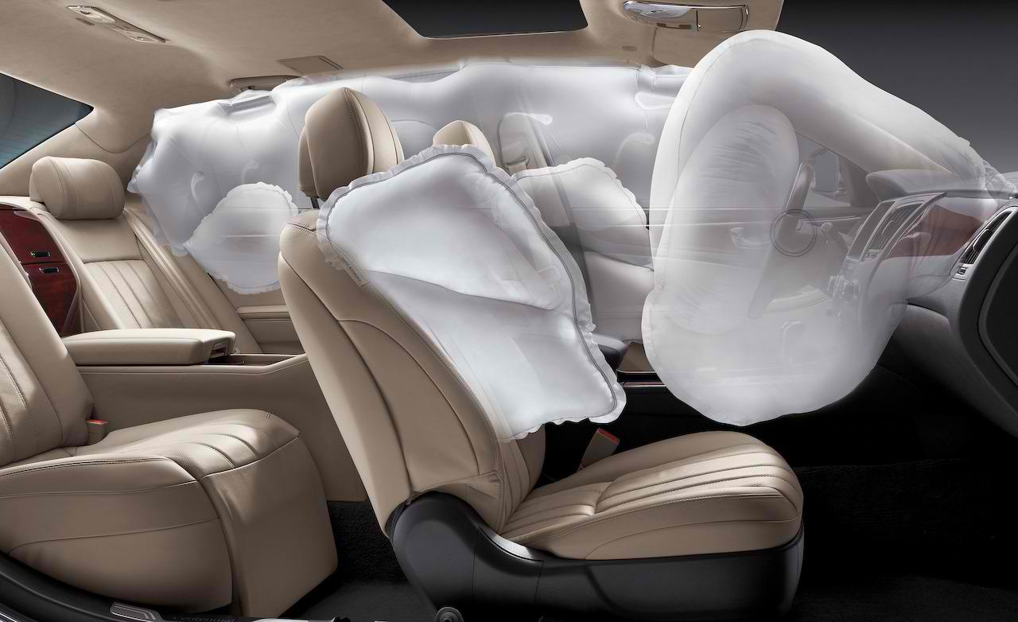
Chapter 8
Momentum & Impulse

Slide 9
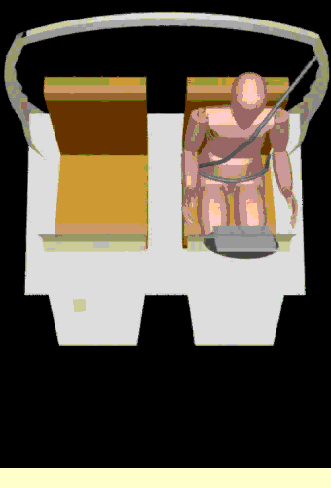
Understanding Impulse
How do air bags help save lives?
Do air bags change the momentum of a person in a car?
Momentum (ρ) = mass x velocity
A person with a mass of 60 kg
is traveling at 30 m/s on a highway.
Calculate the momentum.
ρ_{i} = 60 kg x 30 m/s
The momentum of this person is
1,800 kg▪m/s
The momentum of this person is not
affected by his/her seatbelt or airbag.

Slide 10
Understanding Impulse
Is the impulse affected by the air bags in a collision?
Impulse (∆ρ) - Measures the change in momentum
for a single object (not a system)
By how much does the 60 kg person’s momentum
change when going from 30 m/s to a full stop?
ρ_{i} = 1,800 kg▪m/s ρ_{f} = 0 kg▪m/s
∆ρ = -1,800 kg▪m/s
Impulse can also be described as…
∆ρ = force x time
So how does an air bag affect the change in momentum?
Air bags & seatbelts increase the time to completely stop.

Slide 11
Calculating Impulse
Person #1
A 70 kg person driving at 40 m/s in a car with airbags. When the car crashes into a wall and comes to a complete stop, what’s the change in momentum?
ρ_{i} = 70 kg x 40 m/s ρ_{f} = 0
Change in momentum = -2,800 kg▪m/s
The airbag expands and causes the person to stop moving over a period of 1.4 seconds? How much force is applied?
∆ρ = force x time
-2,800 kg▪m/s = F (1.4 s) F = -2,000 N

Slide 12
Calculating Impulse
Person #2
A 70 kg person driving at 40 m/s in a car without any airbags. What’s the change in momentum when it crashes?
ρ_{i} = 70 kg x 40 m/s ρ_{f} = 0
Change in momentum = -2,800 kg▪m/s
Because there’s nothing to slow the person, the change in momentum happens in 0.4 s. How much force is applied?
∆ρ = force x time
-2,800 kg▪m/s = F (0.4 s) F = -7,000 N
A 1 second difference is significant! (7,000 N & 2,000 N)

Slide 13
Try On Your Own
A bowling ball is rolling down
an alley toward a bowling pin.
It hits the 1.5 kg pin and it
flies away at 1.33 m/s.
If the collision occurs over
0.2 seconds, how much force
was applied to the pin?
ρ_{i} = 1.5 kg x 0 m/s ρ_{f} = 1.5 kg x 1.33 m/s
Change in Momentum (∆ρ) = 1.995 kg▪m/s
1.995 kg▪m/s = F x 0.2 s F = 9.975 Newtons
The bowling ball applies a force of 10 N to the pin.

