Slide 1
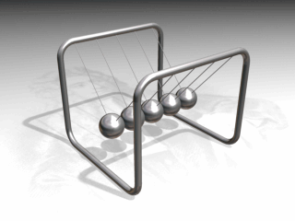
Chapter 9a
Understanding Energy

Slide 2

Two Major States of Energy
Energy – The ability to do work or cause a change
Measured in Joules (J)
Kinetic Energy – Energy in Motion
Which two factors would give a race car
more Kinetic Energy?
A greater mass and speed
results in more KE.
KE = ½ m v²
What would be the kinetic energy
of a 5,000 kg car traveling at 40 m/s?
KE = ½ (5,000 kg) (40 m/s)² KE = 4,000,000 Joules

Slide 3

Two Major States of Energy
Potential Energy – Stored Energy
Which two factors would give a wrecking ball
more Potential Energy?
A greater mass and greater distance
lifted in the air produces more PE!
PE = m a_{g} h = F_{g} h
What would be the potential energy
of a 50,000 N ball raised up 6m?
PE = 50,000N (6m) = 300,000 Joules
Law of Conservation of Energy – Energy cannot be created nor destroyed; Max PE = Max KE

Slide 4
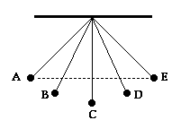
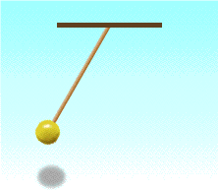
Energy Conversions
Imagine that we are using a pendulum which swings
a 2 kg sphere back and forth from a height of 1m.
At which point(s) is the potential
energy the greatest?
A & E
At which point(s) is the kinetic
energy the greatest?
C
Ignoring air resistance…
What is the maximum PE? (2 kg)(9.8 m/s²)(1m) = 19.6 J
What is the maximum KE? ½ (2 kg)(v)² = 19.6 J
What is the maximum velocity? v = 4.4 m/s

Slide 5
Try On Your Own
A 200 kg wrecking ball needs to reach a speed of 30 m/s when it is released for it to knock down a brick wall.
How high must the wrecking ball be lifted?
Max KE = ½ m v² = ½ (200 kg) (30 m/s)² = 90,000 J
Max PE = m a_{g} h 90,000 J = 200 kg (9.8 m/s²) height
height = 46 meters
What if the wrecking ball above had a mass of 600 kg? How high would it need to be lifted to reach 30 m/s? Explain your answer!
46 meters ~ All objects fall with the same acceleration!
But which has more kinetic energy???

Slide 6
Conservation of Mechanical Energy
Mechanical Energy – The sum of Potential and Kinetic Energies
ME=PE+KE
The conservation of mechanical energy states that mechanical energy remains constant in the absence of air resistance or friction.
Conservation of mechanical energy is path independent.
Energy of one type is transferred to another by the work accomplished by gravity.
PE=100 J
KE=0 J
ME=100 J
PE=30 J
KE=70 J
ME=100 J
PE=0 J
KE=100 J
ME = 100 J

Slide 7
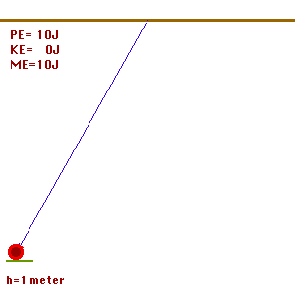
Conservation of Mechanical Energy
(Pendulum)
PE=10 J
KE=0 J
ME=10 J
PE=10 J
KE=0 J
ME=10 J
PE=0 J
KE=10 J
ME=10 J
Maximum
potential
Energy, zero
kinetic
energy
Maximum
kinetic
energy,
zero potential energy
Maximum
potential
Energy, zero
kinetic energy
Maximum
kinetic
Energy, zero
potential
energy
Maximum
potential
Energy, zero
kinetic
energy
Maximum
potential
Energy, zero
kinetic
energy

Slide 8
Conservation of Mechanical Energy (Problem Solving)
ME₁=ME₂
PE₁+KE₁=PE₂+KE₂
If v₁=0 and h₂=0 then
PE₁+KE₁=PE₂+KE₂
mgh₁+ 0 = 0+ ½ mv₂²
PE₁=KE₂ (The initial potential energy is converted to the final kinetic energy. The work accomplished by gravity causes the change of potential to kinetic energy.)
1
h₁
2
h₂

Slide 9
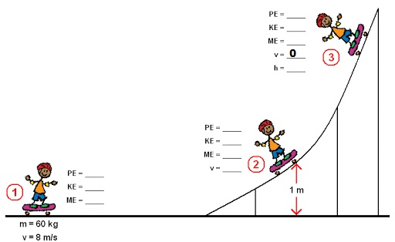
Conservation of Mechanical Energy
Steps for Problem Solving:
In the beginning, the object will either have ALL GPE or ALL KE – meaning one of them will be zero. If you add them together, you will have the TOTAL MECHANICAL ENERGY (ME).
For each part of the situation, the total mechanical energy (ME) will ALWAYS be the same!
Therefore, you will calculate either the PE or KE at the next point, depending on what info is given to you, then subtract that from the total ME to get the other energy.

Slide 10
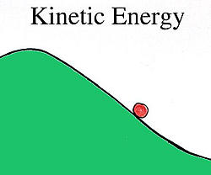

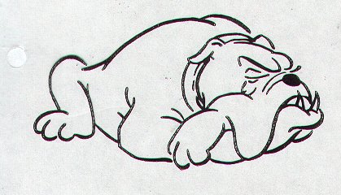


Write a “P” or a “K” under each picture on your paper to tell whether the pictures are showing POTENTIAL or KINETIC energy.
zzzz
P
K
K
K
P

Slide 11

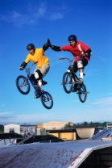
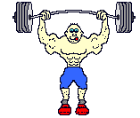



Do Now:
Determine which pictures are for Potential energy and
which pictures are for Kinetic energy:
1.
2.
3.
K
K
P
4.
5.
6.
P
K
P

Slide 12
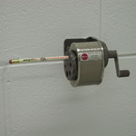
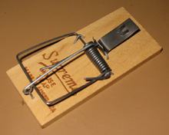
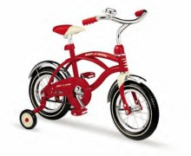





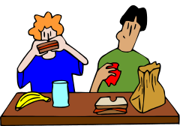
6 DIFFERENT FORMS OF ENERGY
Both potential & kinetic energy come in many forms. Six of the most common ones are:
MECHANICAL ENERGY
Energy of moving parts
THERMAL (HEAT) ENERGY
Energy of the heat IN an object
CHEMICAL ENERGY
Energy in chemical bonds of food, gas, batteries, burning wood etc.

Slide 13
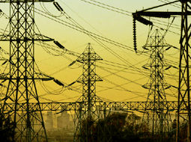






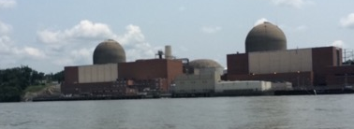

6 DIFFERENT FORMS OF ENERGY (continued)
ELECTRICAL ENERGY
Moving electrical charges
ELECTROMAGNETIC ENERGY
Light energy, X-rays, radio waves
NUCLEAR ENERGY
Stored in the nucleus of an atom & released when atoms are split or joined together, nuclear reactors, atomic bombs, stars, sun

Slide 14
OTHER FORMS OF ENERGY
  SOUND
  LIGHT
  SOLAR
  WIND
  GEOTHERMAL
  ELASTIC
  NUCLEAR or ATOMIC
  GRAVITATIONAL

Slide 15




Do Now:
Determine the form of energy the object has.
a. electrical energy
b. chemical energy
c. mechanical energy
d. nuclear energy
e. electromagnetic energy
f. heat energy.
1.
2.
b
e
3.
4.
d
a
(Nuclear power plant )

Slide 16
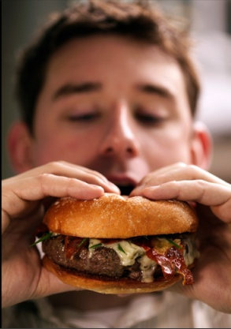
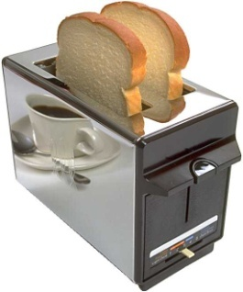
Energy Transformations
Conversions Between Forms of Energy
  A change from one form of energy to another is called energy conversion.
  Most forms of energy can be converted into any other form.
  For example a toaster converts electrical energy to thermal energy. Your body converts chemical energy in the food you eat into the mechanical energy you need to move your muscles.
  Usually heat energy is also formed in an energy conversion.
Electrical Energy into Thermal Energy
Chemical Energy into Mechanical Energy
Notes:
STOP HERE! Use the rest of this slide show later.

Slide 17
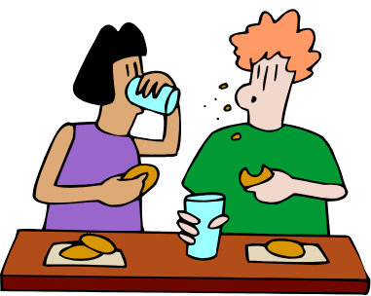

ENERGY CONVERSIONS (ENERGY TRANSFORMATIONS)
Energy can be converted (transformed or changed) from one form to another.
For example…
1) Food has POTENTIAL CHEMICAL energy.
2) When you eat it, the bonds in the atoms are broken and the energy is released to your cells.
Your body CHANGES the chemical energy to KINETIC MECHANICAL ENERGY when you run, jump, write, walk.
4) Finally, your body creates THERMAL (HEAT) ENERGY you can feel because the molecules inside you are moving!

Slide 18


Think about the energy conversions taking place with a flashlight.
Light & Heat
Batteries
Wires
CHEMICAL ENERGY
ELECTRICAL ENERGY
ELECTROMAGNETIC ENERGY

