Slide 1
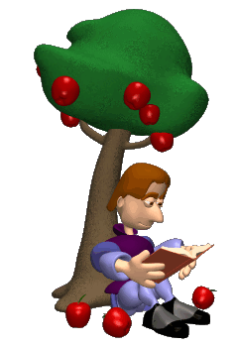
Chapter 6-7a
Understanding
Forces and Motion

Slide 2
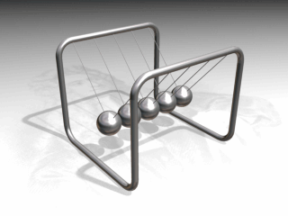

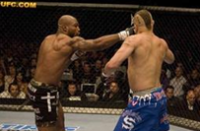
Understanding Forces
Force – A push or pull between two objects
Newton’s Laws
An object in motion stays in motion
& an object at rest stays at rest
until an unbalanced force acts upon it
Force (N) = Mass (kg) x Acceleration (m/s²)
For every action force there is an
equal and opposite reaction force
Why can’t you punch a piece of paper
so hard that you break your fist?

Slide 3
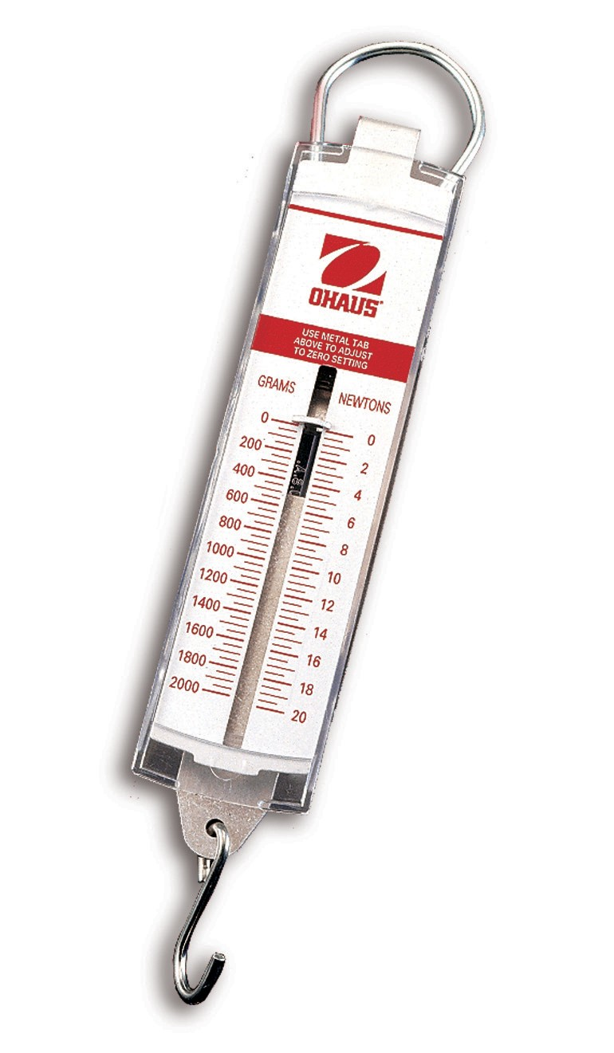
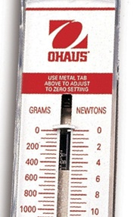
Measuring Forces
Spring Scale – Measures forces in
Newtons with + or - direction
How to use the spring scale…
Make sure the scale is zeroed
Use the Newton’s scale and
measure to the tenths place
Practice these measurements:
10.0 N
2.5 N
3.7 N

Slide 4
Balanced Forces
Free Body Diagrams – Illustrate all forces acting upon
an object of interest
Example #1 – Block resting on Table
What is our object of interest?
Which force is acting upward?
Normal Force exists between any
two solid objects
Which force is acting downward?
Weight – The force of gravity
What do you notice about the size of the arrows?
F_{N}
F_{g}

Slide 5
Balanced Forces
What is the net force acting on the block?
Net Force – The sum of all forces +1.6 N
acting upon an object
-1.6 N
Net Force = 1.6N + (-1.6N) = 0 Newtons
What happens if F_{gravity} is greater than F_{normal}?
The table will break!
F_{N}
F_{g}

Slide 6
Other Common Forces
There are other forces besides gravity & normal forces.
Which forces are working in each of these situations?
The block is moved by a person… F_{Applied}
The block is hanging from a string… F_{Tension}
The block is moved by an
engine or machine… F_{thrust}
Which force works against moving objects?
The block is sliding across the desk
or falling from the sky… F_{friction}
Air resistance is the friction created by falling objects

Slide 7
Forces in Motion
Example #2 – Block Pulled at a Constant Velocity
How much force is needed
to pull the block at
a constant velocity?
If the F_{pull} is equal to 0.4N then…
The friction must be equal and opposite! F_{f} = -0.4N
Again, the net force is 0 Newtons.
An object at rest or moving at a constant velocity
will always have a net force of zero!
F_{N}
F_{f}
F_{applied}
F_{g}

Slide 8
Try On Your Own
Create a free body diagram of a 6,000 N Dune Buggy that is trying to drive forward using a force of 200 N but is being pulled backward with 200 N by a gorilla.
What is the net force? 0 Newtons
What do you notice about the arrows?
F_{N} 6,000 N
F_{applied} -200 N
F_{thrust} 200 N
F_{g} -6,000 N

Slide 9
Chapter 6-7b
Calculating Forces
and True Acceleration

Slide 10
Forces in Motion
Example #2 – Block Pulled at a Constant Velocity
What is the net force acting
on this block as it is pulled
at a constant velocity?
The net force is 0 Newtons.
An object at rest or moving at a constant velocity
will always have a net force of zero!
But can we pull a block with
a force greater than friction?
F_{N}
F_{f}
F_{applied}
F_{g}

Slide 11
Accelerating Forces
Example #3 – Block Pulled at a Constant Acceleration
What happens to the block if it is
pulled with a force of 1.4 N?
Now the forces are unbalanced.
Net Force = 1.4 N + (-0.4 N) = 1 N
This means that there is a constant acceleration.
How will that affect the velocity of the block?
The block will continue to move faster and faster until…
The forces are balanced again!
F_{N}
F_{f}
F_{applied}
F_{g}

Slide 12
Accelerating Forces
Example #3 – Block Pulled at a Constant Acceleration
How can we measure the affect
of a 1 N force on this block?
Using Newton’s 2nd Law we can find out
how fast the 0.2 kg block is accelerating…
Net Force (N) = Mass (kg) x Acceleration (m/s²)
1 N = 0.2 kg x a a = 5 m/s²
F_{N}
F_{f}
F_{applied}
F_{g}

Slide 13
Accelerating Forces
What happens to the block of wood once we stop pulling?
Does friction still act on the block?
Yes! As long as the block is moving,
friction will be working against it.
Without the pulling force, the block
will continue to slide in a positive
direction, but what will be its acceleration?
Net Force (N) = Mass (kg) x Acceleration (m/s²)
-0.4 N = 0.2 kg x a a = -2 m/s²
So the friction will slow down the block
until it comes to a stop.
F_{N}
F_{f}
F_{applied}
F_{g}

Slide 14
Try On Your Own
Draw a free-body diagram for a 0.005 kg bullet just as it leaves a gun that is fired upward with a F_{net} of 2,000 N.
Then calculate the acceleration of the bullet.
Net Force = mass x acceleration
2,000 N = 0.005 kg x a
a = 400,000 m/s²
What does the free-body diagram look
like once the bullet leaves the gun?
Or when reaches its highest peak?
Or when it is coming back down?
The weight (F_{g}) of the bullet never changes!
F_{Thrust}
F_{g}

Slide 15
Chapter 6-7c
Weight, Gravity,
and Types of Friction

Slide 16
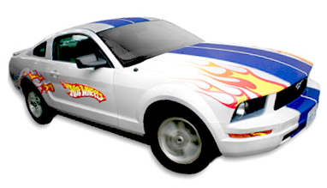
Understanding Acceleration
A toy car at rest speeds up to 10 m/s to the right within 2 seconds? What is its acceleration?
a = v_{f} – v_{i} a = 5 m/s²
Δt
A true acceleration describes a car that changes its speed!
How much force is needed to accelerate this 0.4 kg toy car at 5 m/s²?
F_{net} = ma F_{net} = 2 N
The direction in which are these forces and accelerations occurring is… Horizontally or Vertically?
Horizontally (Left to Right, Back and Forth)

Slide 17
Understanding Acceleration
But what’s the force of gravity (weight) acting
on this 0.4 kg toy car?
F_{g} = ma_{g}
Remember that for all objects…
The acceleration due to gravity on Earth is -9.8 m/s²
F_{g} = 0.4 kg x -9.8 m/s² F_{g} = -3.92 N
In which direction is the car actually accelerating?
The true acceleration of the car is 5 m/s²
caused by a net force. (F_{net} = ma)
The acceleration due to gravity is -9.8 m/s²
cause by the force of gravity. (F_{g} = ma_{g})

Slide 18
Types of Friction
Which is harder to do…
Get a broken down car to start moving or
Keep the car moving at a constant speed?
Static Friction – The friction exerted between two objects before one starts moving; F_{f} = μ_{s}F_{N}
μ_{s} is the coefficient of static friction
which is unique between surfaces.
Would the coefficient of friction be greater for
A block of steel on ice or
A block of wood on a brick surface?
A block of steel on ice μ_{s} = 0.03
A block of wood on a brick surface μ_{s} = 0.60

Slide 19
The Force of Static Friction
How much friction must be overcome to push an 800 N wooden sled across a wooden floor with a μ_{s} of 0.50?
You should realize that on a flat surface…
F_{f} = μ_{s}F_{N} F_{f} = 0.50 (800 N)
So the pushing force would need to exceed 400 N.
F_{N}
F_{f}
F_{applied}
F_{g}

Slide 20
The Force of Kinetic Friction
Kinetic Friction – The friction exerted between two objects while it is moving; F_{f} = μ_{k} F_{N}
μ_{k} is the coefficient of kinetic friction.
How much force keeps an 800 N wooden sled moving at a constant speed across the floor if the μ_{k} is 0.20?
F_{f} = μ_{k}F_{N} F_{f} = 0.20 (800 N) = 160 N
It takes 400 N to move the sled & 160 N to keep it going.
F_{N}
F_{f}
F_{applied}
F_{g}

Slide 21
Try On Your Own
What is the coefficient of friction for a 0.51 kg steel slab that is being pulled at a constant speed across a metal table with a spring scale which reads 2.9 N?
Which equation should we use first?
F_{g} = ma_{g} F_{f} = μF_{N}
F_{g} = 0.51 kg x -9.8 m/s F_{g} = -5 N
Next, we identify the F_{f} and F_{N}
F_{N} = F_{g} = 5.0 N
F_{f} = F_{applied} = 2.9 N
Then we use… F_{f} = μF_{N} 2.9 N = μ 5.0 N
The coefficient of friction (μ_{k})= 0.58

