Slide 1
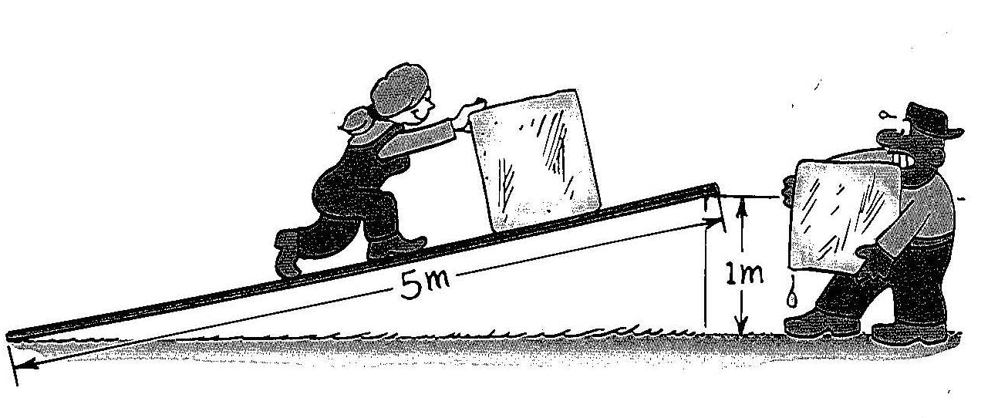
Chapter 9b
Understanding Work

Slide 2
Actually Doing Work
How much potential energy does an 80 N bowling ball at the top of a 20 m building have?
PE = m a_{g} h = F_{g} h 80 N (20 m) = 1,600 Joules
But how did it get that potential energy?
Someone had to put the bowling ball on top of the building!
Work – Measures a change in potential &/or kinetic energy
on an object of interest; Work = Force Distance
Does lifting an object in the air accomplish work? Yes!
Causing an object to accelerate accomplishes work? Yes!
Pushing an object at a constant speed accomplishes work?
No. If the KE/PE of the object doesn’t change, No Work!

Slide 3

Actually Doing Work
If you had to push a heavy shopping cart filled with groceries, what would be the best way to do it?
The best way to push the
cart is horizontally.
If you push upward or
downward when the cart
is moving forward, you aren’t
doing any work on the object.
Work is only accomplished when the
force is applied in the same direction
that the object is moving.
Carrying something doesn’t accomplish any work on the object!

Slide 4
Calculating Work
A 5 kg bowling ball at rest is thrown and reaches
a velocity of 6 m/s before it is released.
a) What is it’s kinetic energy as it is released?
KE = ½ m v² KE = ½ (5 kg) (6 m/s)² KE = 90 J
How much work is accomplished by the bowler?
W = ΔKE = 90 J
If the ball is accelerated over a horizontal distance of 1.2 meters, how much force is required?
W = F d 90 J = F (1.2 m) F = 75 N
Is work on the ball positive, negative, or none
after it is released?

Slide 5
Calculating Power
Can we compare the work done by two different people?
Phillip pushes a crate with a net force of 45 N
over a distance of 2 meters in 10 seconds.
Lori pushes a crate with a net force of 30 N
over a distance of 3 meters in 45 seconds.
Did they really do the same amount of work on the crate?
Yes ~ 90 Joules, but who seems to be working harder?
Power (Watts) = Work (J)/Time (s)
Phillip Lori
90 J = 9 Watts 90 J = 2 Watts
10 s 45 s

Slide 6
Try On Your Own
Jim lifts an 5 N backpack up the stairs at school. Each step is 0.2 meters across and 0.3 meters up.
If he walks up 12 steps, how much work did he do
on the backpack?
W = F d …but what’s the distance?
d = 12 x 0.3 m = 3.6 m
W = 5 N (3.6 m) W = 18 Joules
If it took 12 seconds to walk up the stairs,
how much power did he develop?
P = W/t P = 18 J/12 s P = 1.5 Watts

Slide 7
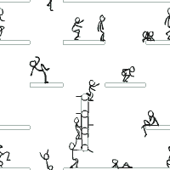
Work

Slide 8

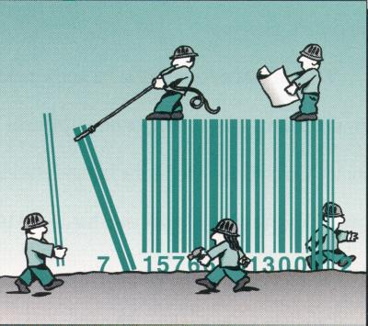
Work has a special meaning in physics.
Work
Unlike your everyday experience, where you go to an after school job and earn money, work in physics does not pay for your car insurance.

Slide 9




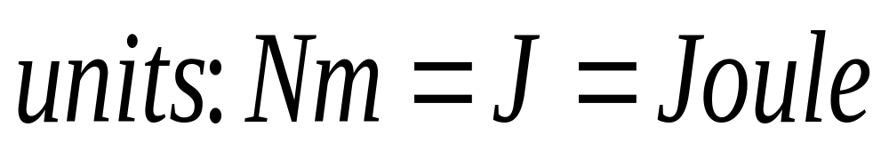
Work is done on an object
when a force is applied to an object and the object is displaced.
Work is only done if the object moves a distance.
Do not confuse applying a force with doing work.
Pushing or pulling on an object may make you sweat but you do no work unless it moves.
Work = Force x displacement (cosine of angle for the portion of the force parallel to the distance traveled)
Only the force parallel to the direction of the displacement does work.
Units: Newton x Meter (Nm)
Work is a scalar quantity

Slide 10




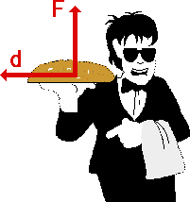
Read the following five statements and determine whether or not they represent examples of work.
A teacher applies a force to a wall and becomes exhausted.
NO
A book falls off a table and free falls to the ground.
YES
A waiter carries a tray full of meals above his head by one arm across the room. (Careful! This is a tricky question.)
NO
A rocket accelerates through space.
YES

Slide 11

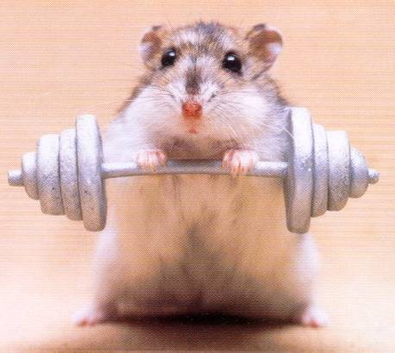
Power

Slide 12
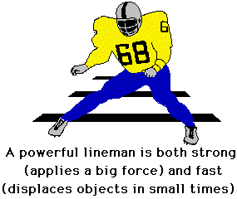
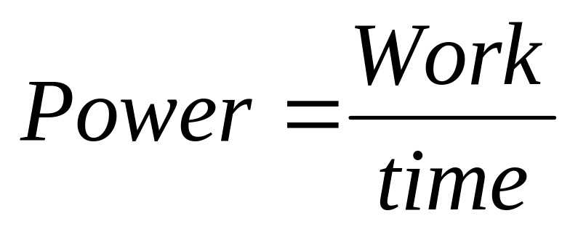
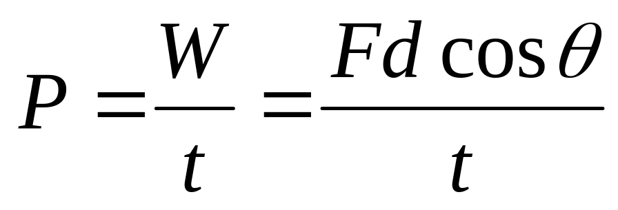
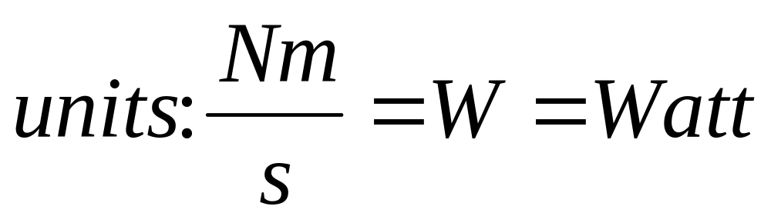
In Physics Power is the Rate of Doing Work

Slide 13
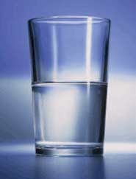
A watt is a small unit
If you lift a glass of water (~2N) to your mouth (~0.5 m) in 1 second you do one joule of work and you are doing work at rate of one watt
Since a watt is relatively small, power is often measured in kilowatts (kW)

Slide 14
Work and POWER SAMPLE PROBLEMS

Slide 15
A student lifts a box of books that weighs 185 N. The box is lifted 0.800m. How much work does the student do?
Givens:
F = 185 N
d = 0.800m
Unknown:
W = ?
W = Fd
W = (185 N)(0.800m)
W = 148 J

Slide 16
An electric motor lifts an elevator that weighs 1.20 x 10⁴ N a distance of 9.00m in 15.0 s. What is the power of the motor in watts and in kilowatts?
P = W/t = Fd/t
Givens:
F = 1.2x10⁴ N
d = 9.0m
t = 15 s
Unknown:
P = ?
P = (1.2x10⁴N)(9m)/(15s)
P = 7.2 x10³ W
= 7.2 kW

