Slide 1
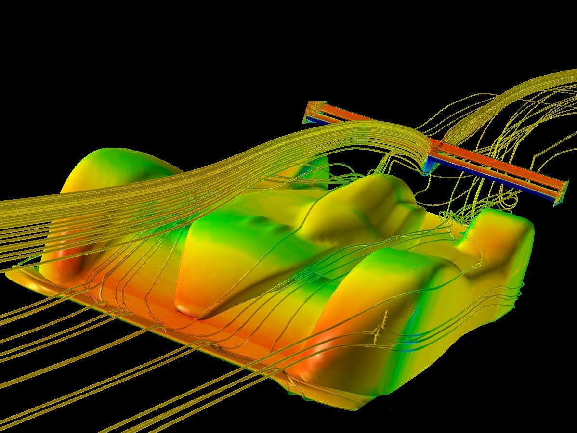
Chapter 1a
Measuring in Physics

Slide 2
Understanding Measurements
Physics – Uses mathematics to explain the relationship between energy & matter
Common Base Units
Measurement | Base Unit | Symbol
Length | meter | m
Time | seconds | s
Volume | liters | L
Mass | kilograms | kg
Acceleration | meters/sec/sec | m/s²
Forces | Newtons | N
Electric Current | ampere | A

Slide 3
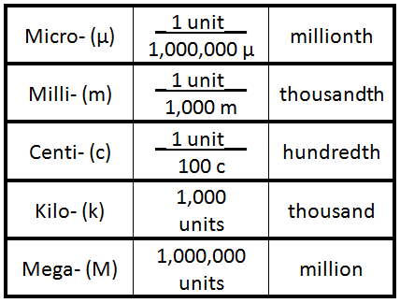
Understanding Units
Prefixes for SI Units (please don’t copy this table)
How much money is a centi-dollar?
How much money is a kilo-dollar?

Slide 4
Using Scientific Notation
The universe is very wide... How wide is it?
It’s 210,000,000,000,000,000,000,000 miles wide!
How do we say this number? I have no clue! ☹
Scientific Notation – Easily describes very small or large numbers; Remember that…
The decimal must be moved to the right of the first whole number.
Positive exponents are used for large numbers while negative exponents are for small numbers.
Which of these numbers is greater?
200,000 = 2 x 10⁵ or 2 x 10⁻⁵ = 0.00002

Slide 5
Using Scientific Notation
How can we convert this number to scientific notation?
210,000,000,000,000,000,000,000 miles
First, where is the decimal? It’s after the last zero.
Now, move the decimal to the right of the first number.
How many spaces is that? 23
So, the correct way to describe this number is…
2.1 x 10²³ miles
Now try these…
0.07 km = 7 x 10⁻² km 3,550 g = 3.55 x 10³ km
6,020,000 = 6.02 x 10⁶ 0.003071 = 3.071 x 10⁻³

Slide 6
Converting Units
Dimensional Analysis – Uses conversion factors to change the unit for a number. Always write the units first!
Convert 7,000 cm into meters
7,000 cm x 1 m = 70 m
100 cm
Convert 70 m into kilometers
70 m x 1 km = 0.07 km
1,000 m
Which of these values is the greatest?
7,000 cm or 70 m or 0.07 km

Slide 7
Using Dimensional Analysis
A man is driving a car at a speed of 30 m/s on Route 1.
Is he going faster than the speed limit?
Convert 30 m/s into mi/hr
30 m x ___1 mi___ x 60 s x 60 min = 67 mi
s 1,609.44 m 1 min 1 hr hr
Yes, he is going faster than the speed limit!
If an airplane is traveling at 200 m/s,
approximately how fast is it traveling in miles per hour?

Slide 8
Try On Your Own
How many seconds are in one week?
(Write your answer in scientific notation)
1 week x 7 days x 24 hr x 60 min x 60 s =
1 week 1 day 1 hr 1 min
604,800 s or 6.048 x 10⁵ s
Your first quiz will test your ability to…
Identify which units are used for measurements
Convert numbers into scientific notation
Convert between different SI units
If you have any questions… Come for extra help soon!

Slide 9
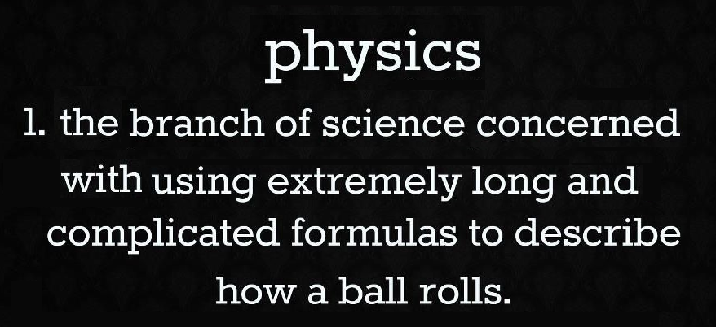
Chapter 1b
Solving Equations

Slide 10

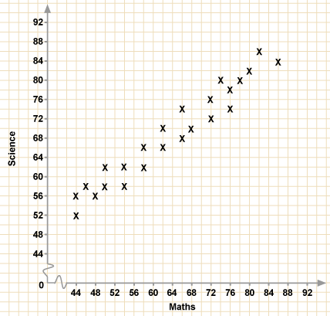
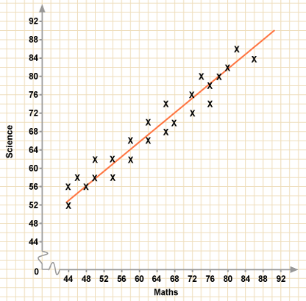


Collecting & Interpreting Data
Let’s create an experiment…
In it, our hypothesis
states that if students receive
tutoring by NHS, they will
higher grades in science.
First we record the number of
minutes a student received
tutoring by NHS.
And then we record that
student’s science test score.
How many students were in this study? 24 Next we…
Draw the Line of Best Fit which best represents the data

Slide 11
Collecting & Interpreting Data
Once we have the line of
best fit you’ll need to…
Make Two New Points!
Find two perfect points on
the line of best fit.
Then we’ll measure slope.
End Point – y=80; x=78
Start Point – y=58; x=50
Slope (m) = Rise =  y
Run  x
Slope (m) = 22 = 0.79 This is a positive correlation!
28 Science test = 0.79 x NHS tutoring
❒ x
❒ y

Slide 12
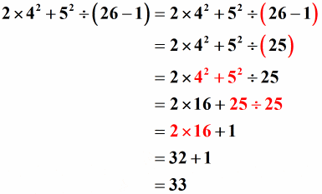
What is PEMDAS?
PEMDAS – The steps in solving an equation…
Parenthesis | Exponents | Multiply & Divide | Add & Subtract

Slide 13
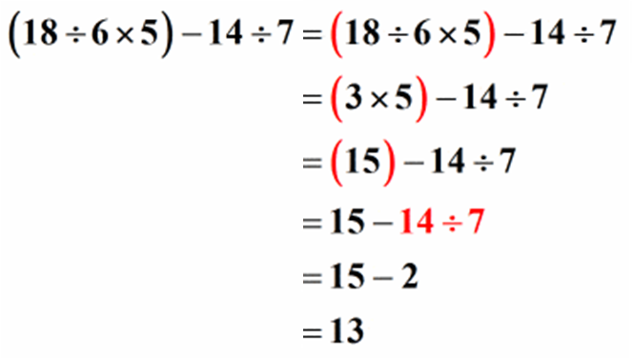
Try On Your Own
Use PEMDAS to solve for this equation…
Parenthesis | Exponents | Multiply & Divide | Add & Subtract

Slide 14

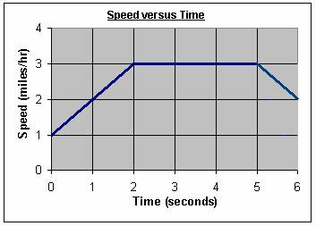
In Conclusion
Being able to collect data, create and interpret graphs, and solve equations will help you how???
Grades in this class, on the SATs, and in college! ☺
Find physics in your everyday life!

