Slide 1



JPS
BOYS SOCCER
Hawks

Slide 2

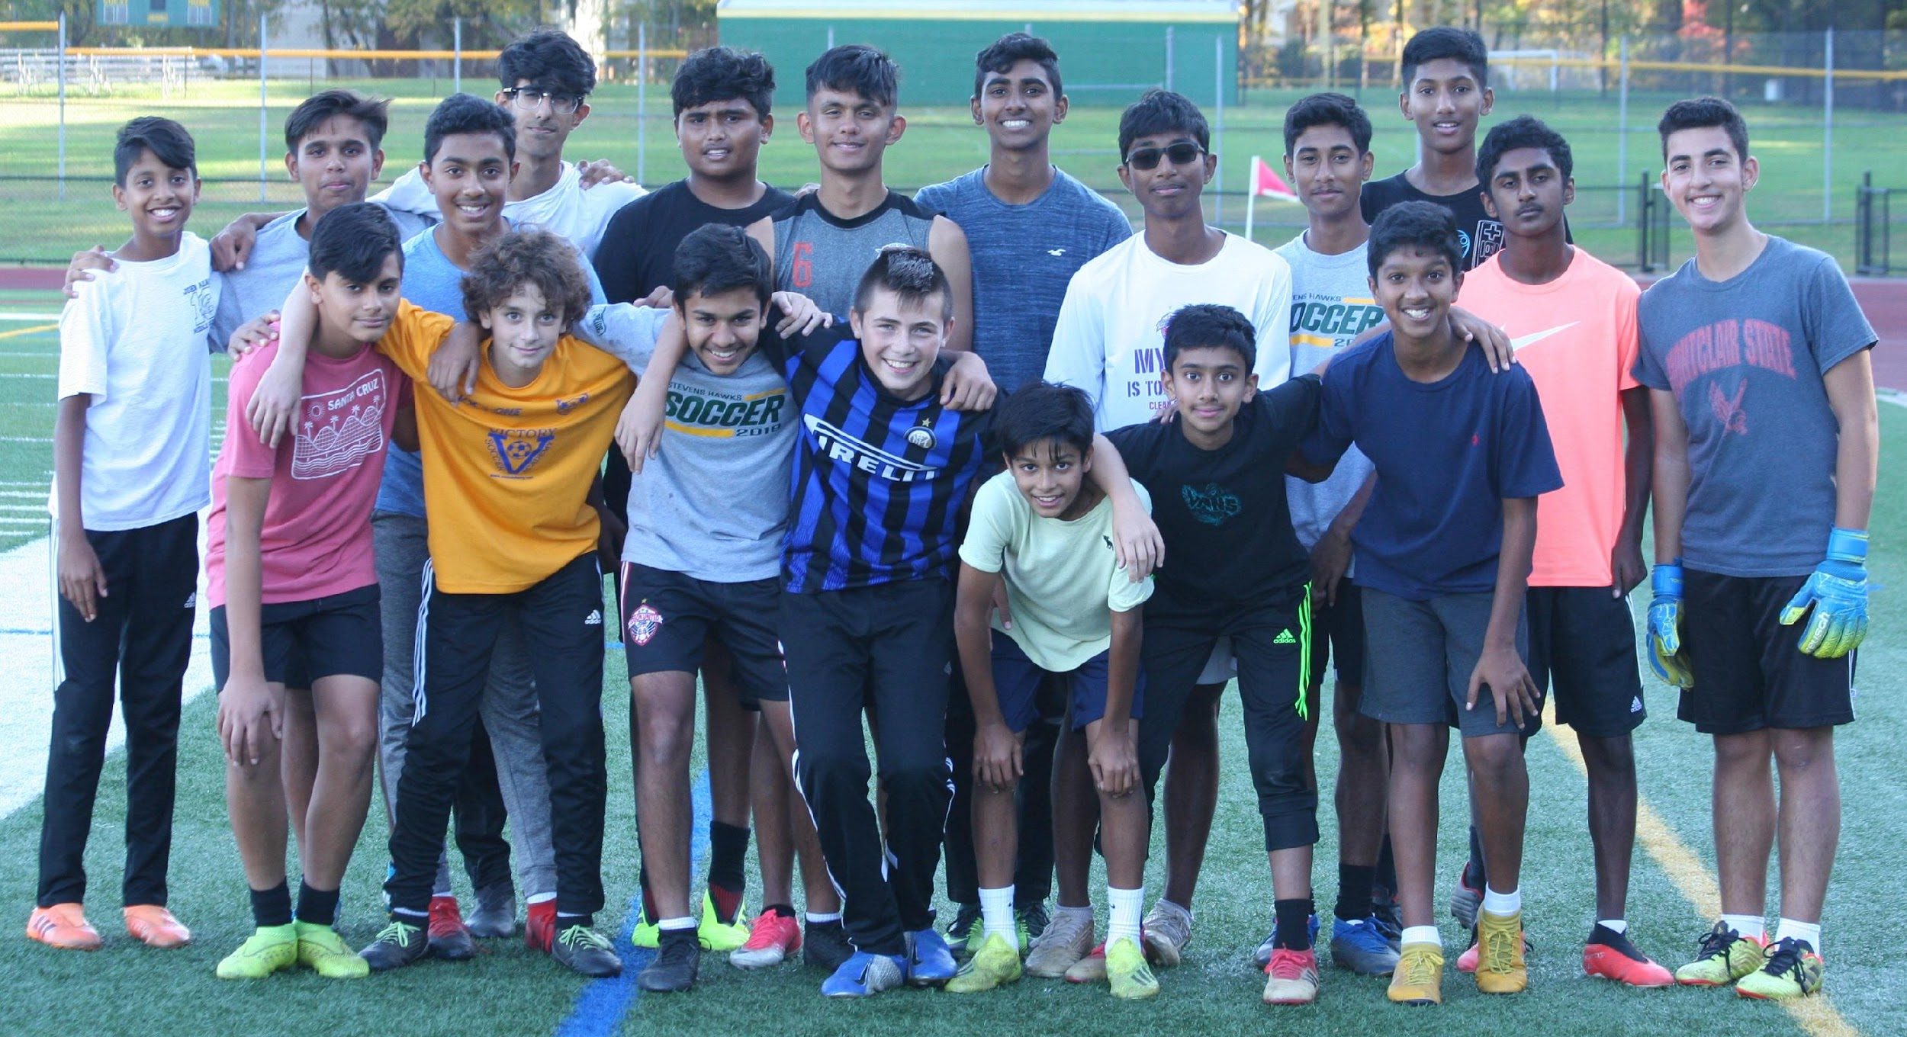
PLAYER SELECTION

Slide 3
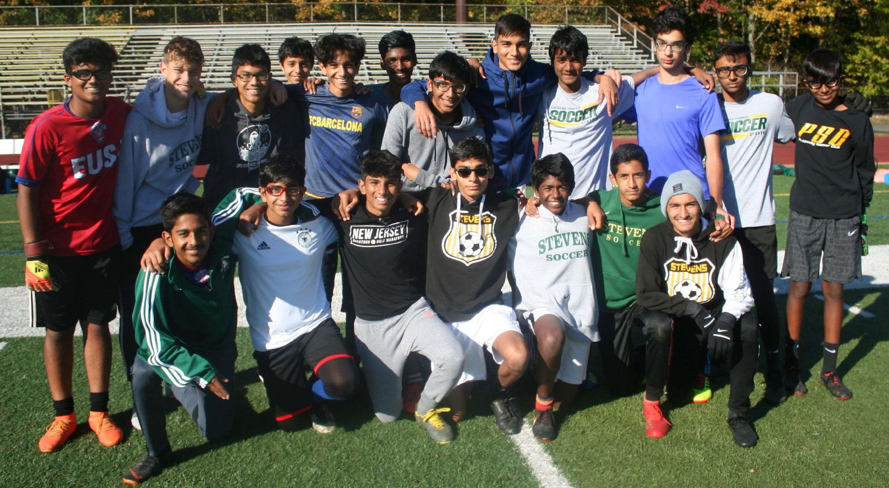
PLAYER SELECTION

Slide 4
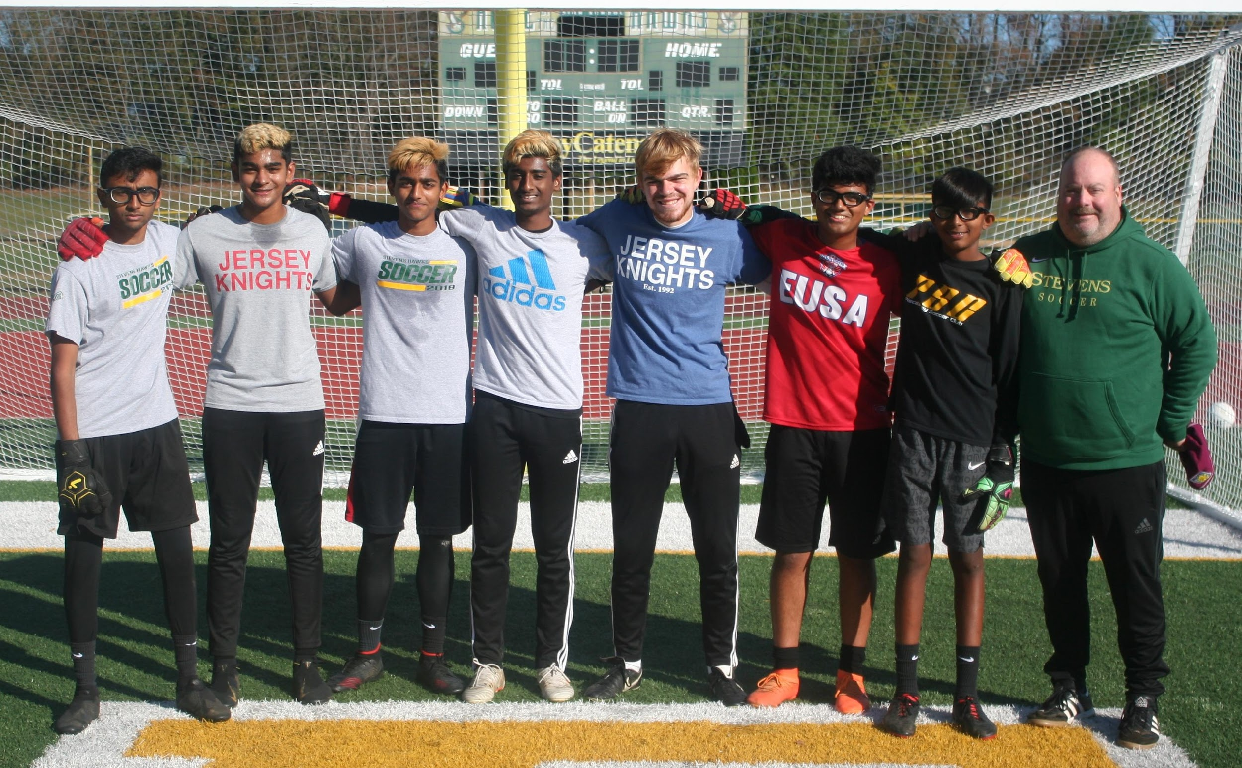
PLAYER SELECTION

Slide 5
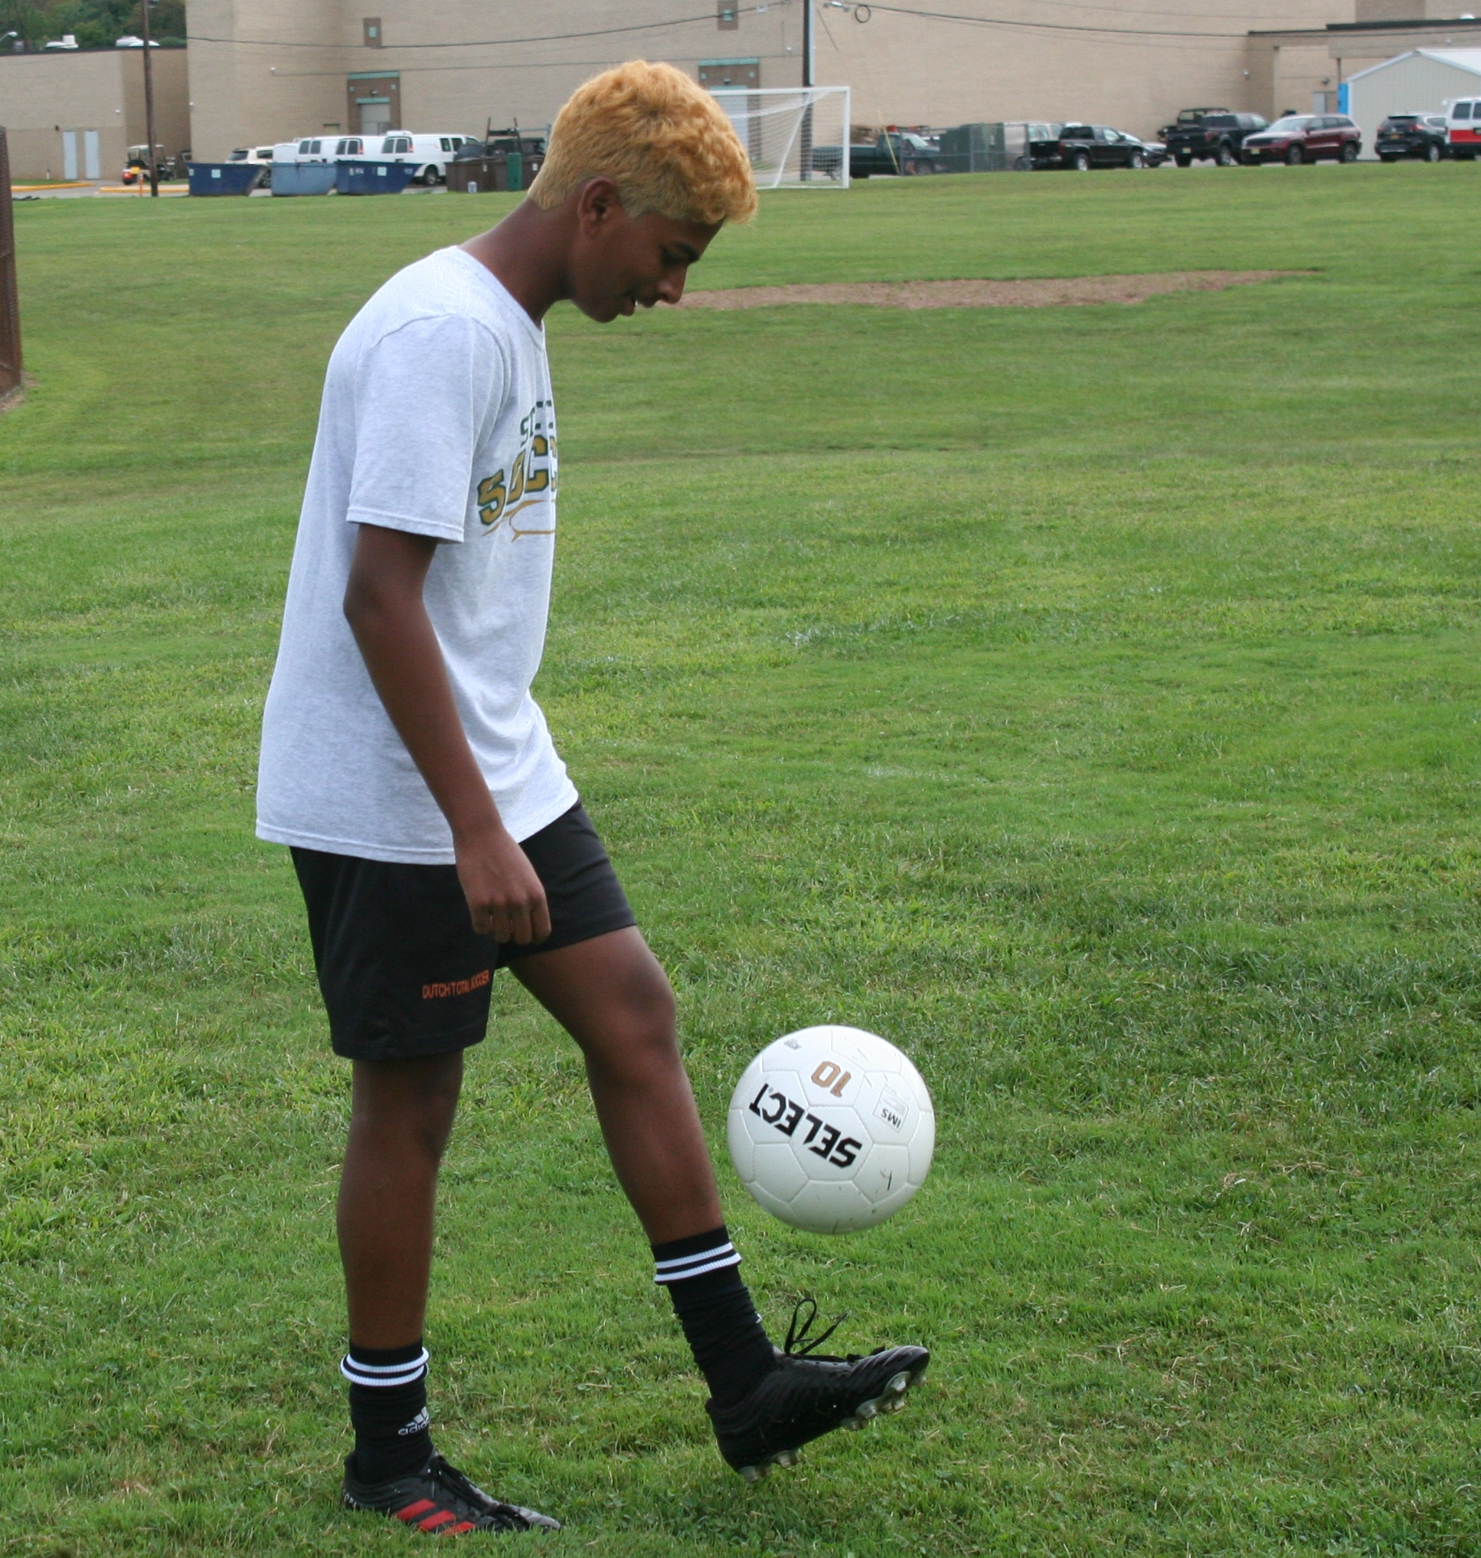
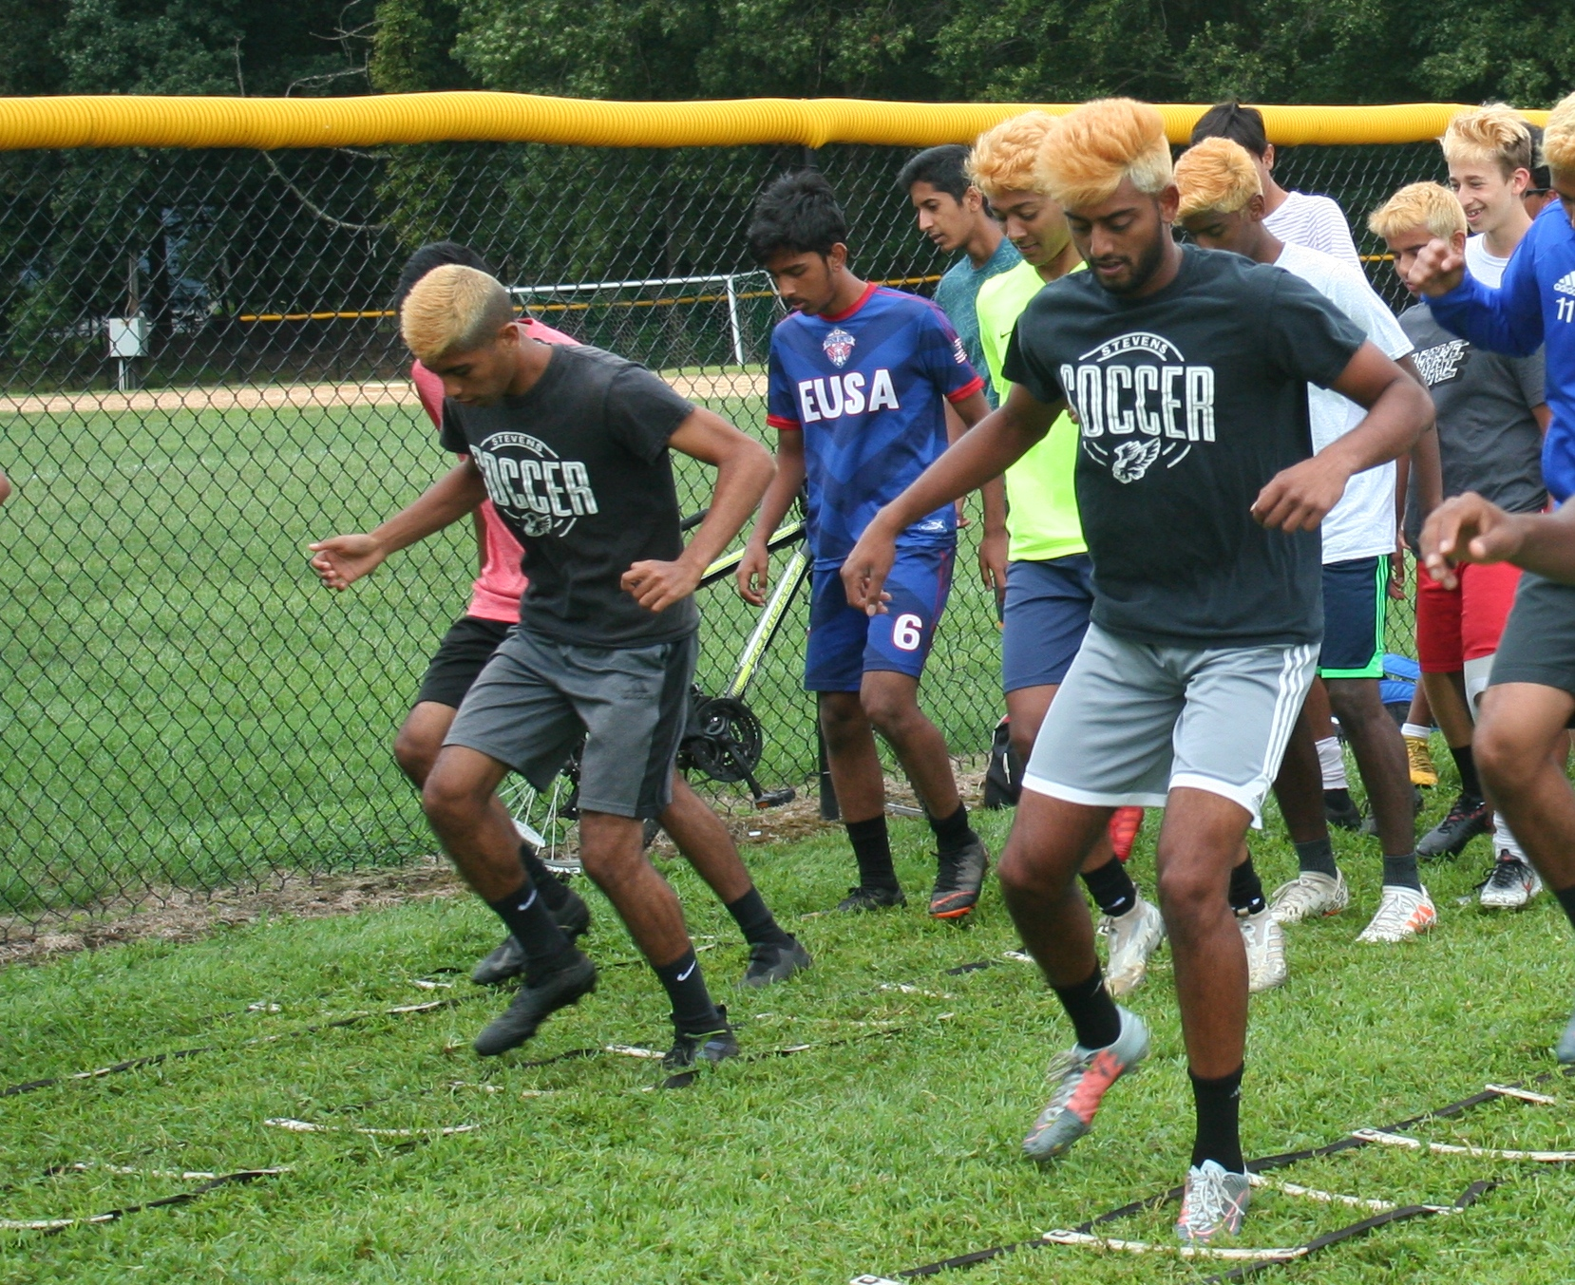
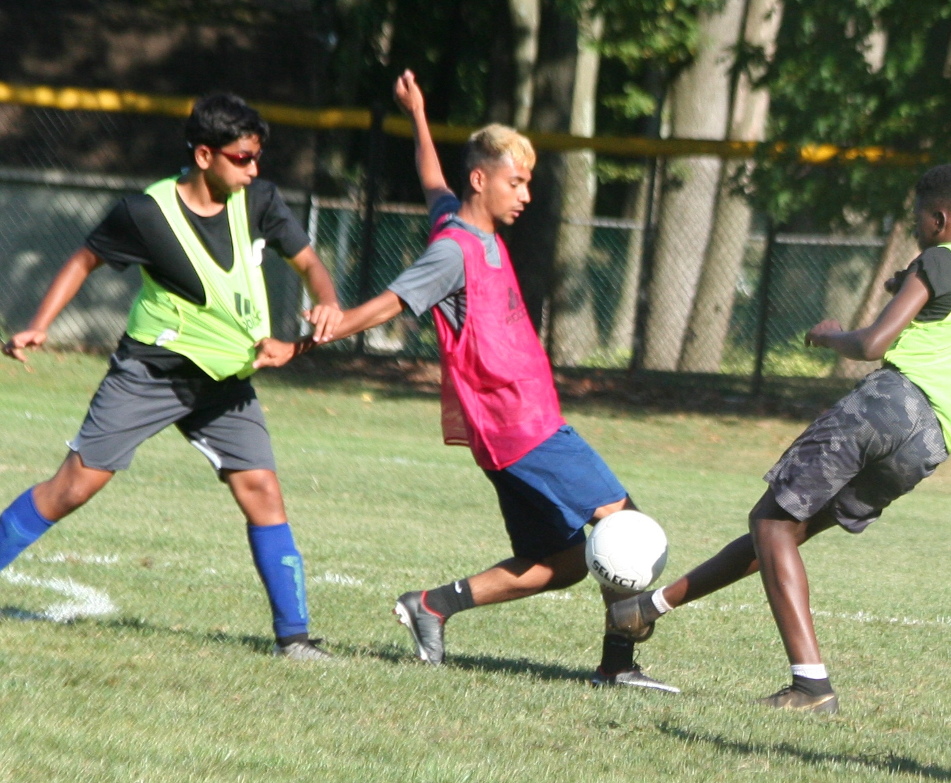
PLAYER SELECTION

Slide 6
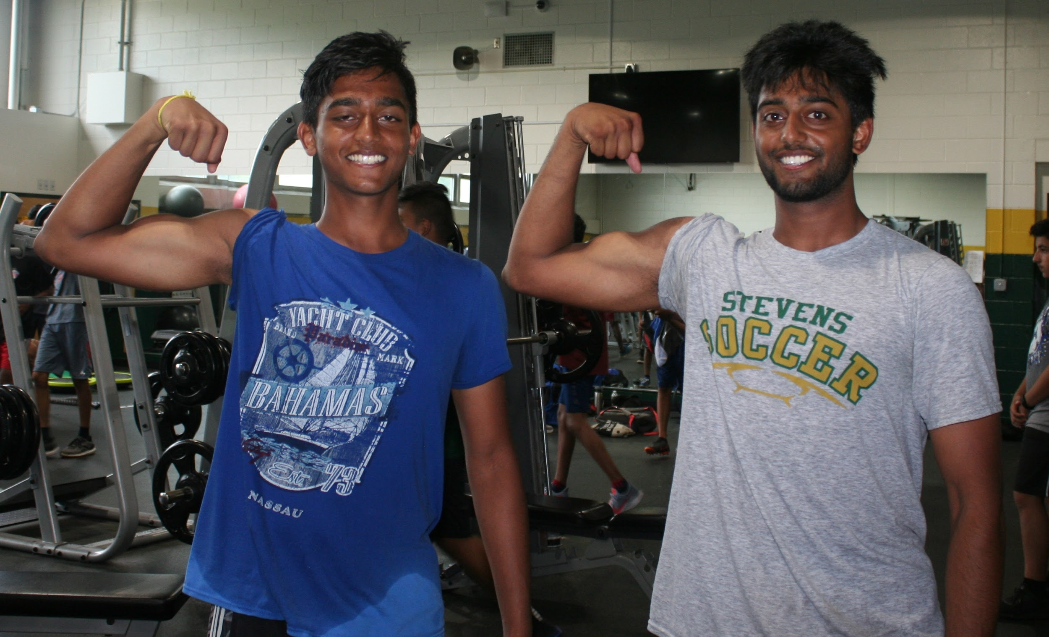
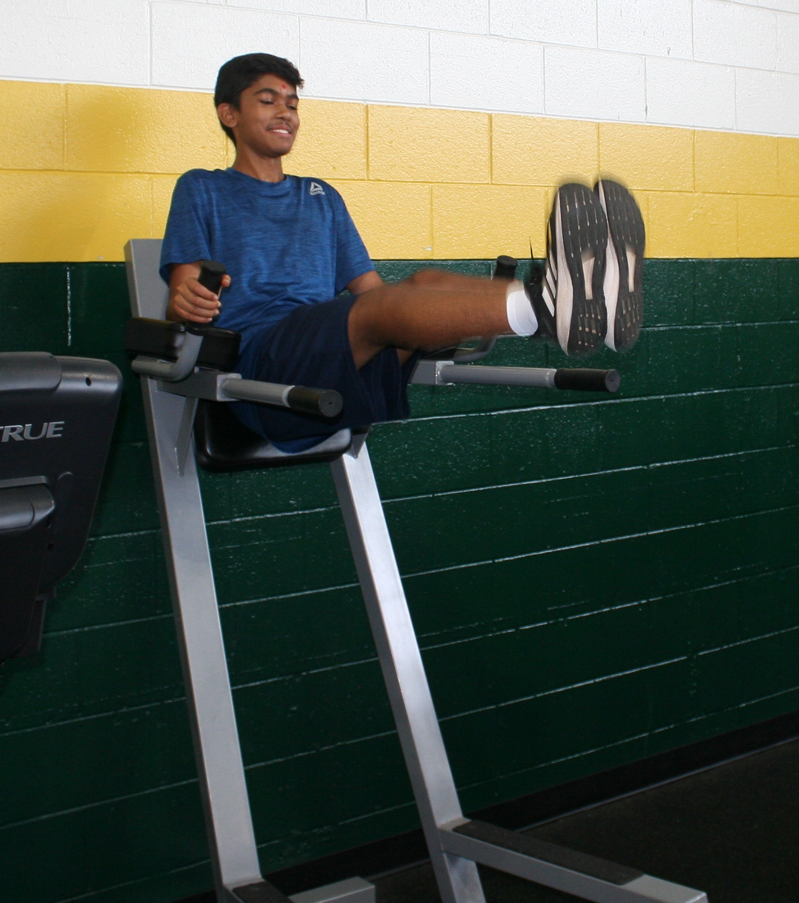
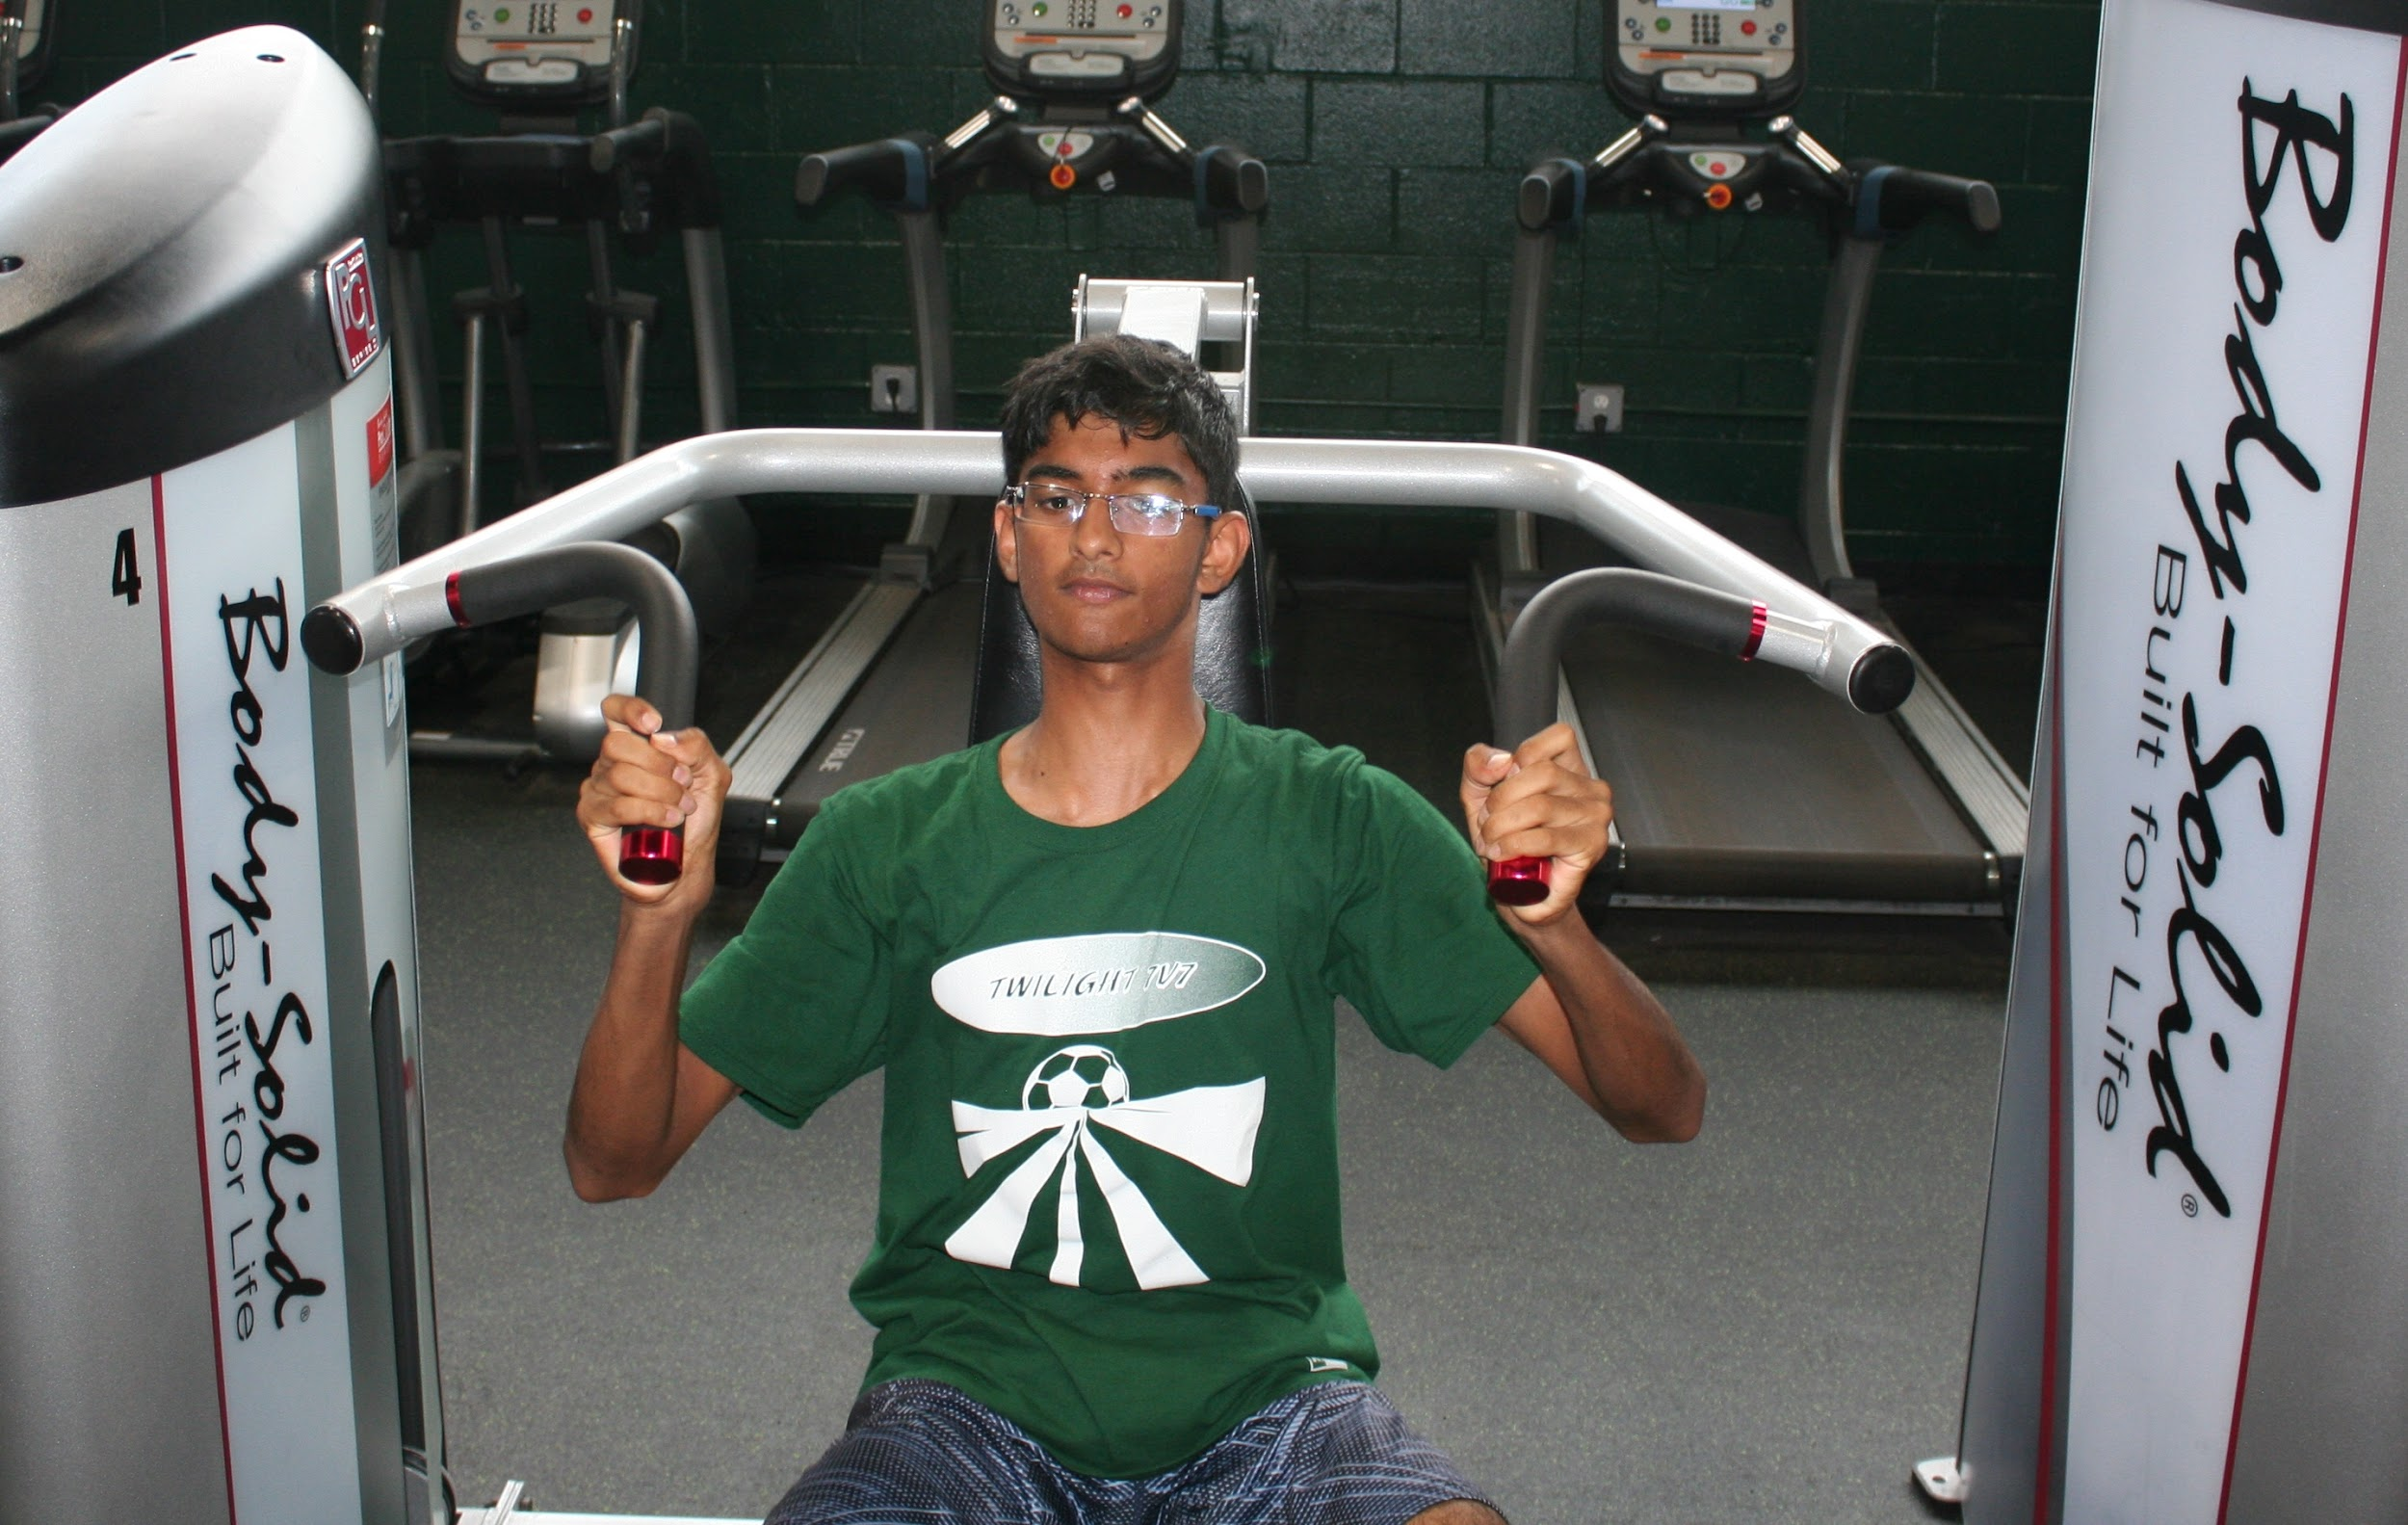
SUMMER PRACTICE

Slide 7
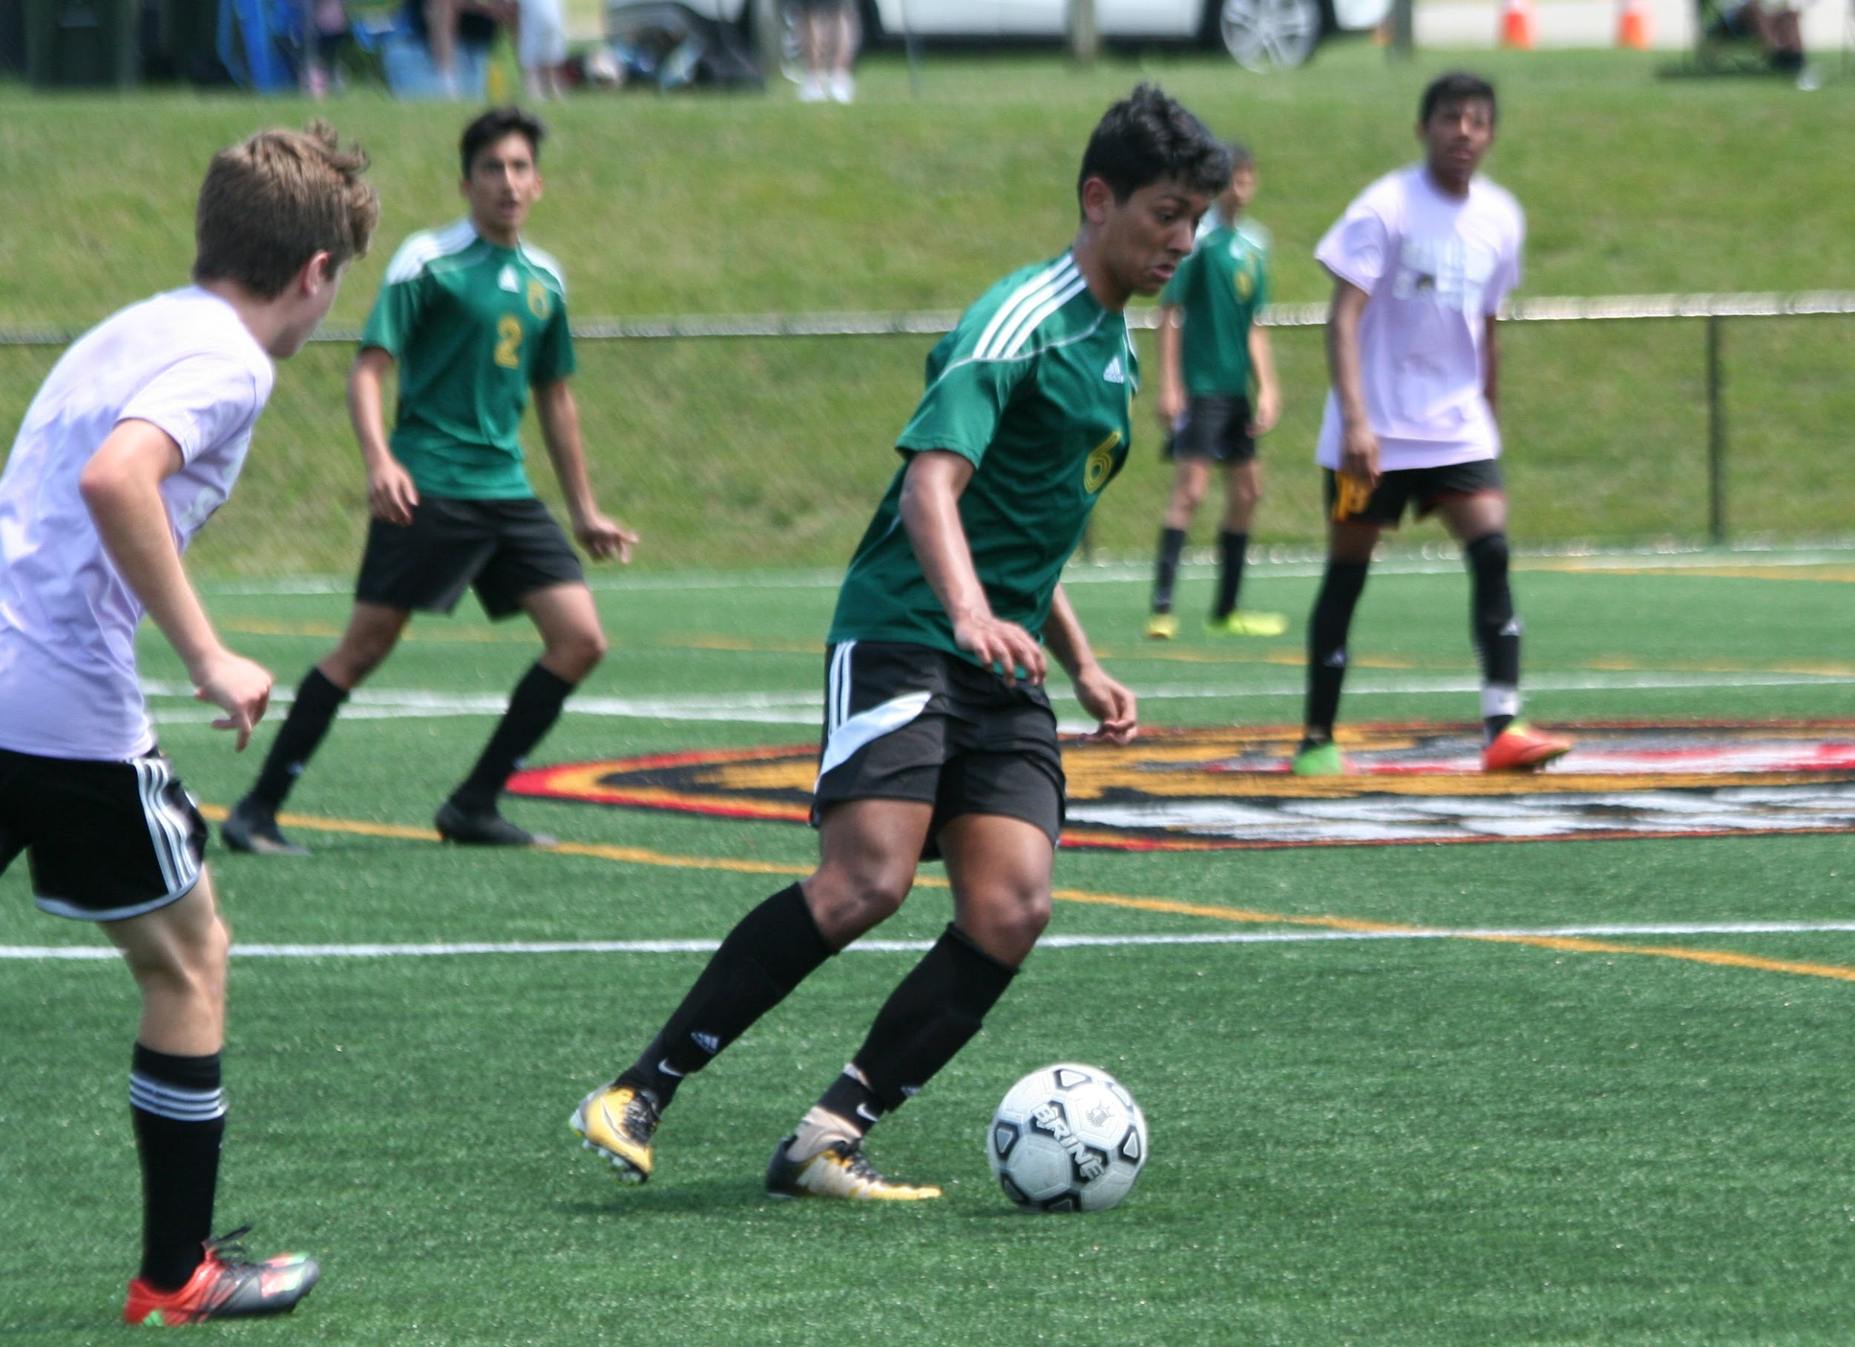
SUMMER TOURNAMANT
Mount Olive Marauder Tournament

Slide 8
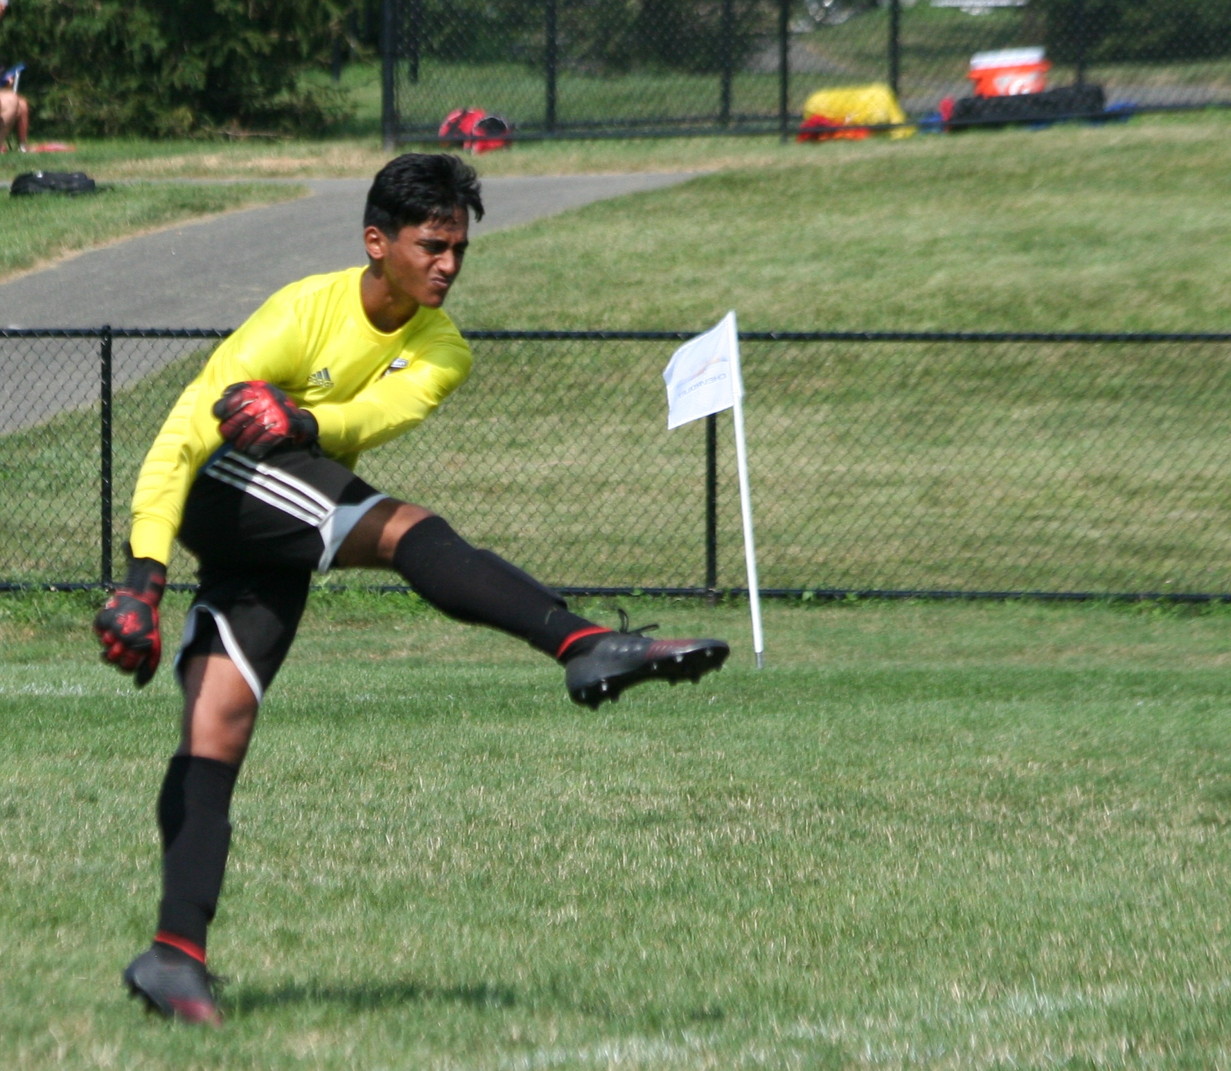
SUMMER TOURNAMANT
Mount Olive Marauder Tournament

Slide 9
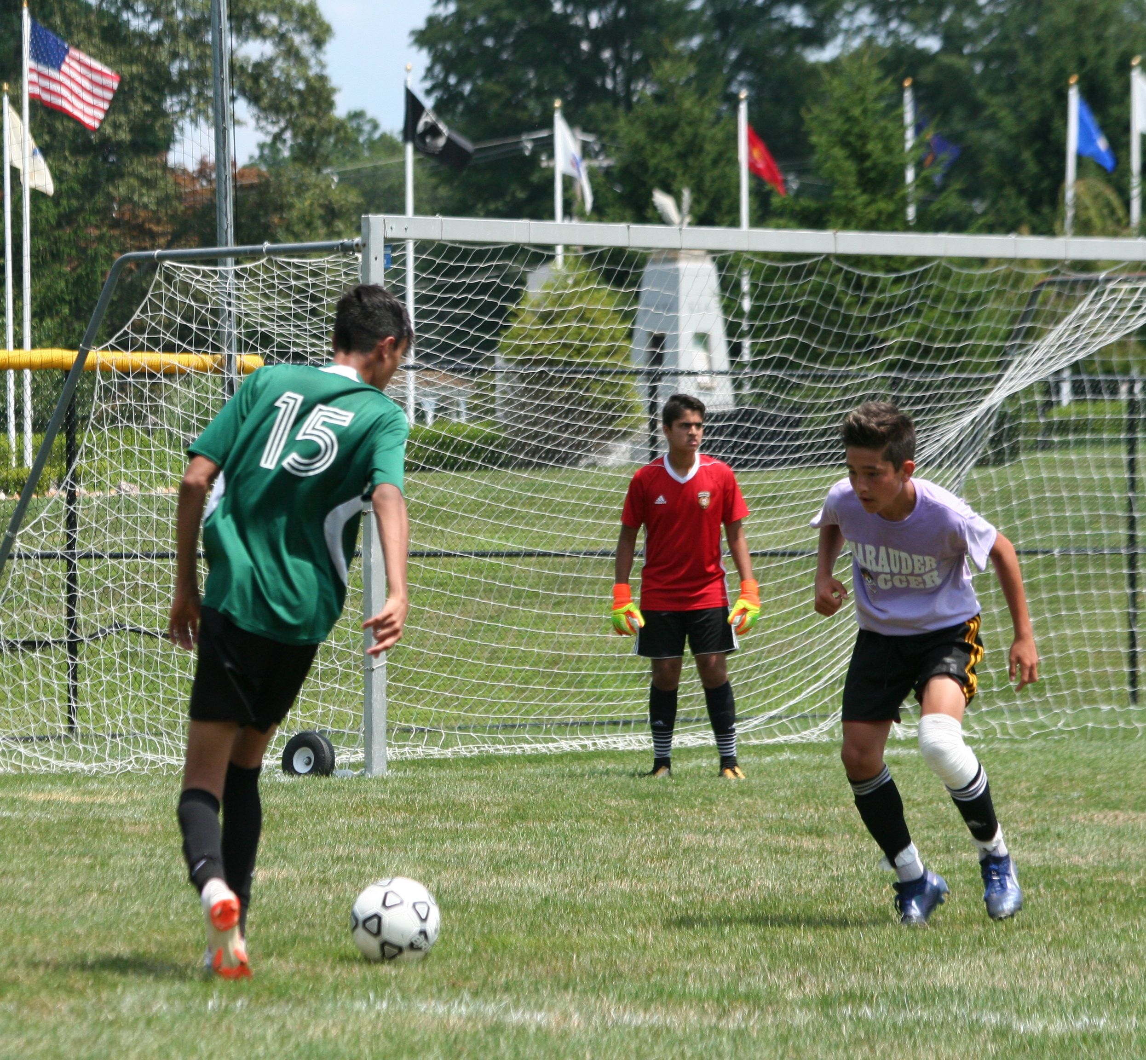
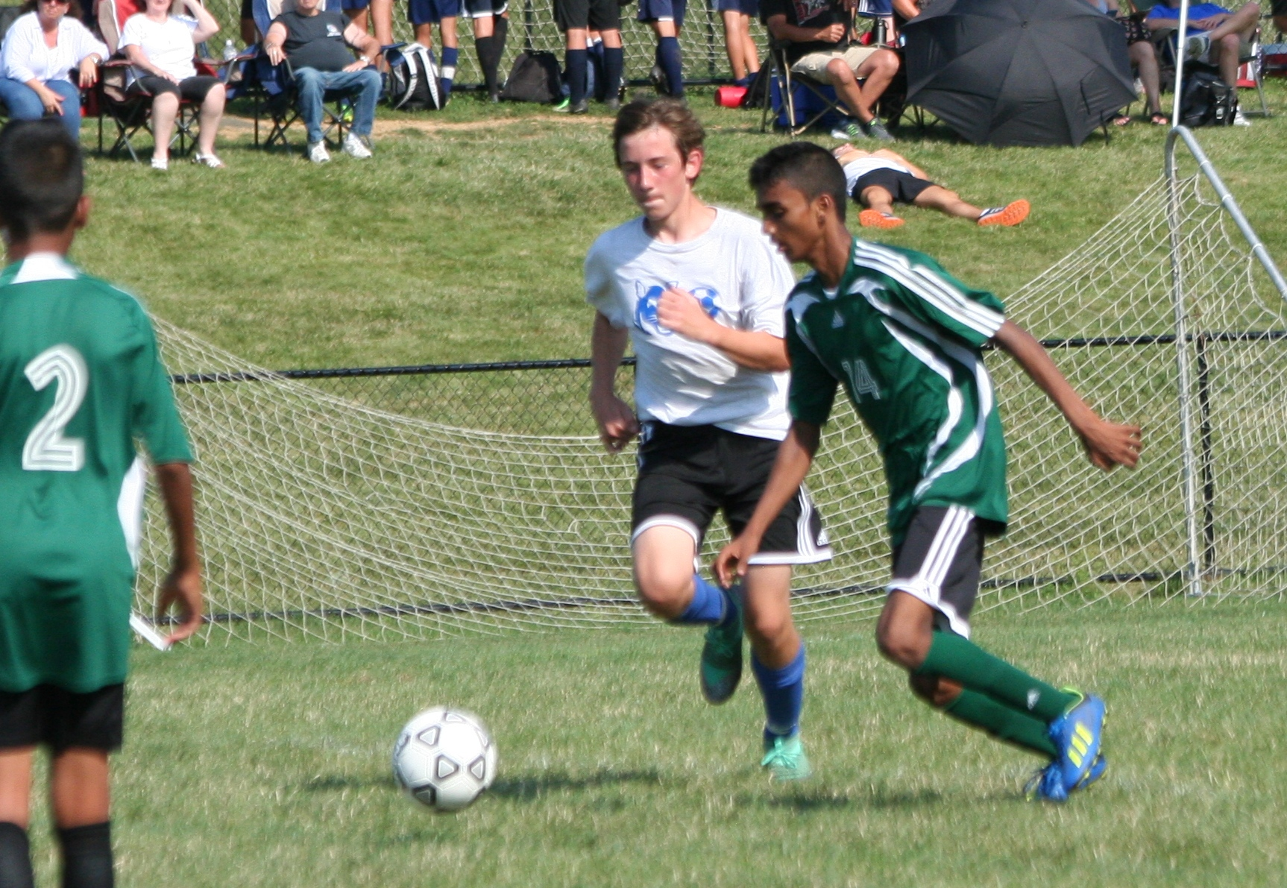
SUMMER TOURNAMANT
Mount Olive Marauder Tournament

Slide 10
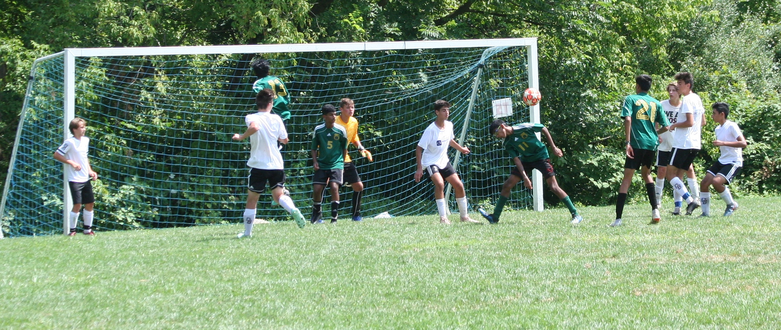
SUMMER TOURNAMANT
Toms River - Kick Off Classic

Slide 11
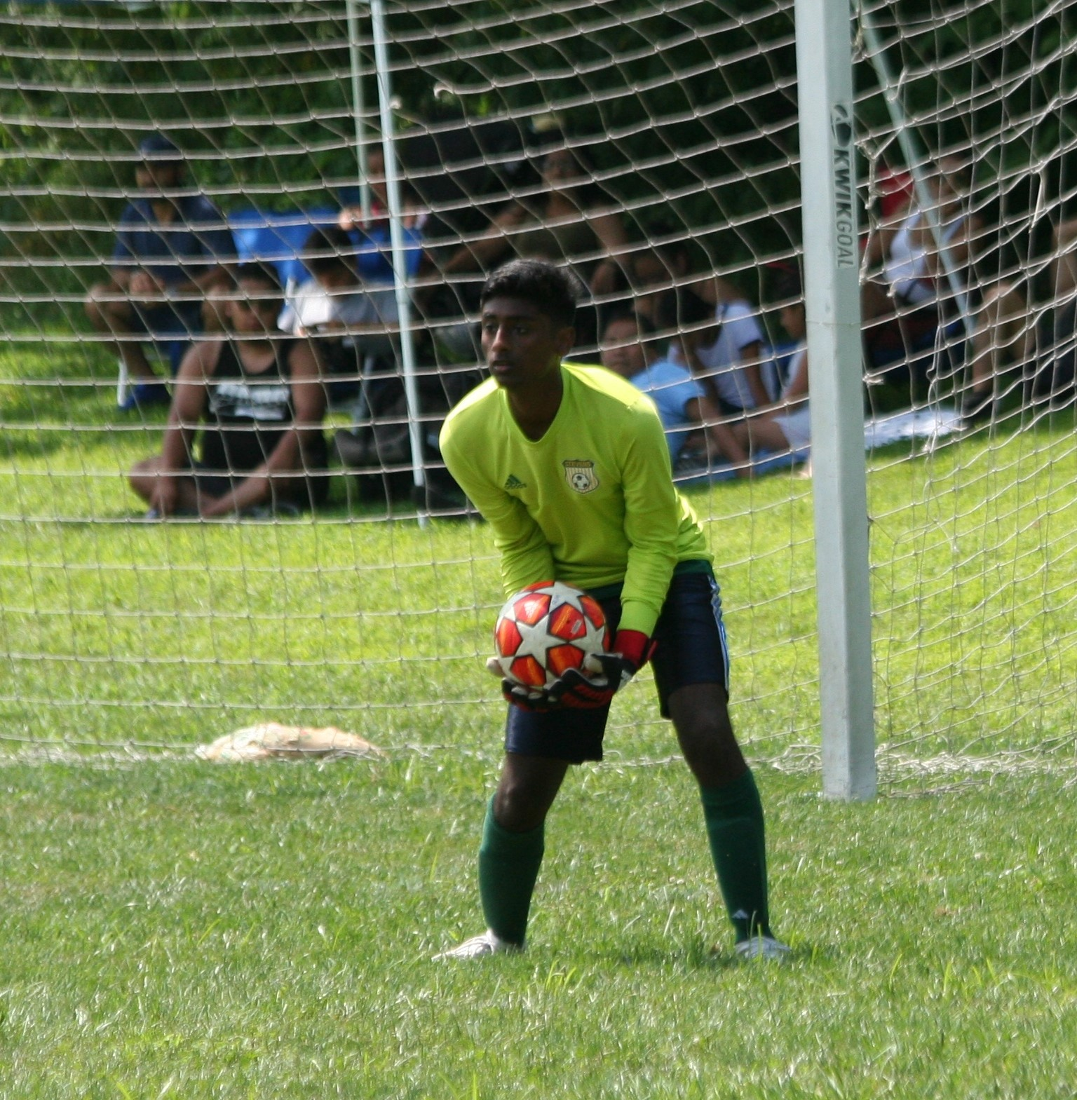
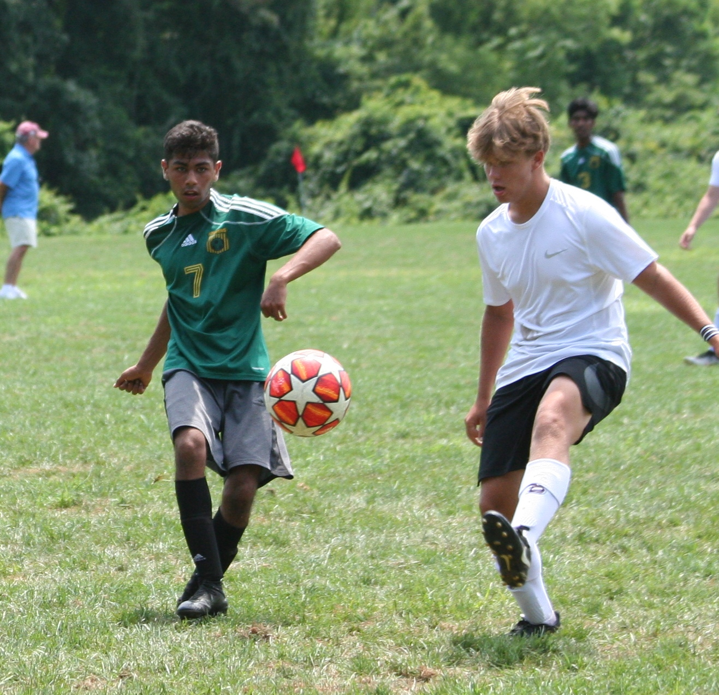
SUMMER TOURNAMANT
Toms River - Kick Off Classic

Slide 12
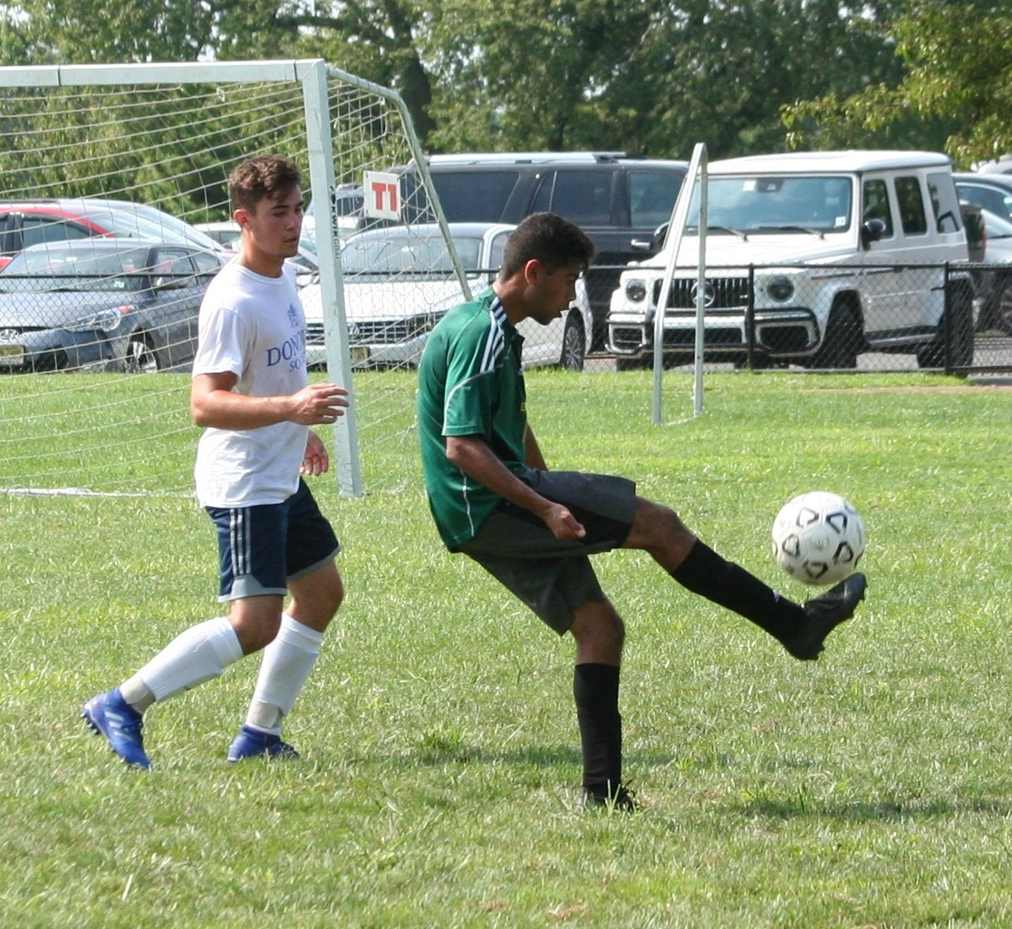
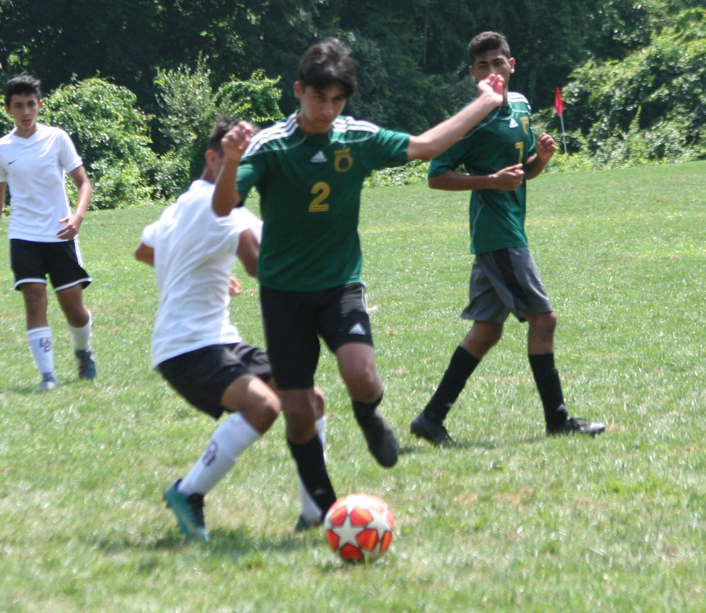
SUMMER TOURNAMANT
Toms River - Kick Off Classic

Slide 13
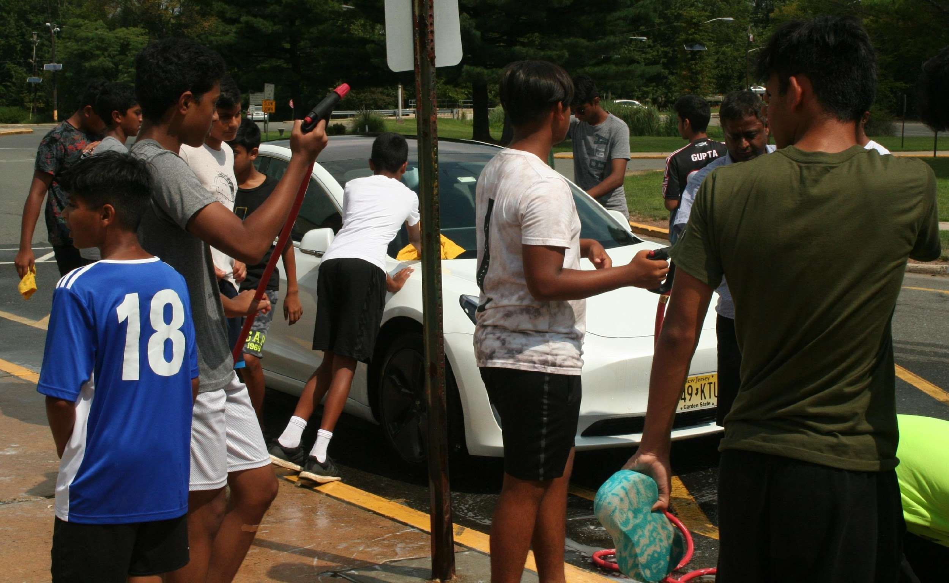
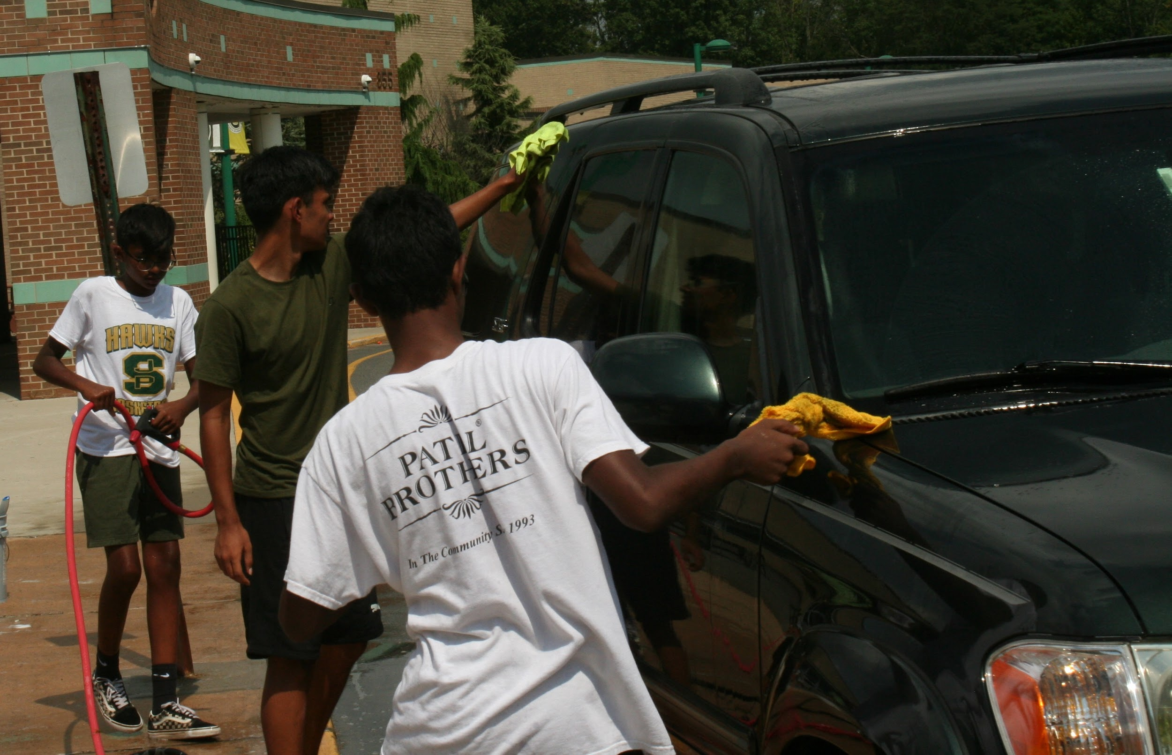
CAR WASH

Slide 14
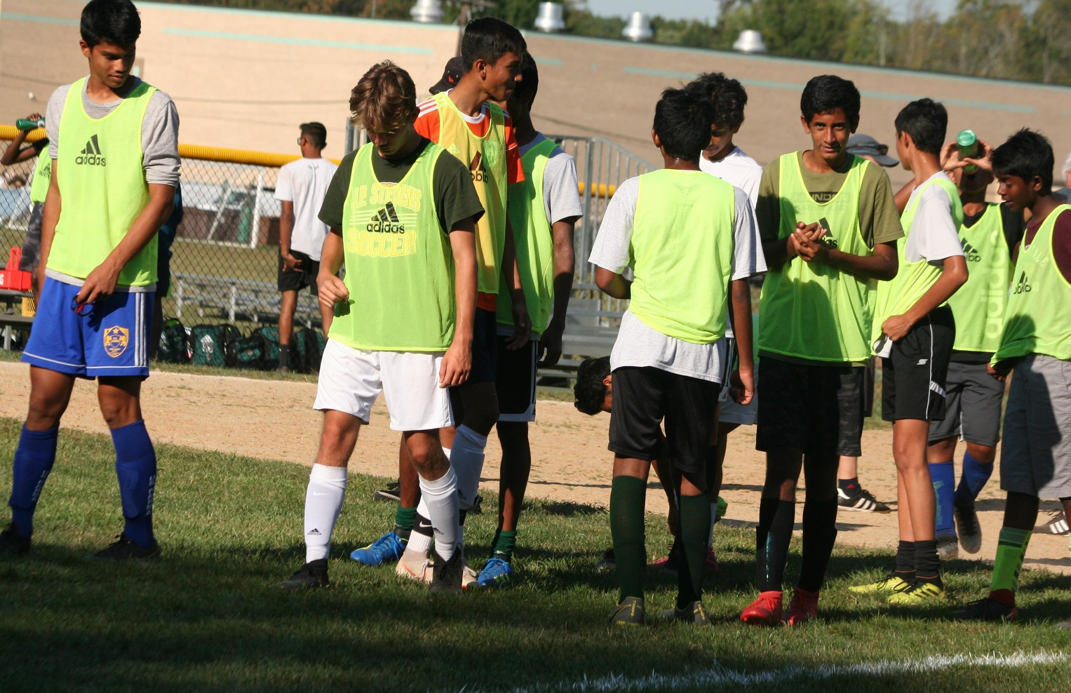
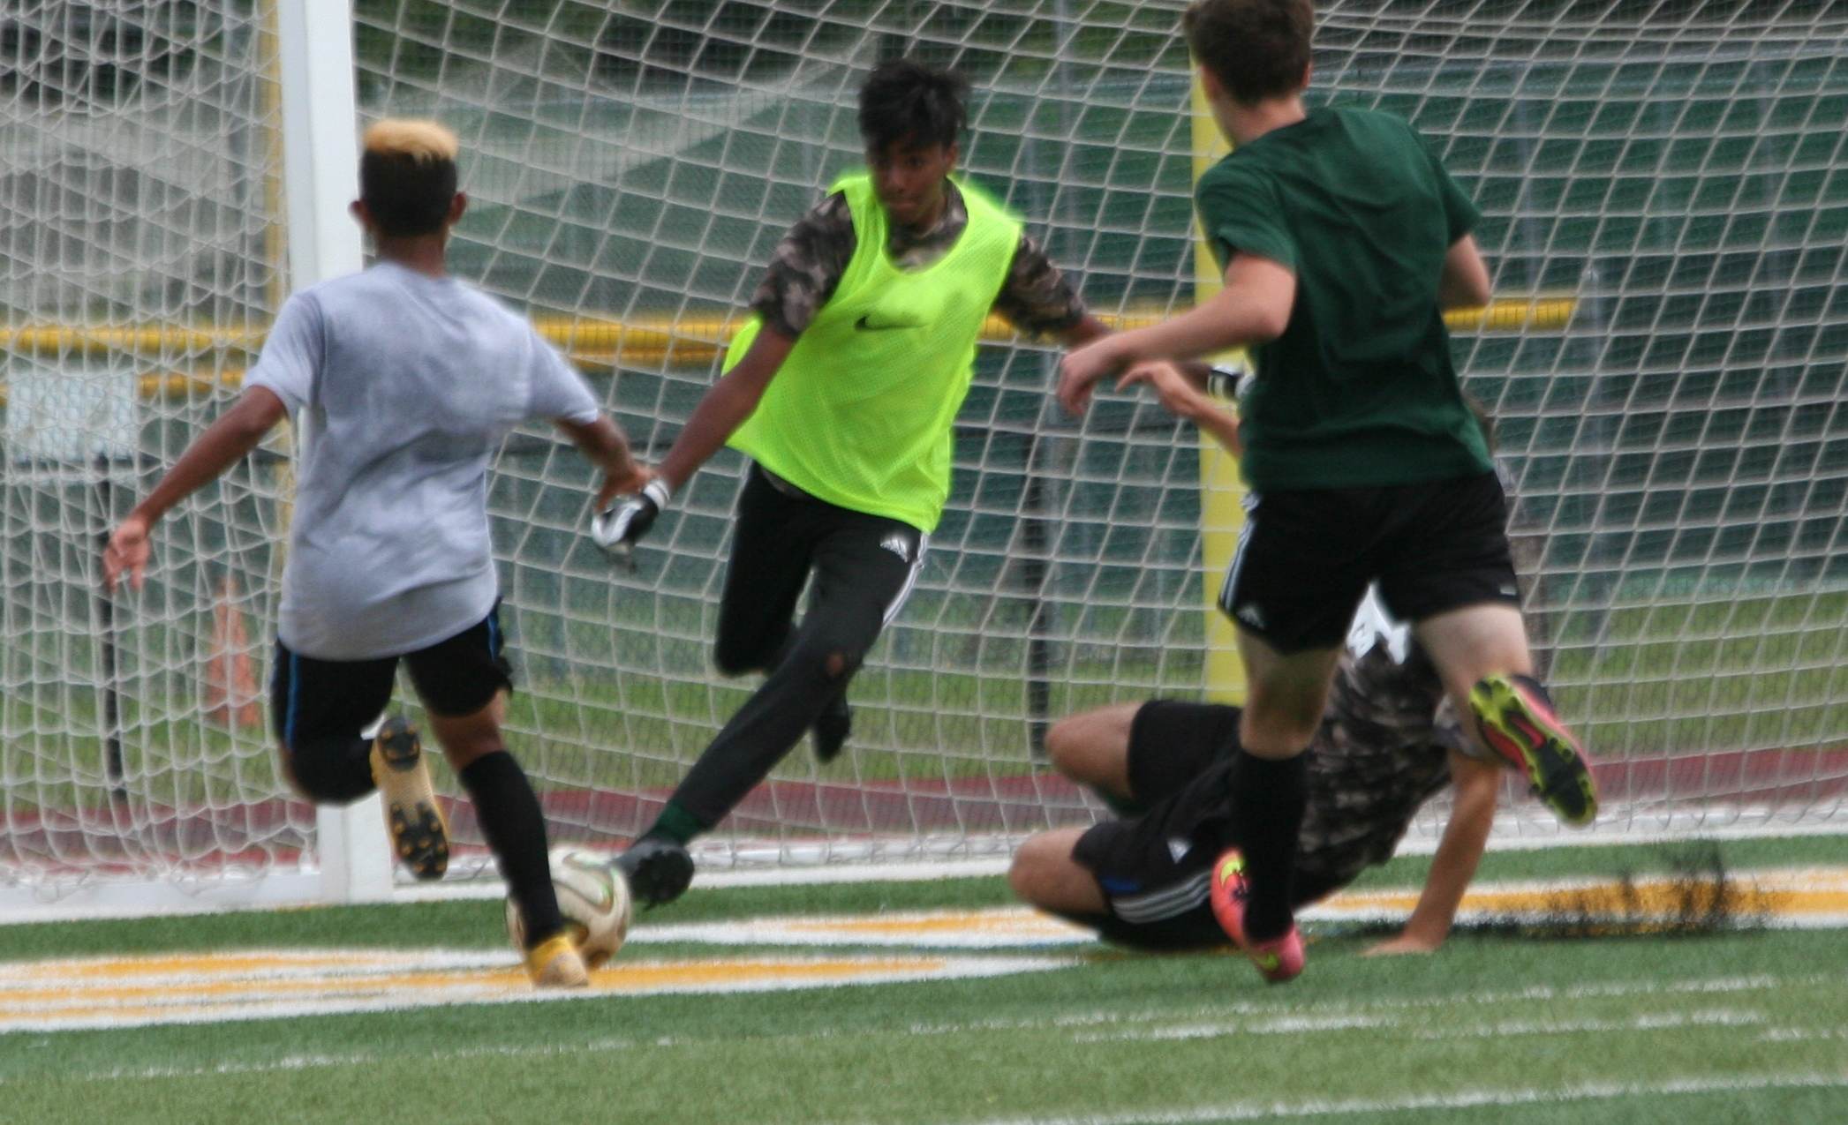
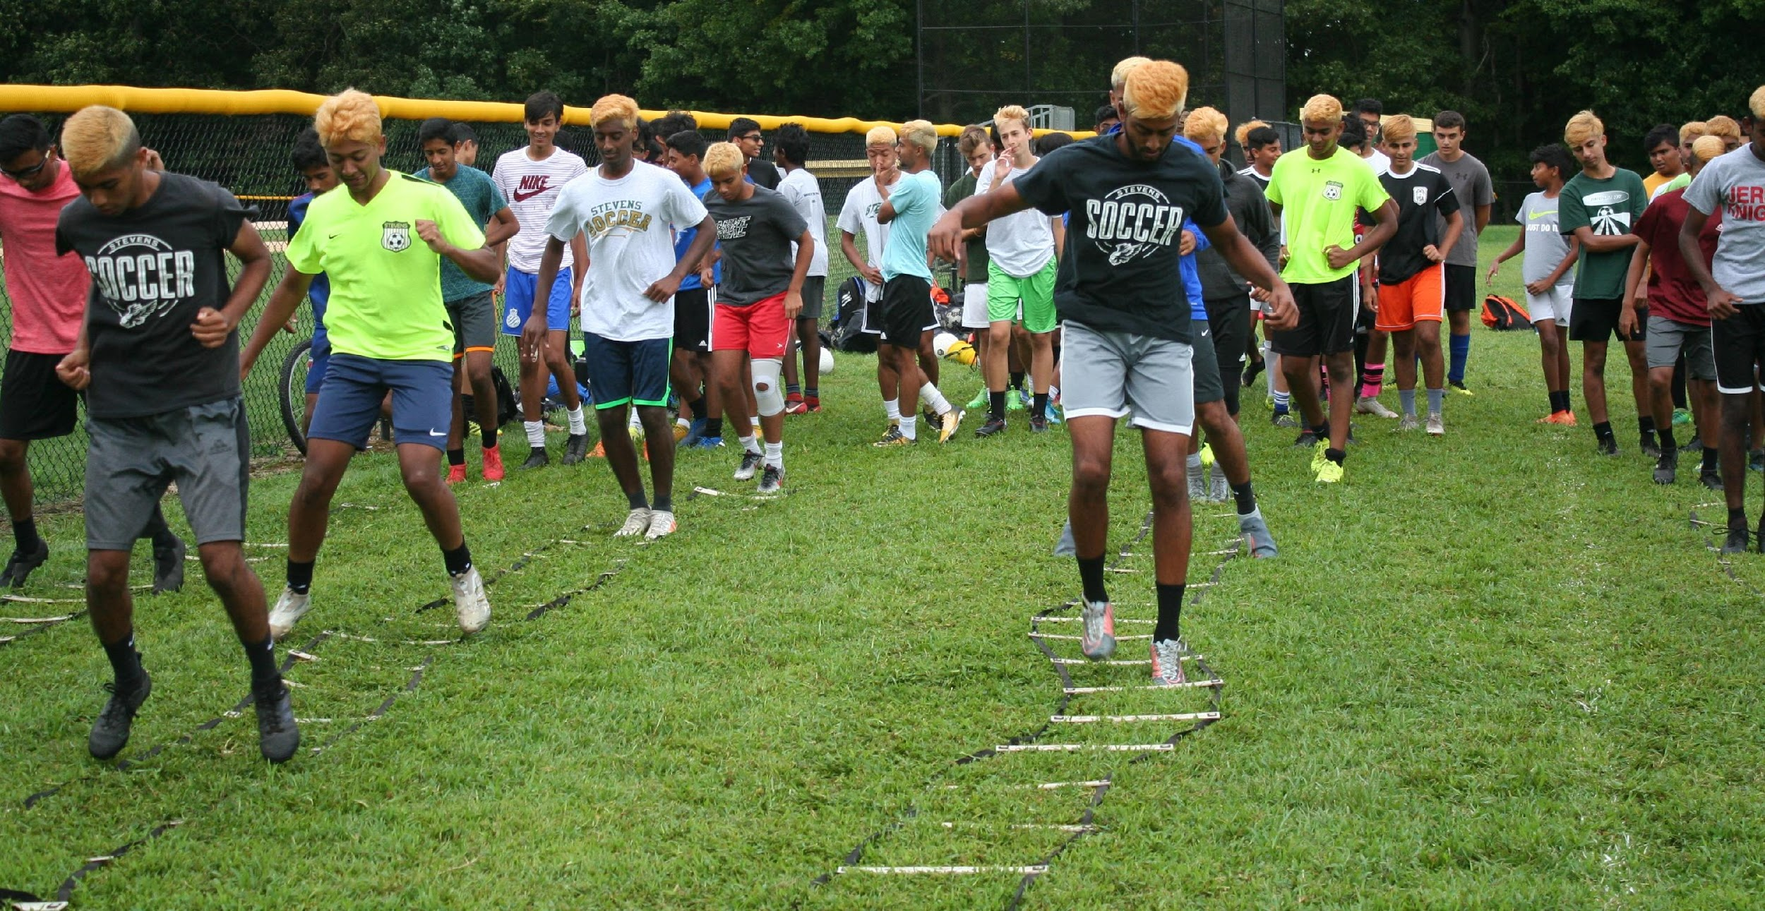
TRAINING AND SCRIMMAGE

Slide 15
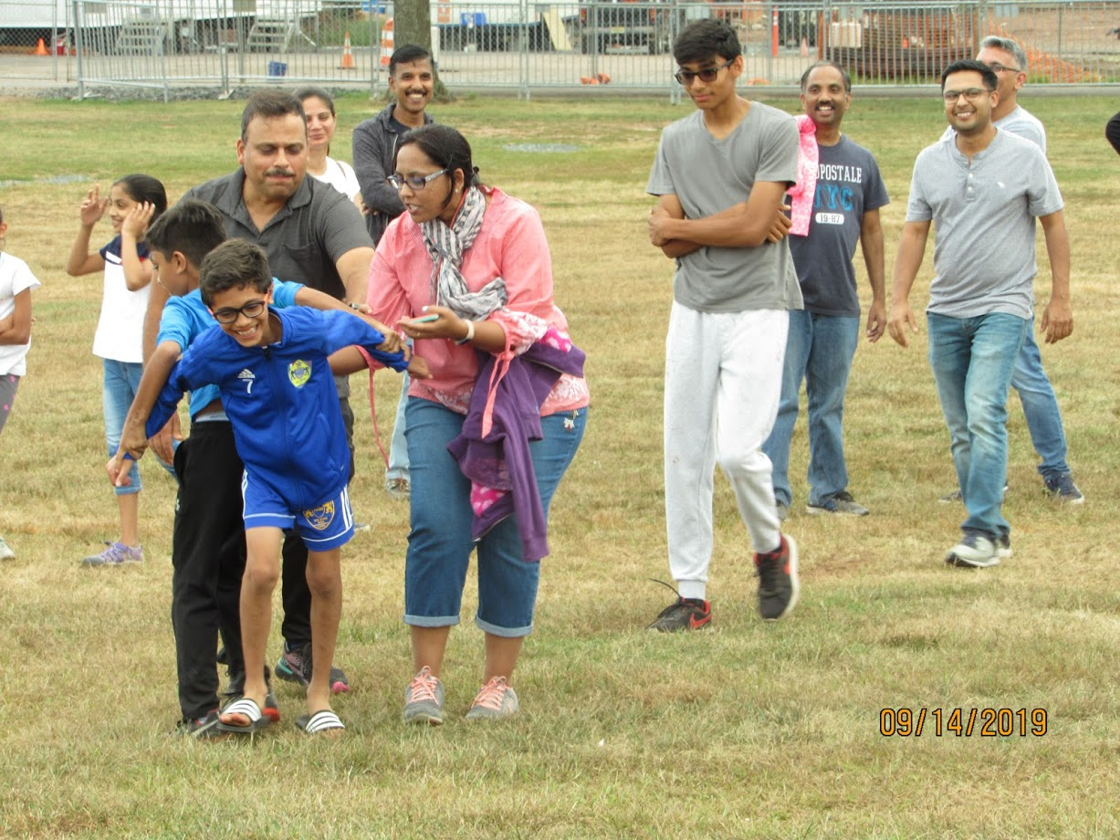
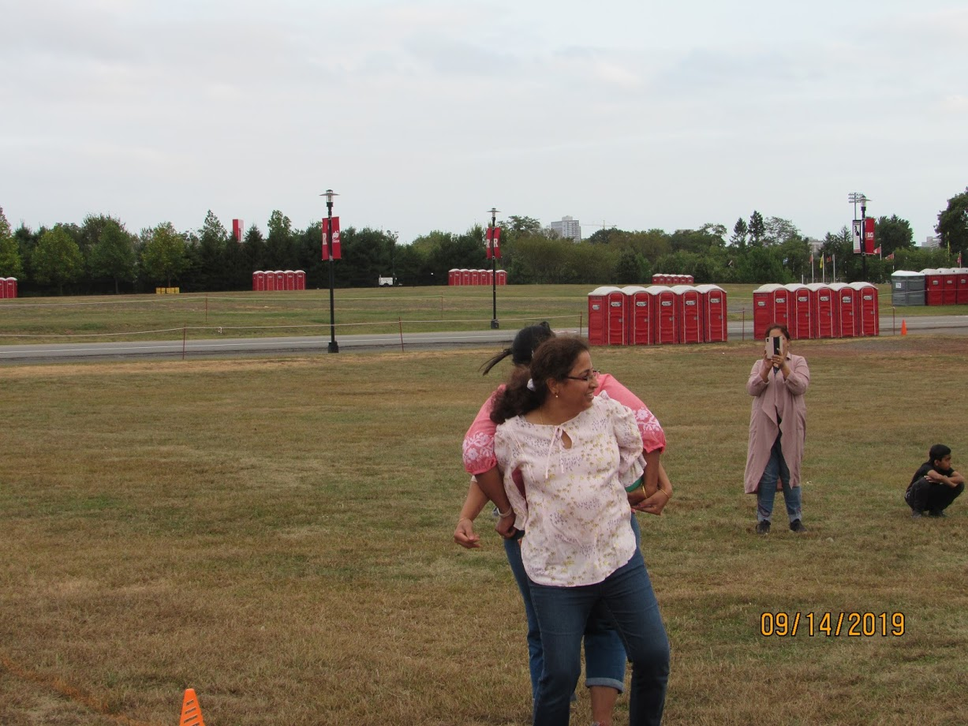
TAILGATING EVENT
RUTGERS GAME- PARENTS

Slide 16
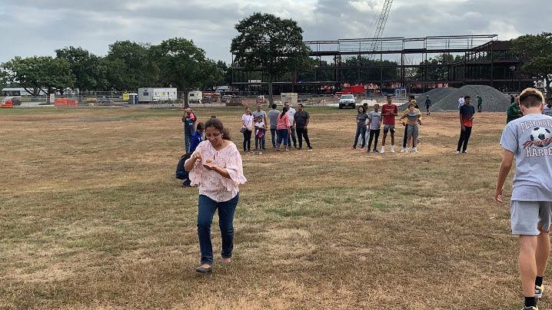
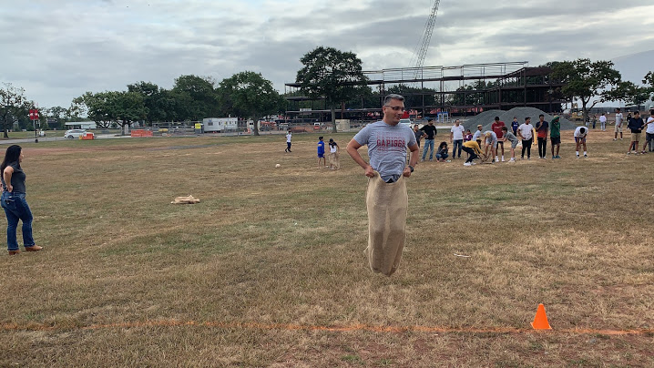
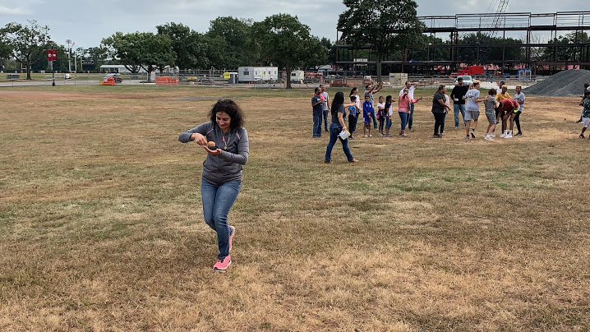
TAILGATING EVENT
RUTGERS GAME- PARENTS

Slide 17
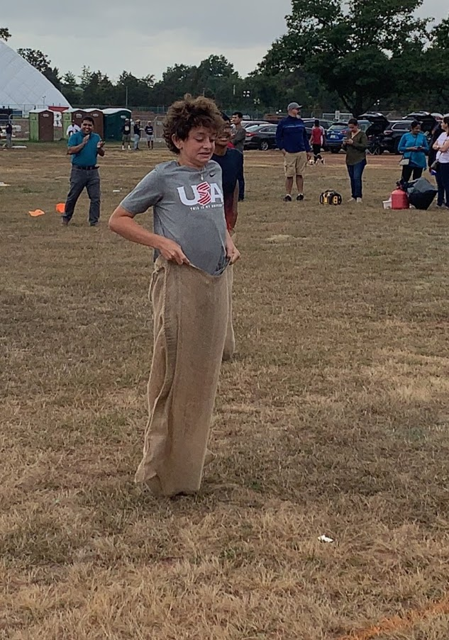
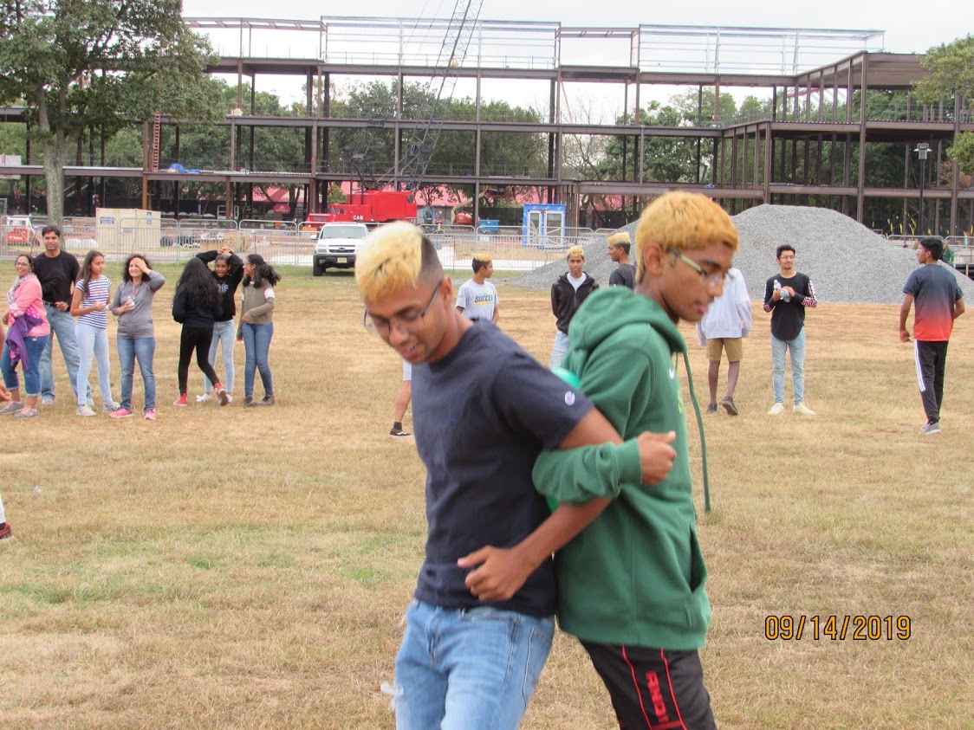
TAILGATING EVENT
RUTGERS GAME- PLAYERS

Slide 18
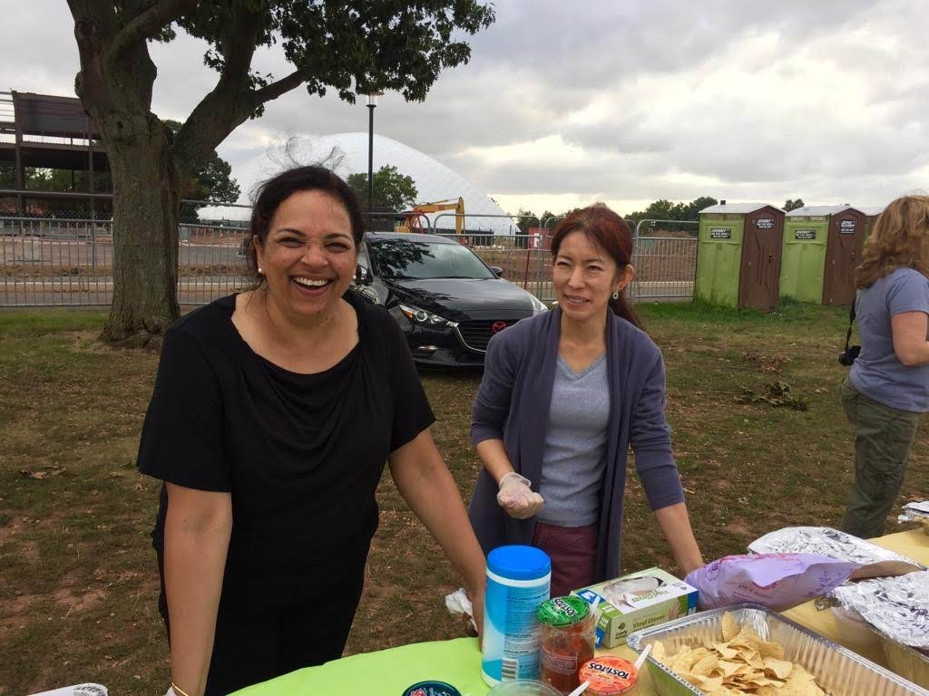
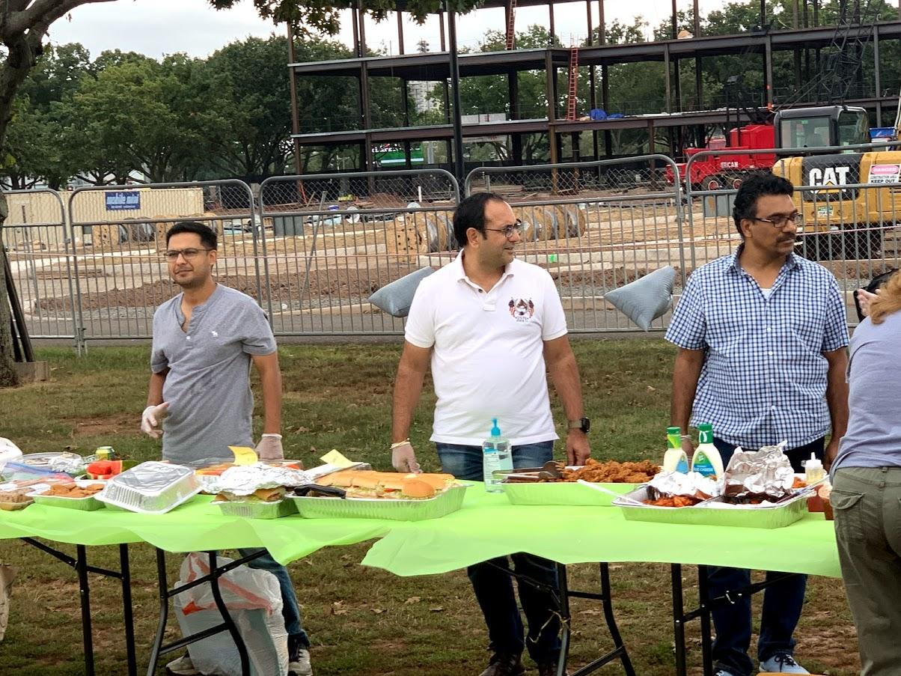
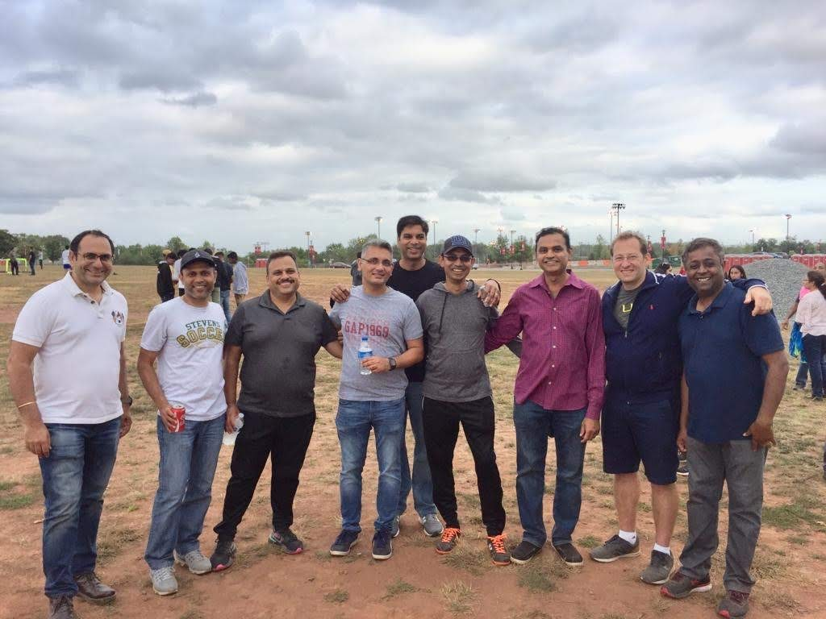
TAILGATING EVENT
RUTGERS GAME- VOLUNTEERS

Slide 19
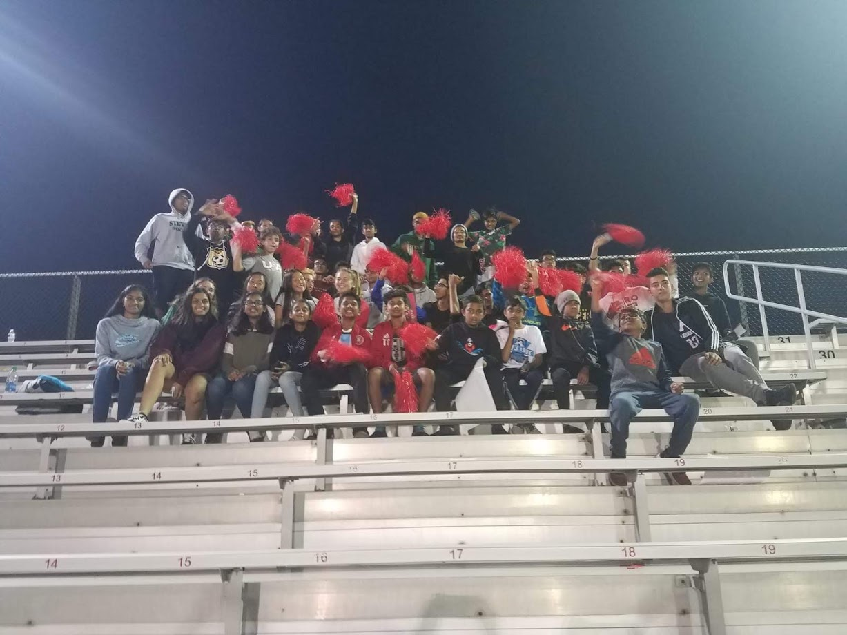
TAILGATING EVENT
RUTGERS GAME- GAMETIME

Slide 20
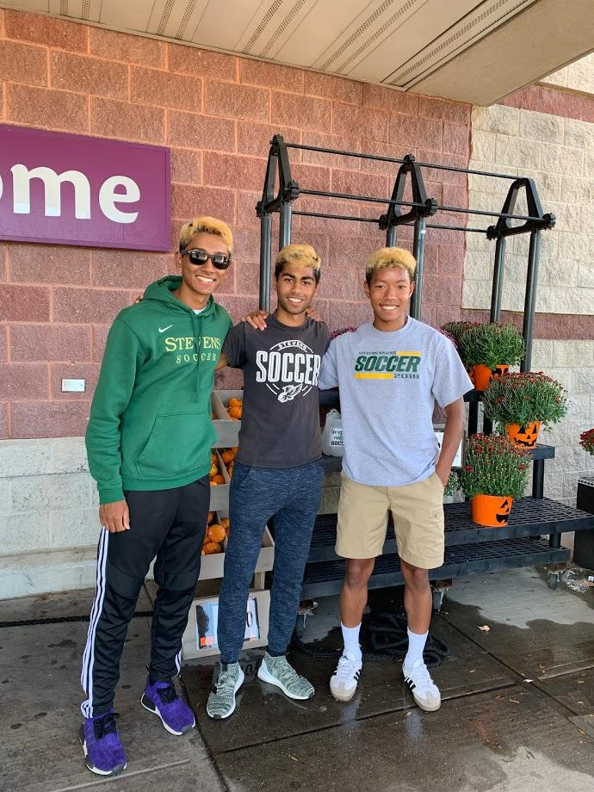
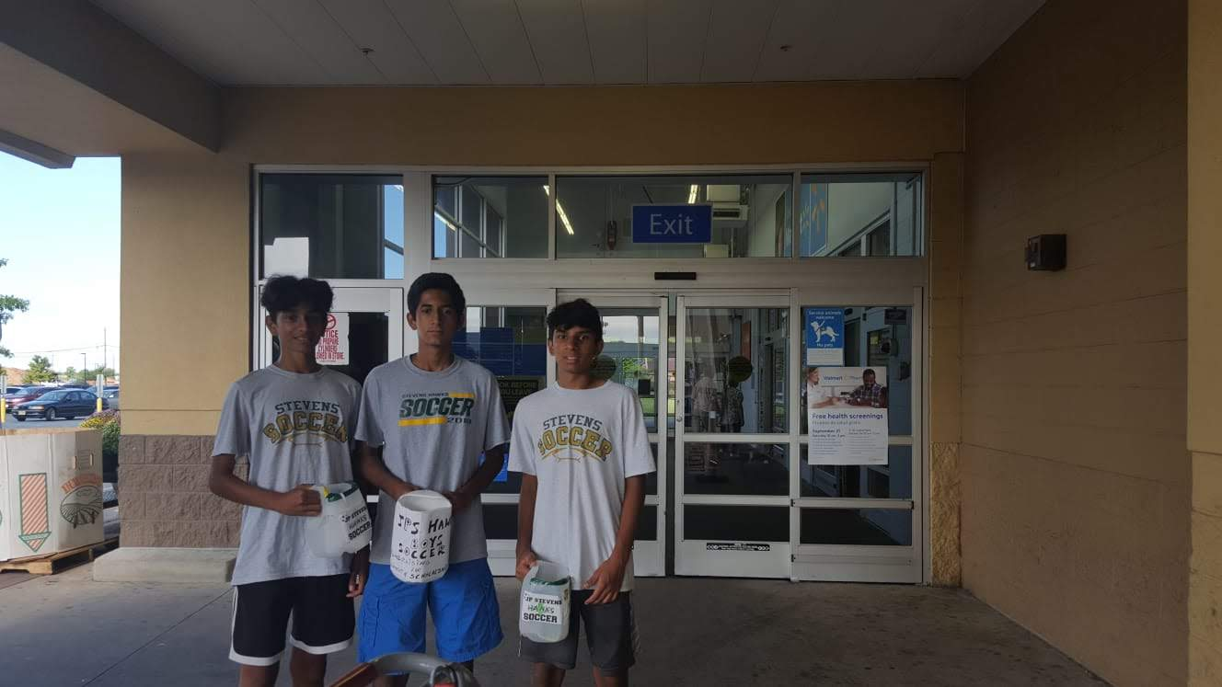
PLAYERS AND PARENTS
CANNING

Slide 21
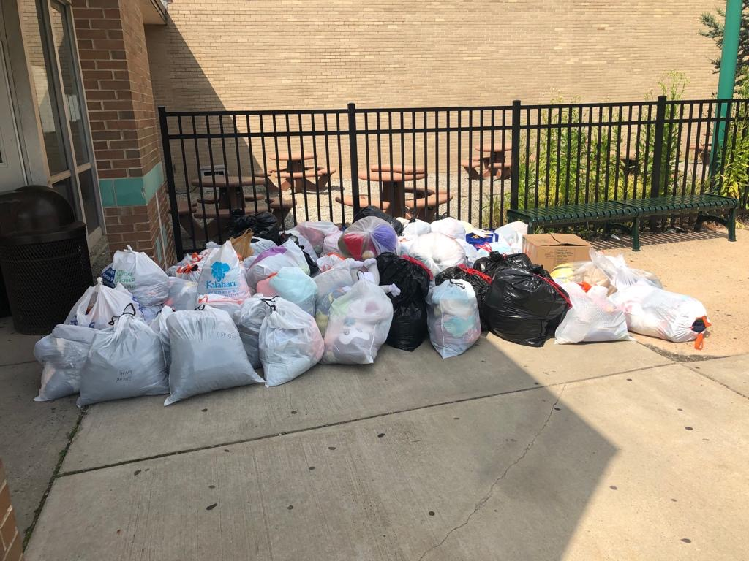
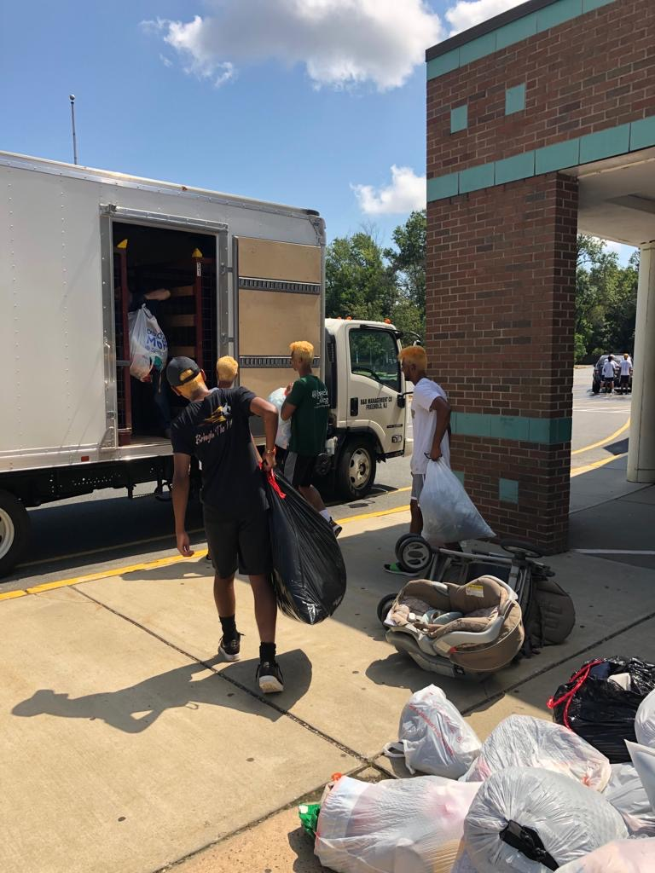
CLOTHING DRIVE

Slide 22


Slide 23
FRESHMAN PLAYERS
Captain
Agrim Chopra
Aditya Rawat
Aadarsh Balaji
Adarsh Manna
Ameya Patil
Anirudh Guduru
Arnav Sehgal
Aryan Gupta
Aryan Nair
Ayman Hasan
Balan Selya
Daksh Goyal
Daniel Iype
Dhruv Dodda
Jack Dotoli
Kanaad Vaidya
Nikhil Srinivas
Nishanth Justin
Pramit Samanta
Sairam Ande
Vihaan Salian
Zachary Mokrauer

Slide 24
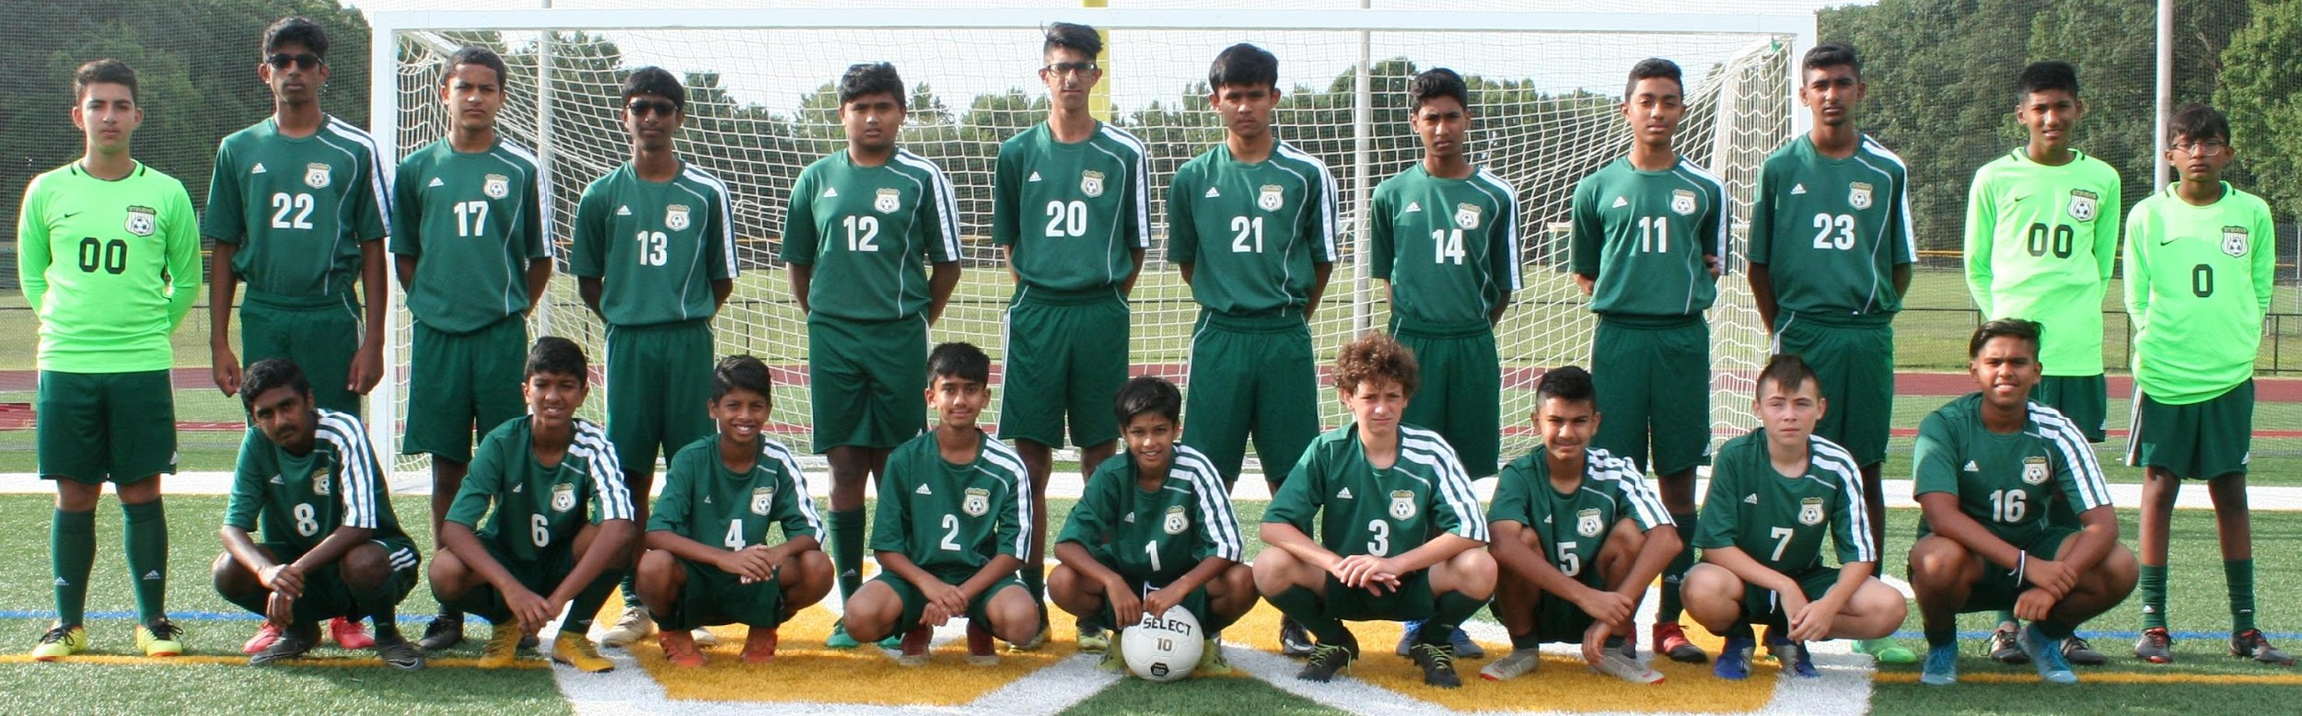
Title
Text

Slide 25
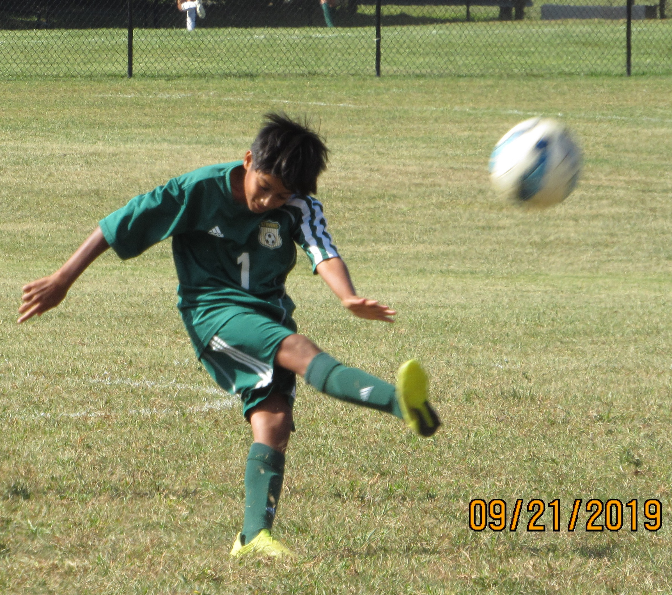
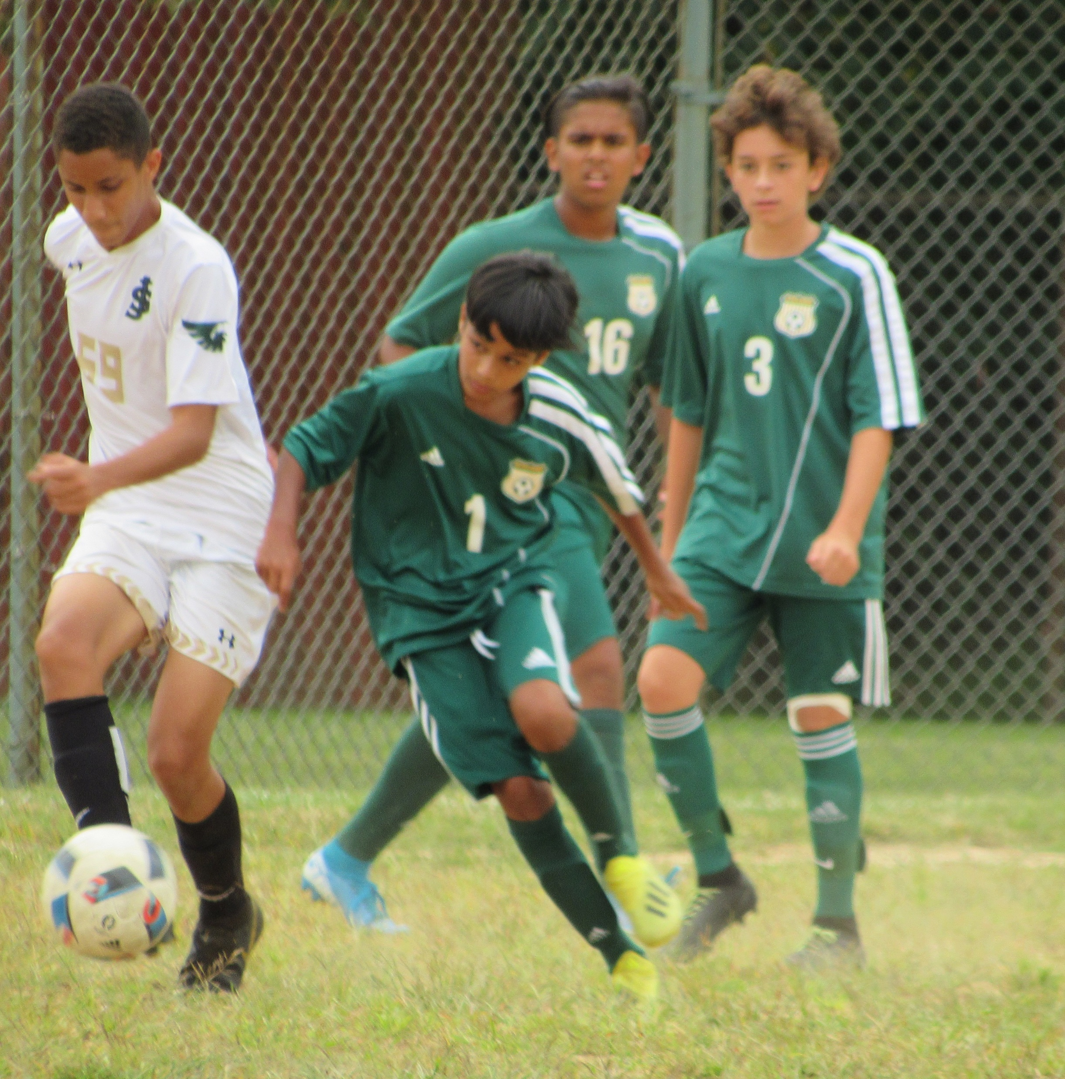
FRESHMAN GAMES

Slide 26
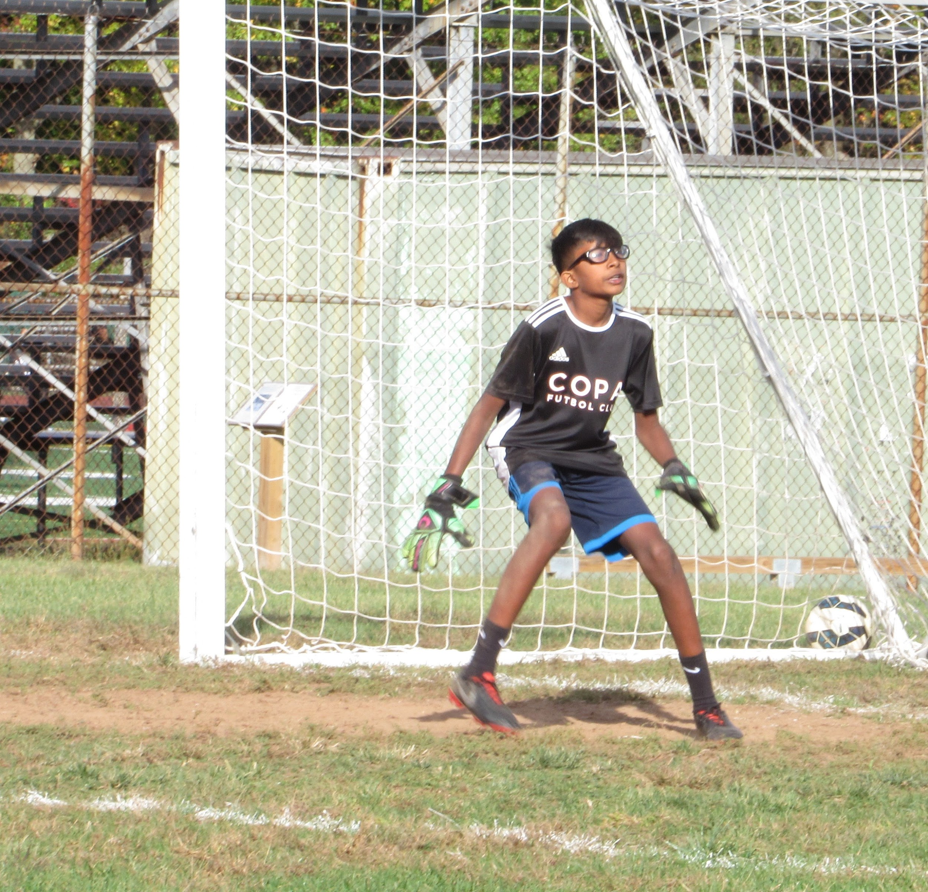
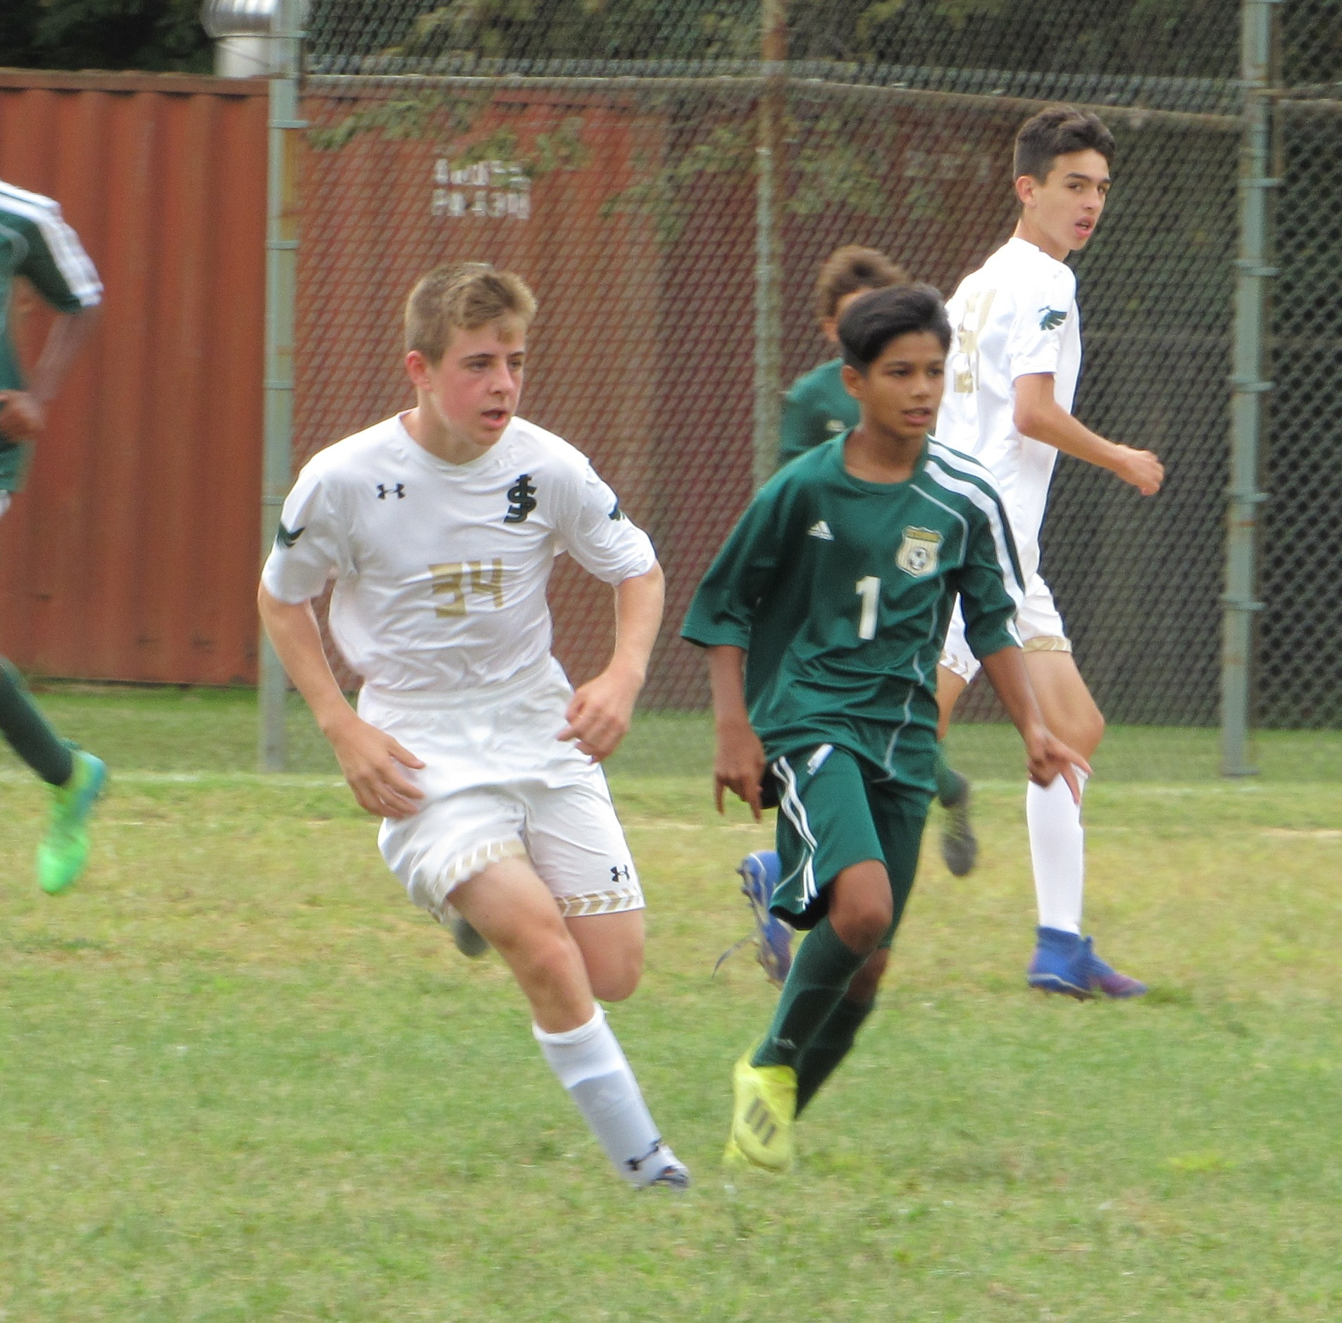
FRESHMAN GAMES

Slide 27
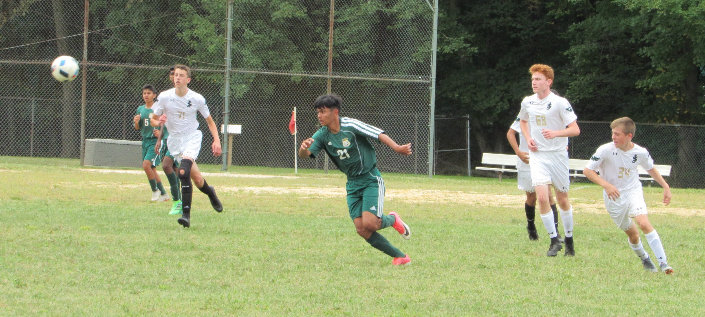
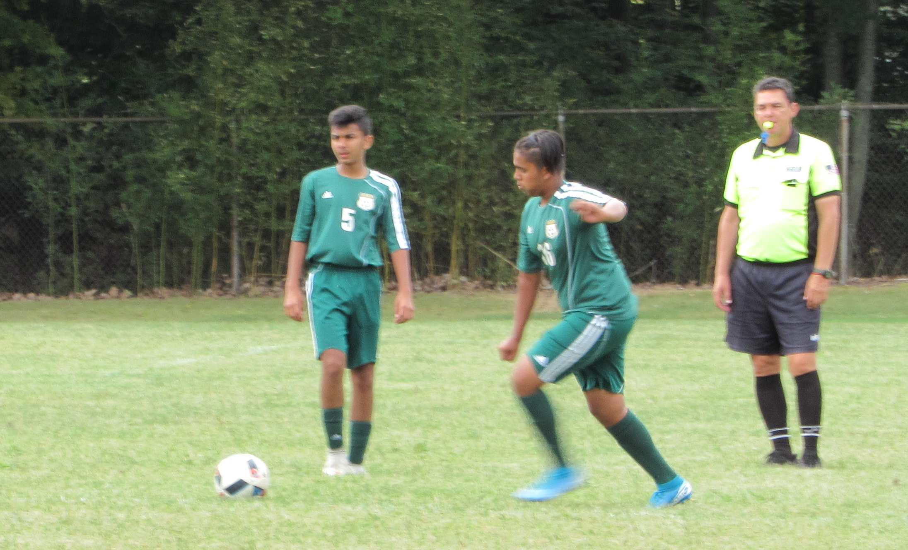
FRESHMAN GAMES

Slide 28
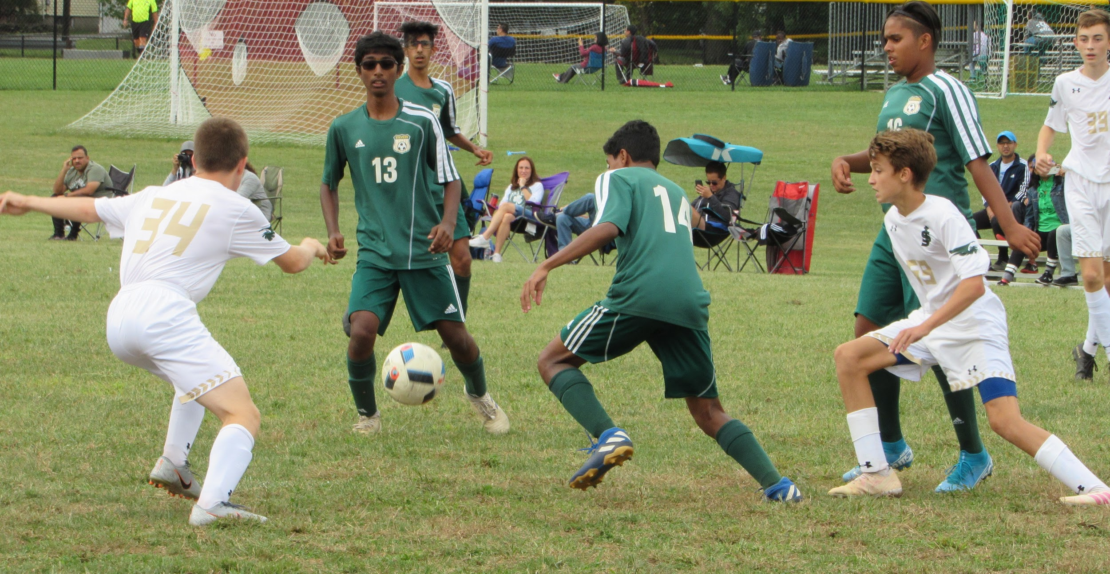
FRESHMAN GAMES

Slide 29
FRESHMAN GAMES
“Coming together is a beginning.
Keeping together is progress.
Working together is success.”
Henry Ford

Slide 30
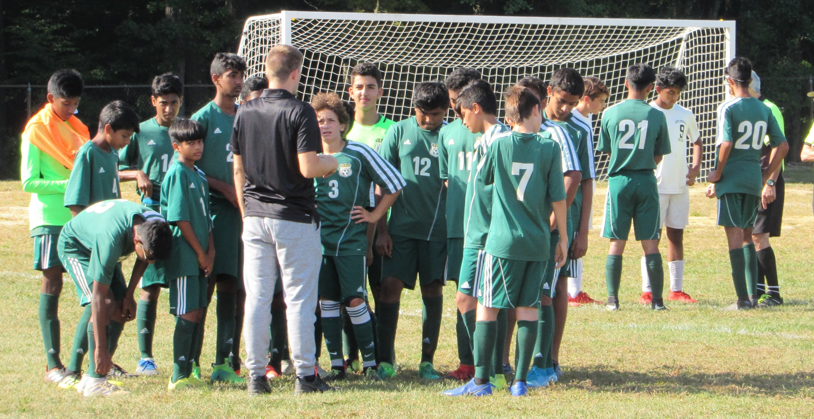
FRESHMAN GAMES

Slide 31


Slide 32
JUNIOR VARSITY PLAYERS
CAPTAIN
Aakash Tummala
Vishwesh Sivabada
Aarav Joshi
Aashish Pandya
Adam D'Souza
Adrian D'Souza
Andrew Medovoy
Anshul Natakala
Aravind Kandasamy
Armaan Ghotra
Aryan Sharma`
Daniel Moraes
Debarshi Dey
Dennis Babynyuk
Divyaman Patel
Jai Bhagia
Krish Raval
Paul Tynkov
Shreyas Basu
Sri Giri

Slide 33
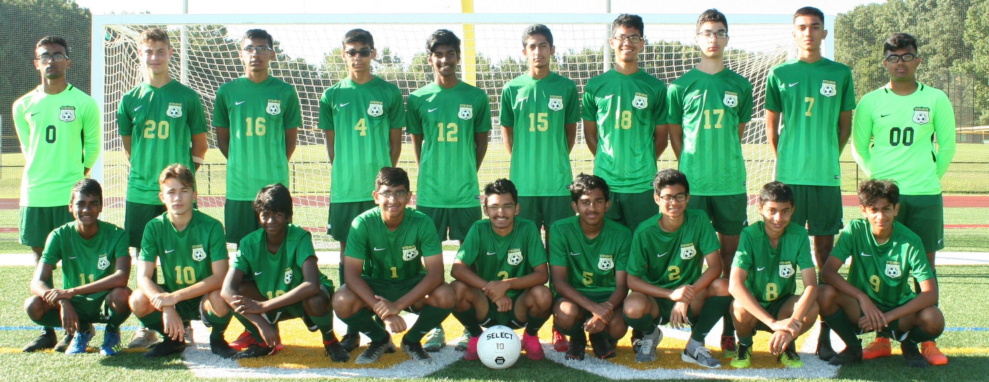
Title
Text

Slide 34
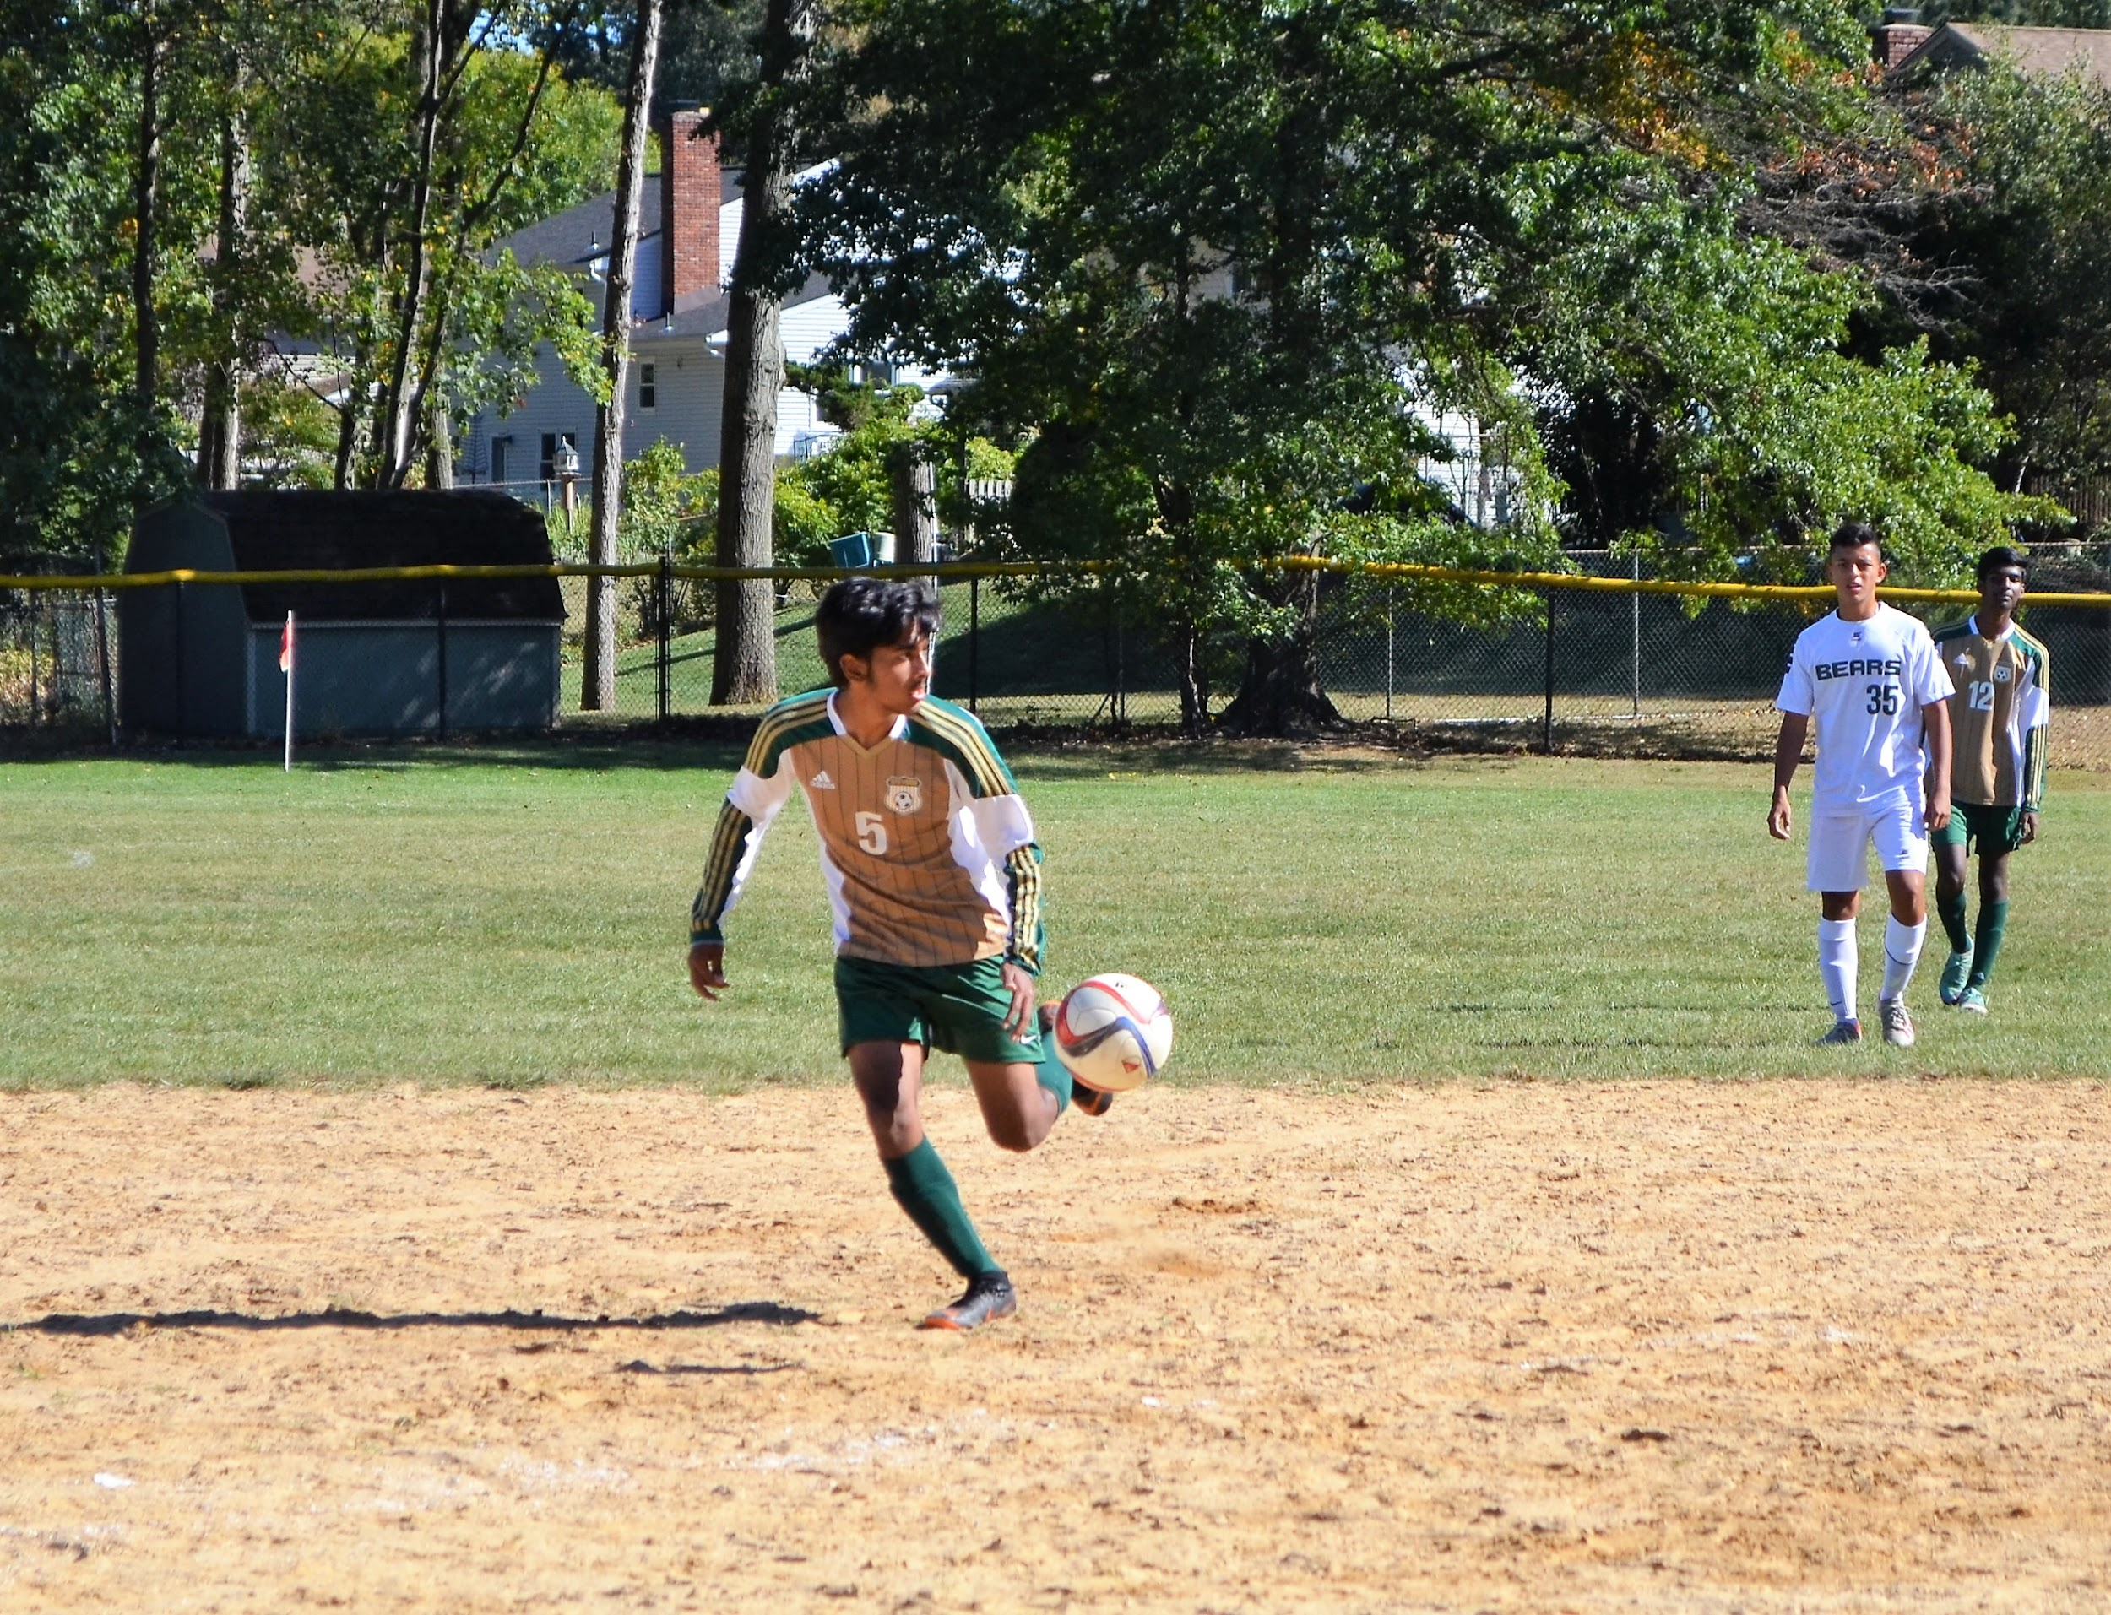
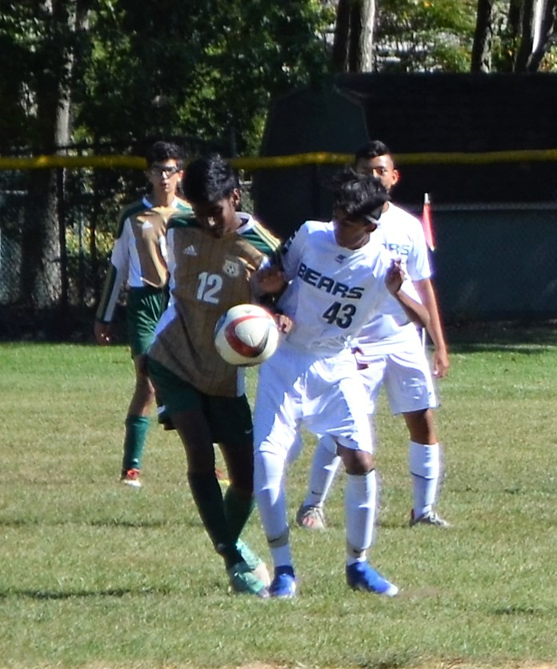
JUNIOR VARSITY GAMES

Slide 35


JUNIOR VARSITY GAMES

Slide 36


Slide 37
VARSITY PLAYERS
CAPTAIN
Aniket Narkhede
Anish Mallavarapu
Aayush Narula
Ajit Mallavarapu
Anish Gayam
Devam Patel
Jakob Virizlay
Keita McFarlane
Matej Virizlay
Nizam Sayed
Pranav Chanthan
Rahul Badiani
Rikhil Badiani
Rishvant Tummala
Ryan Casey
Sahil Kakkad
Siddharth Tangri
Soham Chaudhuri
Soham Kulkarni
Sukhbir Ghotra
Viraaj Kumar
Vishal Sriram

Slide 38

Title
Text

Slide 39


VARSITY GAMES

Slide 40


VARSITY GAMES

Slide 41


VARSITY GAMES

Slide 42


VARSITY GAMES

Slide 43


VARSITY GAMES

Slide 44

VARSITY GAMES

Slide 45


VARSITY GAMES

Slide 46



VARSITY GAMES

Slide 47


VARSITY GAMES

Slide 48


VARSITY GAMES

Slide 49



VARSITY GAMES

Slide 50

SENIOR - VARSITY CAPTAIN
ANIKET NARKHEDE

Slide 51

SENIOR - VARSITY CAPTAIN

Slide 52
SENIOR - VARSITY CAPTAIN
ANISH MALLAVARAPU

Slide 53
SENIOR - VARSITY CAPTAIN

Slide 54
SENIOR VARSITY
AYUSH NARULA

Slide 55


SENIOR VARSITY

Slide 56
SENIOR VARSITY
SUKHBIR GHOTRA

Slide 57

VARSITY TEAM

Slide 58
SENIOR VARSITY
DEVAM PATEL

Slide 59

SENIOR VARSITY

Slide 60
SENIOR VARSITY
JAKOB VRIZLAY

Slide 61

SENIOR VARSITY

Slide 62
SENIOR VARSITY
KEITA MCFARLANE

Slide 63
SENIOR VARSITY

Slide 64
SENIOR VARSITY
RISHVANT TUMMALA

Slide 65


SENIOR VARSITY

Slide 66
SENIOR VARSITY
RYAN CASEY

Slide 67

SENIOR VARSITY

Slide 68
SENIOR VARSITY
VIRAAJ KUMAR

Slide 69
SENIOR VARSITY

Slide 70
EUSA TRAINING

Slide 71
EUSA TRAINING

Slide 72
SENIOR NIGHT

Slide 73
Snack Bar

Slide 74
BOARD MEMBERS
President Vice Presdient
Sourish Chaudhuri Divyesh Joshi
Badiani, Sangita- Treasurer
Bhagia, Jignya- Banquet
Giri, Venu- Snack Bar
Johnstone, Olivia- Clothing Drive
Natakala, Sravan Kumar- Snack Bar
Pham, Linda- Tailgate
Sivabada, Sentha- Canning
McFarlane, Kaori- Candy Sale
Dotoli, Darcey- Candy Sale
Pakhi Singh- Apparel Order

Slide 75
COACHES
Coach Zachary Sieczkowski
Freshman Team
Coach Joseph Cashin
Junior Varsity Team
Assistant Coach Chris O’Brien
Varsity Team
Coach William McMullen
Varsity Team

Slide 76

VARSITY GAMES

Slide 77


THANK YOU ALL COACHES, PARENTS, FAMILY, FRIENDS AND PLAYERS FOR A GREAT 2019 JPS SOCCER BOYS HAWK SEASON.
THANK YOU ALL BOARD MEMBERS AND VOLUNTEER PARENTS FOR MAKING SUCH A EXCITING 2019 SEASON FOR ALL.

