Slide 1
Rotational Motion
If you ride near the outside of a merry-go-round, do you go faster or slower than if you ride near the middle?
It depends on whether “faster” means
a faster linear speed (= speed), ie more distance covered per second,
or
- a faster rotational speed (=angular speed, ω), i.e. more rotations or revolutions per second.
The linear speed of a rotating object is greater on the outside, further from the axis (center), but the rotational speed is the same for any point on the object – all parts make the same # of rotations in the same time interval.

Slide 2
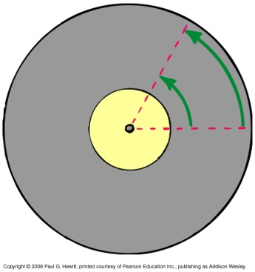
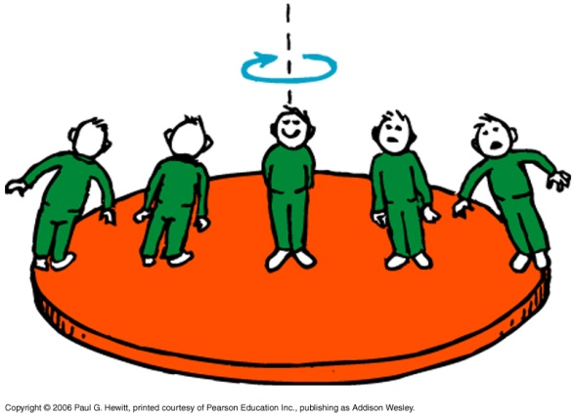
More on rotational vs tangential speed
For motion in a circle, linear speed is often called tangential speed
  The faster the ω, the faster the v in the same way (e.g. merry-go-round), i.e. v ~ ω.
  − ω doesn’t depend on where you are on the merry-go-round, but v does: i.e. v ~ r
directly proportional to
He’s got twice the linear speed than this guy.
Same RPM (ω) for all these people, but different tangential speeds.

Slide 3
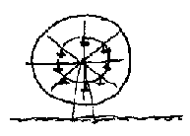
Clicker Question
A carnival has a Ferris wheel where the seats are located halfway between the center and outside rim. Compared with a Ferris wheel with seats on the outside rim, your angular speed while riding on this Ferris wheel would be
A) more and your tangential speed less.
B) the same and your tangential speed less.
C) less and your tangential speed more.
D) None of the above
Answer: B
Same # cycles per second i.e. same angular speed, but less distance covered each second, so less tangential speed

Slide 4
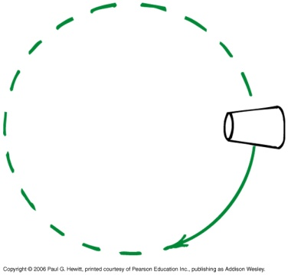
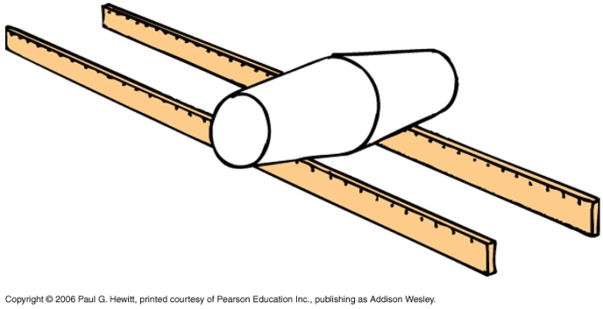
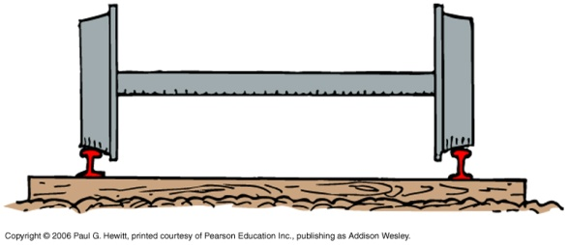
Example and Demo: Railroad train wheels
Model: two tapered cups stuck together and rolling along meter sticks
First note that if you roll a tapered cup along a table, it follows a circle because the wide part moves faster than the narrow part. (Larger v so more distance covered by the wide end).
Now, if you tape two together, at their wide ends, and let them roll along two meter sticks (“tracks”), they will stay stably on the tracks.
Why? When they roll off center, they self-correct: say they roll to the left, then the wider part of the left cup and the narrower part of the right cup are on the tracks, causing rolling back to the right, since the left cup has larger tangential speed.
Railroad wheels act on this same principle!
Notes:
DEMO – need two paper cups and meter sticks?

Slide 5
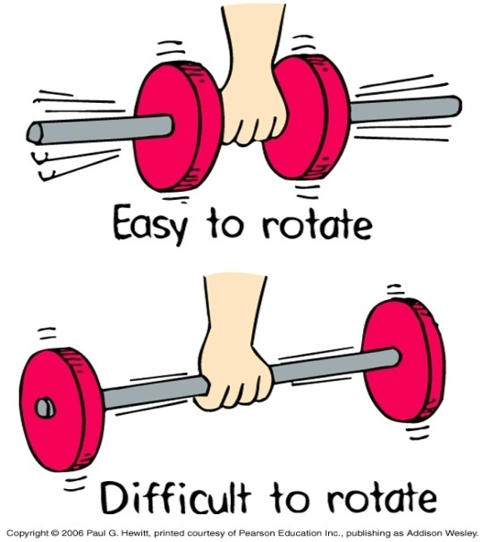
Rotational Inertia
An object rotating about an axis tends to remain rotating about the same axis, unless an external influence (torque, see soon) is acting. (c.f. 1st law)
The property to resist changes in rotational state of motion is called rotational inertia, or moment of inertia, I .
Depends on mass, as well as the distribution of the mass relative to axis of rotation – largest if the mass is further away from the axis
Eg. DEMO: Spinning a pencil with globs of play-doh on it – if the globs are near the ends of the pencil, it is harder to spin, than if the globs are nearer the middle.
Notes:
Get pencil and playdoh.

Slide 6
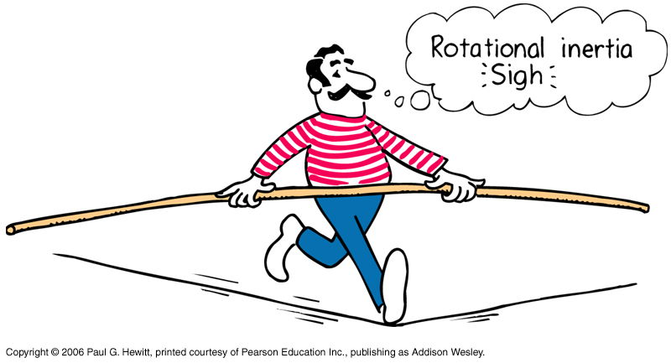
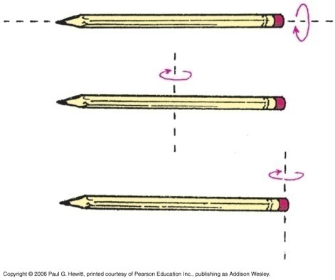
Eg. Tight-rope walker carries a pole to increase his rotational inertia - if he starts to wobble, the pole starts to rotate but its inertia resists this, so the tight-rope walker has time to adjust balance and not rotate and fall.
Better balance (more rotational inertia) if pole is longer and has weights at the ends.
Rotational inertia depends on the axis around which it rotates:
Eg With a pencil:
Easiest to spin here (smallest I )
Harder here
Even harder here

Slide 7
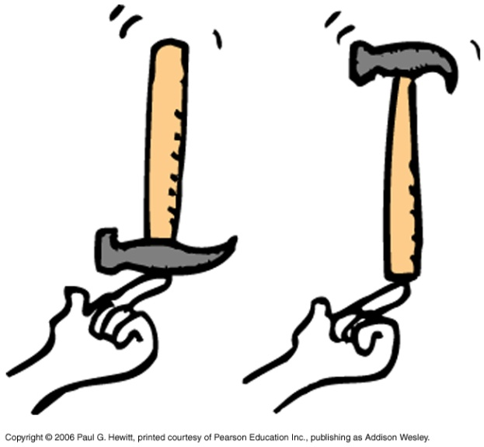
Question
Consider balancing a hammer upright on the tip of your finger. Would it be easier to balance in the left-hand picture or the right-hand picture, and why?
Easier on the right, because it has more rotational inertia (heavy part further away from your finger), so is more resistant to a rotational change.
Notes:
Bring a hammer, or, do the two meter sticks

Slide 8
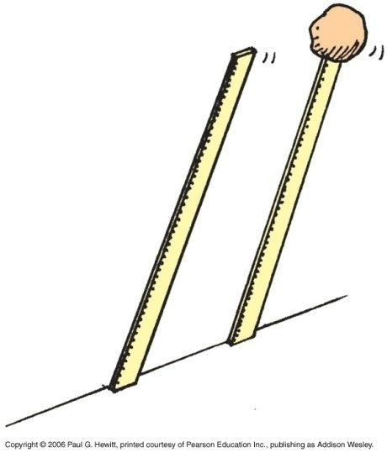
Clicker Question
Consider the meter sticks shown, one with a glob of clay at the top end. If released from upright position, which reaches the ground first?
The one without the clay
The one with the clay
They both reach the ground together
Answer: A
The one without the clay! Try it! Because the stick-with-clay has more rotational inertia, so resists rotation to ground more.
(Also, experiences more torque…see later)

Slide 9
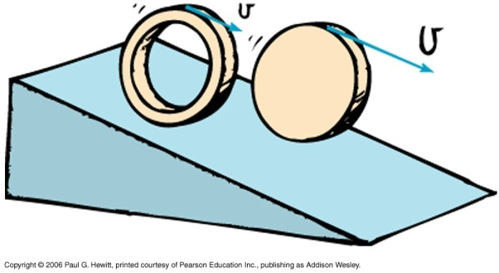
More about rotational inertia: rolling objects down a hill…
Which rolls to the bottom of an incline first, a solid ball, a solid cylinder or a ring?
First ask: which has smallest rotational inertia? – since this will resist rolling the least, so will reach the bottom first.
The shape which has most of its mass closest to the center has least rotational inertia, i.e. first is ball, second is cylinder, and last is the ring.
(In fact this is independent of size and mass, it just depends on their shape!)
Fig 8.14 in your text illustrates some rotational inertia values of various objects – you don’t need to learn these, but do try to understand why the bigger ones are bigger from considering mass distribution.

Slide 10
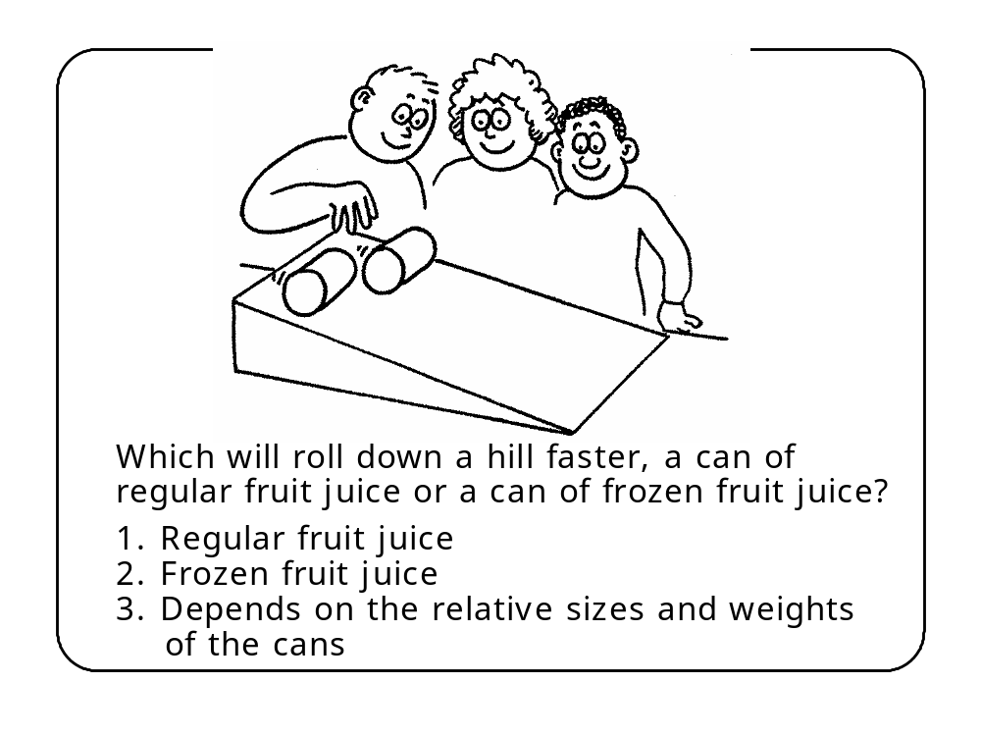
Clicker Question
Hint: Note that the regular juice is a liquid and so is not forced to roll with the can i.e. much of it slides. The frozen juice must roll with the can. So which has less rotational inertia?

Slide 11
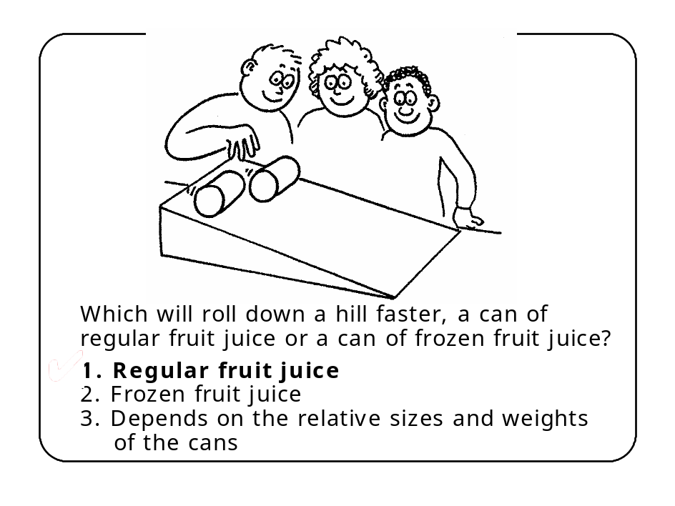
Answer: 1. Regular fruit juice
The regular fruit juice has an appreciably greater acceleration down an incline than the can of frozen juice: Because the regular juice is a liquid and is not made to roll with the can, as the solid juice does. Most of the liquid effectively slides down the incline inside the rolling can.
The can of liquid therefore has very little rotational inertia compared to its mass.
The solid juice, on the other hand, is made to rotate, giving the can more rotational inertia.

Slide 12
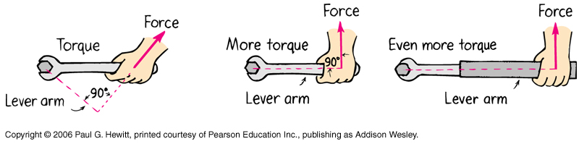
Torque
Rotational analog of force – i.e. causes changes in rotations of objects.
    Torque = lever arm x force
lever arm = the perpendicular distance from the axis of rotation to the line along which the force acts.
Eg. Turning a bolt
Notes:
Start here Tuesday

Slide 13
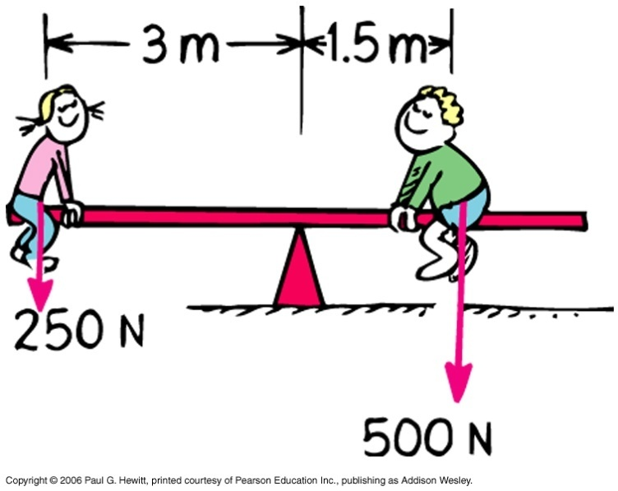
Eg. See-saws.
The dependence of the torque on the lever arm is why kids can balance see-saws even when they have different weights – The heavier one sits closer to the center :
Larger F x Smaller lever-arm = Smaller F x Larger lever-arm.
Mechanical equilibrium:
not only Σ F = 0 (chap 2) but also Σ torques = net torque = 0

Slide 14
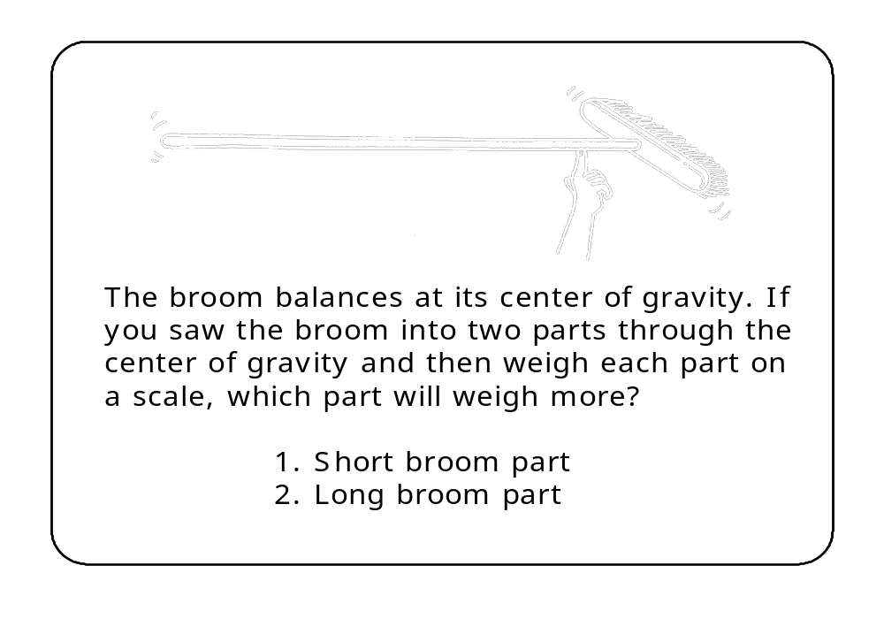
Clicker Question

Slide 15
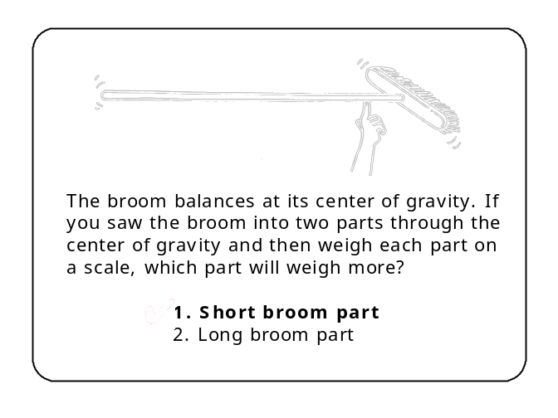
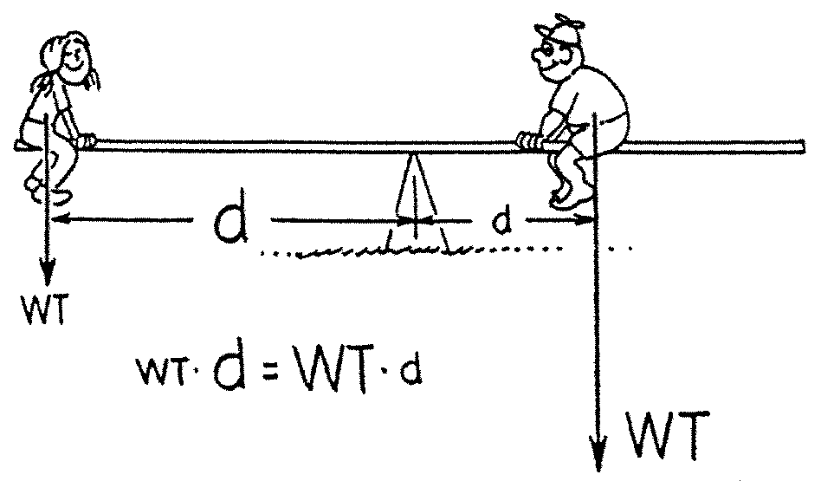
Answer:1. short broom part.
The short broom part balances the long handle just as kids of unequal weights can balance on a seesaw when the heavier kid sits closer to the fulcrum. Both the balanced broom and seesaw are evidence of equal and opposite torques—not equal weights.

Slide 16
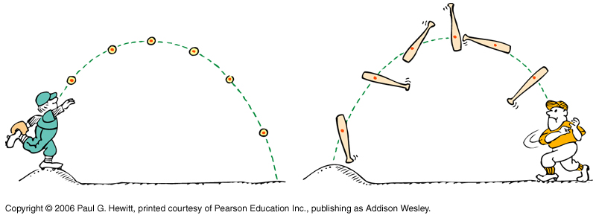
Center of mass/Center of gravity
Center of mass (CM) = average position of all the mass that makes up the object.
Center of gravity (CG) = average position of weight distribution
  So CM = CG for objects on earth. We’ll use CM and CG interchangeably.
Often, motion of a body is complex, but CM motion is very simple:
Eg. Any shaped object thrown in the air may spin in a complicated way as it falls, but the CM always follows a parabola (as if it were a point object, or ball, thrown)

Slide 17
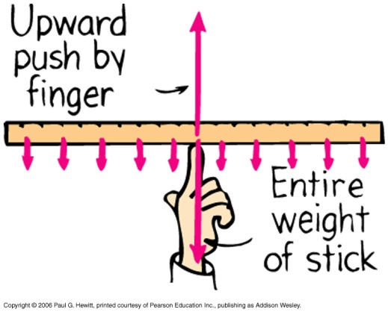
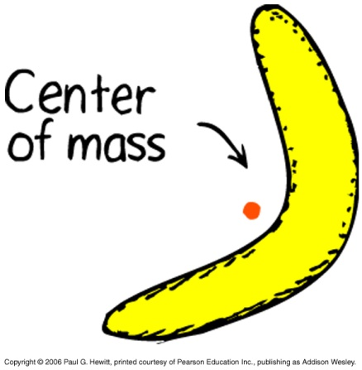
Locating the CM
When object is symmetric, it’s simple eg. For a meter stick, CM is at the center. It acts as if all the mass is concentrated there.
All the small arrows indicate gravity along the stick – can combine to single large arrow acting downward through CM.
If freely suspend an object from any point, the CM lies somewhere along the line vertically down from it. So, to determine exactly where, suspend it freely from some other point on the object, let it adjust, draw again the vertical line: the intersection of the two lines gives CM.
Sometimes, the CM is outside of the object.
Eg. A hollow ring, CM in the center, Or banana:

Slide 18
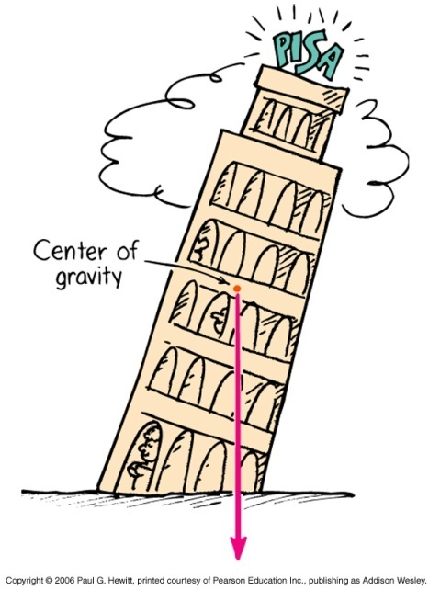
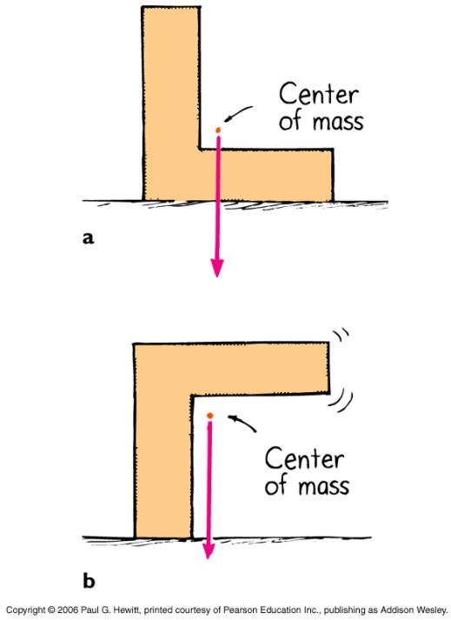
Stability
Stable equilibrium – if vertical line down from CM falls inside the base of object.
stable
unstable
So often design objects with a wide base and lower CM.

Slide 19
Clicker Question
Why should you not leave the top drawers of a heavy cabinet open while the others are closed ?
The center of mass becomes too high to be stable, so it would tip
The center of mass would extend in front of the cabinet, beyond the support base, so it would tip
The torque exerted by the gravitational force on the drawers decreases
It looks messy
Answer B:
Objects are stable if a vertical line dropped from their COM goes through the base of the object. Leaving the top drawers open makes it look like the Γ shape on previous slide.

Slide 20
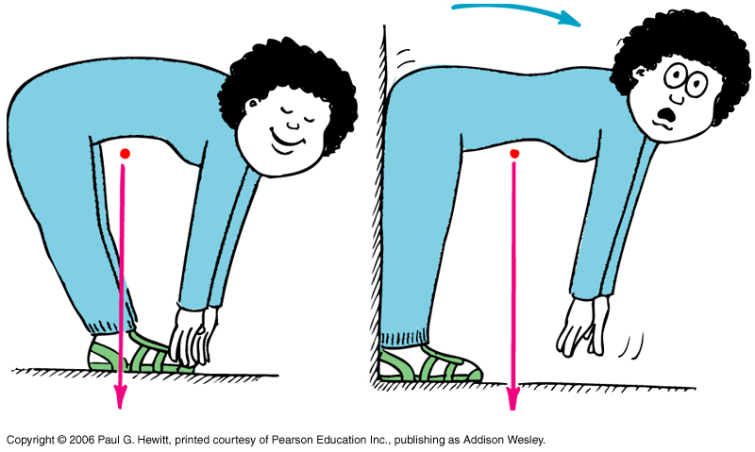
Example
Why is not possible for a flexible person to bend down and touch her toes keeping legs straight, while standing with her back against a wall? (Try this!!)
Hint: Deduce first the CM of the person, approximating her as an L-shape (see last slides).
If she leans back, the CM is above the base (her feet) - stable
If she can’t lean back, CM is no longer above her feet- unstable
The torque from gravity acting on the upper half of the body is larger in the RH case because the lever arm is longer.
Related problem: Try getting up from a chair without putting your feet under your chair.

Slide 21
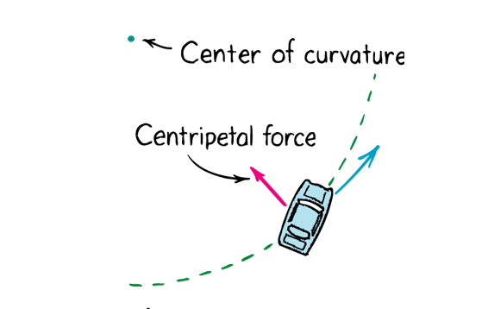
Centripetal Force
Is any force that is directed toward a fixed center.
Often leads to motion in a circle – then, force is inwards, towards center of circle
Examples Centripetal force
Moon orbiting earth Gravitational force
Electrons orbiting nucleus in atom Electrical force
Whirling object at end of a string Tension in the string
Car rounding a bend Friction between tires and road

Slide 22
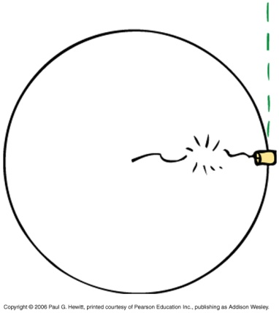
Centrifugal force
When you are the object moving in a circle, you feel an outward force – called centrifugal force. It is a type of “inertial” force , as it is a result of rotation.
First, consider again whirling can on end of string:
Common misconception: to say centrifugal force pulls outward on the can – wrong!
If the string breaks, the can goes off in a straight line because no force acts on it. It is the inward-directed centripetal force of the string that keeps it in a circle before string breaks.
Then why, if we were the can whirling around in a circle, would we feel we are being pushed out, rather than the inward directed centripetal force?

Slide 23
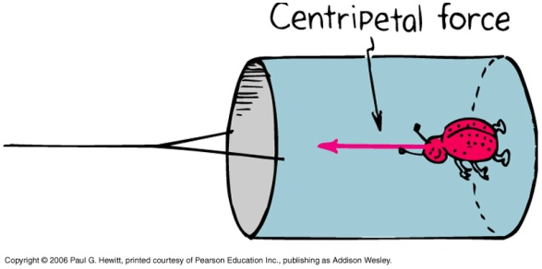
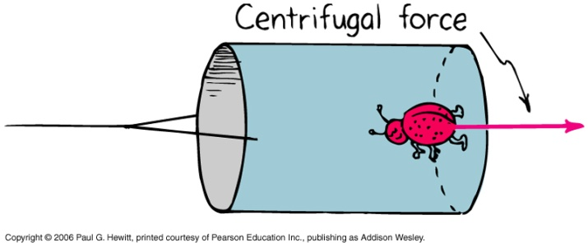
Centrifugal force continued..
…why, if we were the can, would we feel we are being pushed out rather than the inward directed centripetal force?
It’s to do with the frame of reference: a rotating frame is a “non-inertial” frame, unlike inertial (non-accelerating) frames. Only in inertial frames do Newton’s laws strictly hold.
Consider a ladybug inside the can from the point of view of someone outside watching it (i.e. in an inertial frame).
Then the only force acting on it is the walls of the can on her feet, giving the inward directed centripetal force.
Now consider from the ladybug’ s rotating frame.
In her own frame, she is at rest. So there must be a force to cancel the wall inwardly pushing - this is the centrifugal force directed outward.

Slide 24
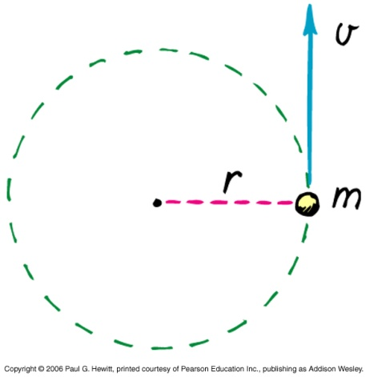
Angular momentum
(c.f. momentum = linear momentum of Ch.6)
Angular Momentum = rotational inertia x rotational velocity
= I ω
For an object rotating around a circular path at const speed :
ang mom. = m v r
Eg. a whirling tin can
Angular momentum is a vector quantity, but in this course, we won’t deal with the (many interesting) consequences of its vector nature (eg gyroscopes). Come ask me later if you’d like to learn more about this!

Slide 25
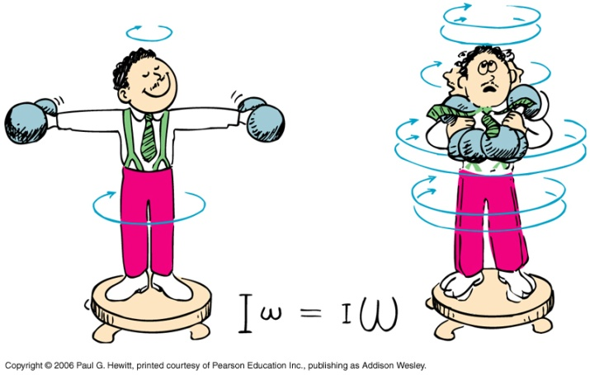
Conservation of Angular Momentum
An object or system of objects will maintain its angular momentum unless acted upon by an unbalanced external torque.
So, if there is no net torque, ang mom is conserved.
DEMO: Sit on a rotating stool, holding weights away from you. Then pull the weights in – you go much faster! Your I decreases when you pull in the masses, and your ω compensates, to keep I ω constant.
This principle is often used by a figure skater, drawing arms and legs in to spin faster.
Notes:
Rotating stool demo with weights

Slide 26
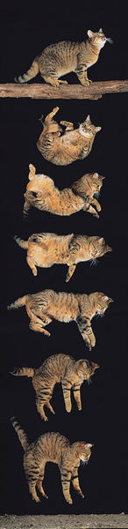
Another example: a falling cat.
Cat begins to fall upside-down but rights itself by twisting yet conserving zero angular momentum: twist parts of its body in such a way that it rotates through 180 degrees but keeping zero ang mom!

Slide 27
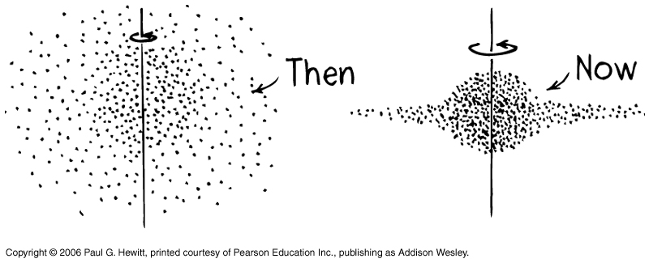
Another place where ang mom conservation plays big role, is in understanding motion of planets, and galaxy shapes.
e.g. we believe originally our galaxy was a huge spherical cloud of gas, rotating very slowly. Gravitational attraction between particles pulled the cloud together, so giving it a smaller radius. By ang mom cons, this means faster rotation; some stars being spun out…
Read in your book about how the moon is gradually getting further away from us because earth’s ang mom is decreasing from ocean-water friction, and so the moon’s must increase to compensate.

Slide 28
If all of Earth’s inhabitants moved to the equator, what would happen to the length of a day?
The day would be longer
The day would be shorter
The length of the day would remain the same
There would be no day, only night
Answer:A
If mass moves to the equator, it is further from the axis of rotation, so the rotational inertia of the earth increases. Because the angular momentum of the earth is conserved, this means its rotational speed decreases, i.e. the length of the day would be longer.

